Slide 1

Section 2: Relative-Age Dating
Scientists use geologic principles to learn the sequence in which geologic events occurred.
K What I Know | W What I Want to Find Out | L What I Learned

Slide 2
Essential Questions
How is uniformitarianism defined and what is its importance to geology?
What geologic principles are used to interpret rock sequences and determine relative ages?
What are the different types of unconformities and how do they differ?
How do scientists use correlation to understand the history of a region?
Copyright © McGraw-Hill Education
Relative-Age Dating

Slide 3
Vocabulary
Review
granite
New
uniformitarianism
relative-age dating
original horizontality
superposition
cross-cutting relationship
principle of inclusions
unconformity
correlation
key bed
Copyright © McGraw-Hill Education
Relative-Age Dating

Slide 4
Interpreting Geology
James Hutton, a Scottish geologist who lived in the late 1700s, attempted to explain Earth’s history in terms of geologic forces, such as erosion and sea-level changes, that operate over long stretches of time. His work helped set the stage for the development of the geologic time scale.
Relative-Age Dating
Copyright © McGraw-Hill Education

Slide 5
Interpreting Geology
Uniformitarianism
James Hutton’s work lies at the foundation of uniformitarianism, which states that geologic processes occurring today have been occurring since Earth formed.
Relative-Age Dating
Copyright © McGraw-Hill Education

Slide 6
Principles for Determining Relative Age
One way scientists learn about the past is by studying the order in which geologic events occurred using a method called relative-age dating.
Scientists use several ways to determine relative ages, called the principles of relative dating. They include original horizontality, superposition, cross-cutting relationships, and inclusions.
Relative-Age Dating
Copyright © McGraw-Hill Education

Slide 7
Principles for Determining Relative Age
Original horizontality
Original horizontality is the principle that sedimentary rocks are deposited in horizontal or nearly horizontal layers.
Relative-Age Dating
Copyright © McGraw-Hill Education

Slide 8
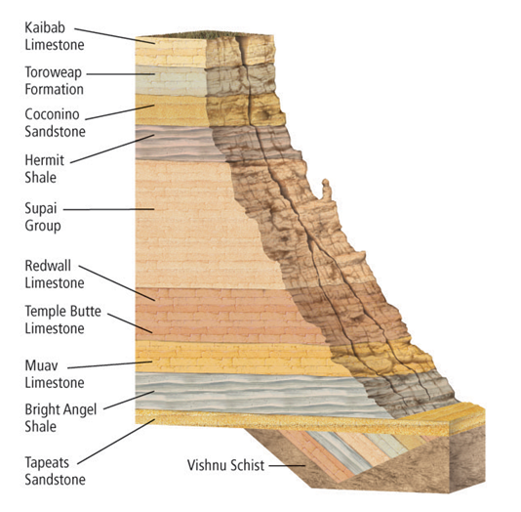
Principles for Determining Relative Age
Original horizontality
The horizontal layers of the Grand Canyon were formed by deposition of sediment over millions of years. The principle of original horizontality states that the tilted strata at the bottom were formed horizontally.
Relative-Age Dating
Copyright © McGraw-Hill Education

Slide 9
Principles for Determining Relative Age
Superposition
Superposition is the principle that in an undisturbed rock sequence, the oldest rocks are at the bottom and each consecutive layer is younger than the layer beneath it.
Relative-Age Dating
Copyright © McGraw-Hill Education

Slide 10
Principles for Determining Relative Age
Cross-cutting relationships
The principle of cross-cutting relationships states that an intrusion is younger than the rock it cuts across.
The principle of cross-cutting relationships also applies to faults.
Relative-Age Dating
Copyright © McGraw-Hill Education

Slide 11
Principles for Determining Relative Age
Inclusions
The principle of inclusions states that the fragments, called inclusions, in a rock layer must be older than the rock layer that contains them.
Relative-Age Dating
Copyright © McGraw-Hill Education

Slide 12
Principles for Determining Relative Age
Unconformities
If an eroded area is covered at a later time by a new layer of sediment, the eroded surface represents a gap in the rock record. Buried surfaces of erosion are called unconformities.
Relative-Age Dating
Copyright © McGraw-Hill Education

Slide 13
Principles for Determining Relative Age
Unconformities
Scientists recognize three different types of unconformities: disconformity, nonconformity, and angular unconformity.
Relative-Age Dating
Copyright © McGraw-Hill Education

Slide 14
Principles for Determining Relative Age
Unconformities
When a horizontal layer of sedimentary rock overlies another horizontal layer of sedimentary rock after a period of erosion, the eroded surface is called a disconformity.
When a layer of sedimentary rock overlies a layer of igneous or metamorphic rock, the eroded surface is called a nonconformity.
Relative-Age Dating
Copyright © McGraw-Hill Education

Slide 15
Principles for Determining Relative Age
Unconformities
Horizontal layers of sedimentary rock are usually uplifted and tilted during mountain building, which exposes them to weathering and erosion. If a horizontal layer of sedimentary rock is later laid down on top of the tilted, eroded layers, the resulting unconformity is called an angular unconformity.
Relative-Age Dating
Copyright © McGraw-Hill Education

Slide 16
Angular Unconformity
Go to your ConnectED resources to play Animation: Angular Unconformity.
Copyright © McGraw-Hill Education
Relative-Age Dating

Slide 17
Principles for Determining Relative Age
Correlation
Correlation is the matching of unique rock outcrops or fossils exposed in one geographic region to similar outcrops exposed in other geographic regions.
Relative-Age Dating
Copyright © McGraw-Hill Education

Slide 18
Principles for Determining Relative Age
Correlation
Through correlation of many different layers of rocks, geologists have determined that Zion National Park, Bryce Canyon, and the Grand Canyon are all part of one layered sequence called the Grand Staircase.
Relative-Age Dating
Copyright © McGraw-Hill Education

Slide 19
Principles for Determining Relative Age
Correlation
A key bed is a rock or sediment layer that serves as a time marker in the rock record and results from volcanic ash or meteorite-impact debris that spread out and covered large areas of Earth.
Relative-Age Dating
Copyright © McGraw-Hill Education

Slide 20
Principles for Determining Relative Age
Correlation
Correlating fossils from rock layers in one location to rock layers in another location shows that the layers were deposited during roughly the same time period, even though the layers are of different material.
Relative-Age Dating
Copyright © McGraw-Hill Education

Slide 21
Review
Essential Questions
How is uniformitarianism defined and what is its importance to geology?
What geologic principles are used to interpret rock sequences and determine relative ages?
What are the different types of unconformities and how do they differ?
How do scientists use correlation to understand the history of a region?
Vocabulary
uniformitarianism
relative-age dating
original horizontality
superposition
cross-cutting relationship
principle of inclusions
unconformity
correlation
key bed
Copyright © McGraw-Hill Education
Relative-Age Dating

