Slide 1

Section 3: Absolute-Age Dating
Radioactive decay and certain kinds of sediments help scientists determine the numeric age of many rocks.
K What I Know | W What I Want to Find Out | L What I Learned

Slide 2
Essential Questions
What are the differences between absolute-age dating and relative-age dating?
How are radioactive elements used to date rocks and other objects?
How can scientists use certain non-radioactive material to date geologic events?
Copyright © McGraw-Hill Education
Absolute-Age Dating

Slide 3
Vocabulary
Review
isotope
New
absolute-age dating
radioactive decay
radiometric dating
half-life
radiocarbon dating
dendrochronology
varve
Copyright © McGraw-Hill Education
Absolute-Age Dating

Slide 4
Radioactive Isotopes
Absolute-age dating enables scientists to determine the numerical age of rocks and other objects.
Absolute-Age Dating
Copyright © McGraw-Hill Education

Slide 5
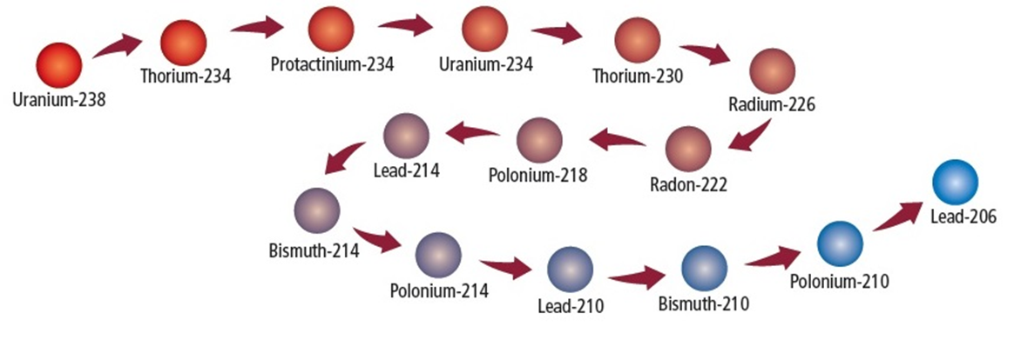
Radioactive Isotopes
Radioactive decay
Radioactive isotopes emit nuclear particles at a constant rate. As the number of protons changes with each emission, the original radioactive isotope, called the parent, is gradually converted to a different element, called the daughter.
Absolute-Age Dating
Copyright © McGraw-Hill Education

Slide 6
Alpha Decay
Go to your ConnectED resources to play Animation: Alpha Decay.
Copyright © McGraw-Hill Education
Absolute-Age Dating

Slide 7
Radioactive Isotopes
Radioactive decay
The emission of radioactive particles and the resulting change into other isotopes over time is called radioactive decay.
Absolute-Age Dating
Copyright © McGraw-Hill Education

Slide 8
Radioactive Isotopes
Radioactive decay
Because the rate of radioactive decay is constant regardless of pressure, temperature, or any other physical changes, scientists use it to determine the absolute age of the rock or object in which it occurs.
Absolute-Age Dating
Copyright © McGraw-Hill Education

Slide 9
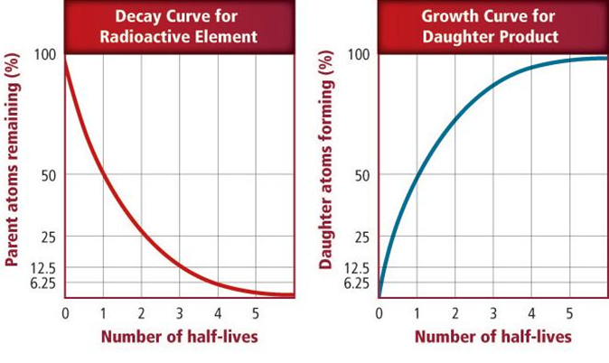
Radiometric Dating
As the number of parent atoms decreases during radioactive decay, the number of daughter atoms increases by the same amount. The ratio of parent isotope to daughter product in a mineral indicates the amount of time that has passed since the object formed.
Absolute-Age Dating
Copyright © McGraw-Hill Education

Slide 10
Radiometric Dating
When scientists date an object using radioactive isotopes, they are using a method called radiometric dating.
Absolute-Age Dating
Copyright © McGraw-Hill Education

Slide 11
Radiometric Dating
Half-life
Scientists measure the length of time it takes for one-half of the original isotope to decay, called its half-life.
Absolute-Age Dating
Copyright © McGraw-Hill Education

Slide 12
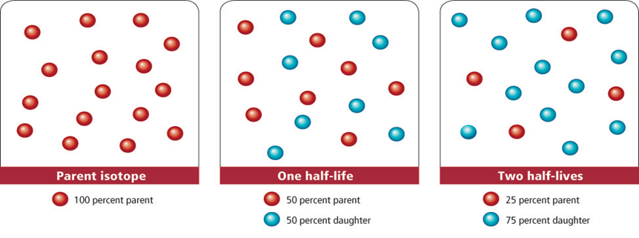
Radiometric Dating
Half-life
After one half-life, a sample contains 50 percent parent and 50 percent daughter. After two half-lives, the sample contains 25 percent parent and 75 percent daughter.
Absolute-Age Dating
Copyright © McGraw-Hill Education

Slide 13
Half-Life
Go to your ConnectED resources to play Animation: Half-Life.
Copyright © McGraw-Hill Education
Absolute-Age Dating

Slide 14
Radiometric Dating
Dating rocks
To date an igneous or metamorphic rock using radiometric dating, scientists examine the parent-daughter ratios of the radioactive isotopes in the minerals that comprise the rock. The best isotope to use for dating depends on the approximate age of the rock being dated.
Absolute-Age Dating
Copyright © McGraw-Hill Education

Slide 15
Half-Lives of Selected Radioactive Isotopes
Go to your ConnectED resources to play Interactive Table: Half-Lives of Selected Radioactive Isotopes.
Copyright © McGraw-Hill Education
Absolute-Age Dating

Slide 16
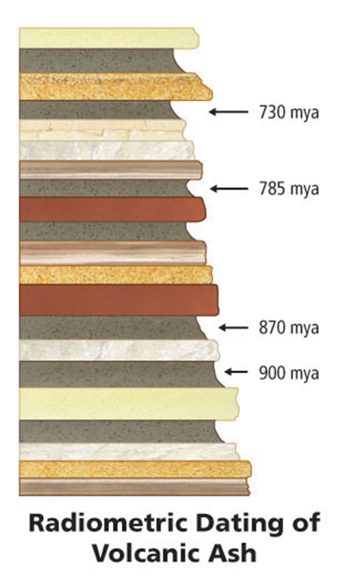
Radiometric Dating
Dating rocks
To help them determine the age of sedimentary rocks, scientists date layers of igneous rock or volcanic ash above and below the sedimentary layers.
Absolute-Age Dating
Copyright © McGraw-Hill Education

Slide 17
Radiometric Dating
Radiocarbon dating
Scientists use carbon-14 to determine the age of organic materials, which contain abundant carbon, in a process called radiocarbon dating.
Absolute-Age Dating
Copyright © McGraw-Hill Education

Slide 18
Other Ways to Determine Absolute Age
Tree rings
Many trees contain a record of time in the rings of their trunks, called annual tree rings. Each annual tree ring consists of a pair of early season and late season growth rings. The width of the rings depends on certain conditions in the environment.
Absolute-Age Dating
Copyright © McGraw-Hill Education

Slide 19
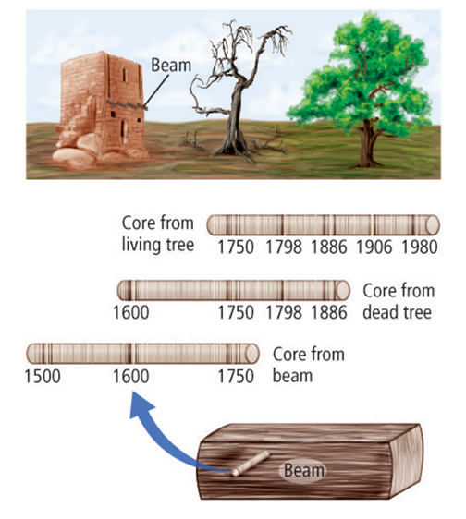
Other Ways to Determine Absolute Age
Tree rings
Tree-ring chronologies can be established by matching tree rings from different wood samples, both living and dead.
Absolute-Age Dating
Copyright © McGraw-Hill Education

Slide 20
Other Ways to Determine Absolute Age
Tree rings
The science of using tree rings to determine absolute age is called dendrochronology and has helped geologists date relatively recent geologic events and environmental changes.
Absolute-Age Dating
Copyright © McGraw-Hill Education

Slide 21
Other Ways to Determine Absolute Age
Ice cores
Ice cores contain a record of past environmental conditions in annual layers of snow deposition. Geologists use ice-core chronologies to study glacial cycles through geologic history.
Absolute-Age Dating
Copyright © McGraw-Hill Education

Slide 22
Other Ways to Determine Absolute Age
Varves
Bands of alternating light- and dark-colored sediments of sand, clay, and silt are called varves.
Using varved cores, scientists can date cycles of glacial sedimentation over periods as long as 120,000 years.
Absolute-Age Dating
Copyright © McGraw-Hill Education

Slide 23
Review
Essential Questions
What are the differences between absolute-age dating and relative-age dating?
How are radioactive elements used to date rocks and other objects?
How can scientists use certain non-radioactive material to date geologic events?
Vocabulary
absolute-age dating
radioactive decay
radiometric dating
half-life
radiocarbon dating
dendrochronology
varve
Copyright © McGraw-Hill Education
Absolute-Age Dating

