Slide 1

Section 4: Fossil Remains
Fossils provide scientists with a record of the history of life on Earth.
K What I Know | W What I Want to Find Out | L What I Learned

Slide 2
Essential Questions
What are the methods by which fossils are preserved?
How do scientists use index fossils?
How are fossils used to interpret Earth’s past physical and biological history?
Copyright © McGraw-Hill Education
Fossil Remains

Slide 3
Vocabulary
Review
groundwater
New
evolution
original preservation
altered hard part
mineral replacement
mold
cast
trace fossil
index fossil
Copyright © McGraw-Hill Education
Fossil Remains

Slide 4
The Fossil Record
Fossils provide evidence of the past existence of a wide variety of life-forms, most of which are now extinct. The diverse fossil record provides evidence that species—groups of closely related organisms—have evolved.
Evolution is the change in species over time.
Fossil Remains
Copyright © McGraw-Hill Education

Slide 5
The Fossil Record
When geologists find fossils in rocks, they know that the rocks are about the same age as the fossils, and they can infer that the same fossils found elsewhere are also of the same age.
Fossil Remains
Copyright © McGraw-Hill Education

Slide 6
The Fossil Record
Original preservation
Fossils with original preservation are the remains of plants and animals that have been altered very little since the organisms’ deaths.
Such fossils are uncommon because their preservation requires extraordinary circumstances, such as freezing, arid, or oxygen-free environments.
Fossil Remains
Copyright © McGraw-Hill Education

Slide 7
The Fossil Record
Altered hard parts
Under most circumstances, the soft organic material of plants and animals decays quickly. Over time, the remaining hard parts, such as shells, bones, or cell walls, can become fossils with altered hard parts.
Fossil Remains
Copyright © McGraw-Hill Education

Slide 8
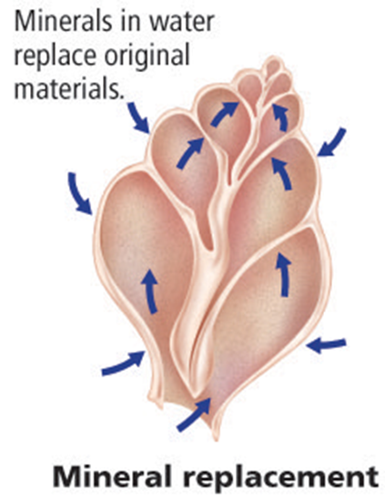
The Fossil Record
Altered hard parts
In the process of mineral replacement, the pore spaces of an organism’s buried hard parts are filled in with minerals from groundwater.
Fossil Remains
Copyright © McGraw-Hill Education

Slide 9
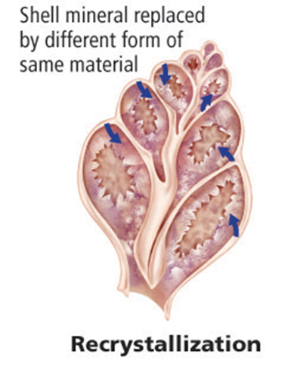
The Fossil Record
Altered hard parts
Recrystallization can occur when a buried hard part is subjected to changes in temperature and pressure over time. The original mineral is transformed into a new mineral.
Fossil Remains
Copyright © McGraw-Hill Education

Slide 10
The Fossil Record
Molds and casts
A mold forms when sediments cover the original hard part of an organism, such as a shell, and the hard part is later removed by erosion or weathering.
A mold might later become filled with a material to create a cast of the shell.
Fossil Remains
Copyright © McGraw-Hill Education

Slide 11
The Fossil Record
Trace fossils
Sometimes the only fossil evidence of an organism is indirect. Indirect fossils, called trace fossils, include traces of worm trails, footprints, and tunneling burrows.
Trace fossils can provide information about how an organism lived, moved, and obtained food.
Fossil Remains
Copyright © McGraw-Hill Education

Slide 12
Index Fossils
Index fossils are fossils that are easily recognized, abundant, and widely distributed geographically. They also represent species that existed for relatively short periods of geologic time.
Fossil Remains
Copyright © McGraw-Hill Education

Slide 13
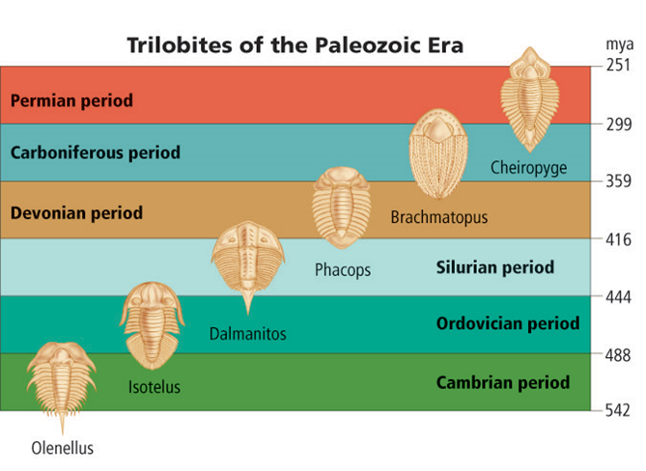
Index Fossils
These trilobite species make excellent index fossils for the Paleozoic Era because each species lived for a relatively short period of time before becoming extinct.
Fossil Remains
Copyright © McGraw-Hill Education

Slide 14
Fossils
Go to your ConnectED resources to play BrainPOP: Fossils.
Copyright © McGraw-Hill Education
Fossil Remains

Slide 15
Review
Essential Questions
What are the methods by which fossils are preserved?
How do scientists use index fossils?
How are fossils used to interpret Earth’s past physical and biological history?
Vocabulary
evolution
original preservation
altered hard part
mineral replacement
mold
cast
trace fossil
index fossil
Copyright © McGraw-Hill Education
Fossil Remains

