Slide 1

Section 3: The Cenozoic Era
Mammals became the dominant terrestrial animals during the Cenozoic while the continents assumed their present forms.
K What I Know | W What I Want to Find Out | L What I Learned

Slide 2
Essential Questions
What was the extent of glaciation during the Cenozoic?
How can the tectonic activity in North America during the Cenozoic be described?
How did climate change affect life-forms during the Cenozoic?
Copyright © McGraw-Hill Education
The Cenozoic Era

Slide 3
Vocabulary
Review
San Andreas Fault
New
Homo sapiens
bipedal
Copyright © McGraw-Hill Education
The Cenozoic Era

Slide 4
Cenozoic Paleogeography
The Cenozoic Era encompasses about 1.5 percent of Earth’s total history— approximately the last 66 million years.
Humans evolved during the Cenozoic, appearing in their present-day form during the Pleistocene Epoch.
The Cenozoic Era
Copyright © McGraw-Hill Education

Slide 5
Cenozoic Paleogeography
Mammals diversified widely during the Cenozoic, but modern humans did not appear until the end of the era.
The Cenozoic Era
Copyright © McGraw-Hill Education

Slide 6
Cenozoic Paleogeography
Cooling trend
Earth’s climate was relatively warm during the earliest epoch of the Cenozoic.
However, as Australia was splitting apart from Antarctica during the Eocene Epoch, the worldwide climate began to cool.
The Cenozoic Era
Copyright © McGraw-Hill Education

Slide 7
Cenozoic Paleogeography
Cooling trend
After Antarctica and Australia split apart, Antarctica was isolated over the south pole. A cold current began to flow around it, and a permanent ice cap began to grow during the Oligocene.
The Cenozoic Era
Copyright © McGraw-Hill Education

Slide 8
Cenozoic Paleogeography
Miocene warming
In the early Miocene Epoch, the climate warmed again. The ice cap on Antarctica began to melt, and the ocean flooded the margins of North America.
The Cenozoic Era
Copyright © McGraw-Hill Education

Slide 9
Cenozoic Paleogeography
Miocene warming
When the warming trend of the early Miocene Period reversed, Antarctica’s ice cap stopped melting and the Arctic Ocean began to freeze. This resulted in the formation of the arctic ice cap and set the stage for the ice ages.
The Cenozoic Era
Copyright © McGraw-Hill Education

Slide 10
Cenozoic Paleogeography
Ice ages
Throughout the Pleistocene, ice covered much of Earth’s northern hemisphere. Glaciers advanced and retreated in at least four stages over North America and the northern latitudes.
The Cenozoic Era
Copyright © McGraw-Hill Education

Slide 11
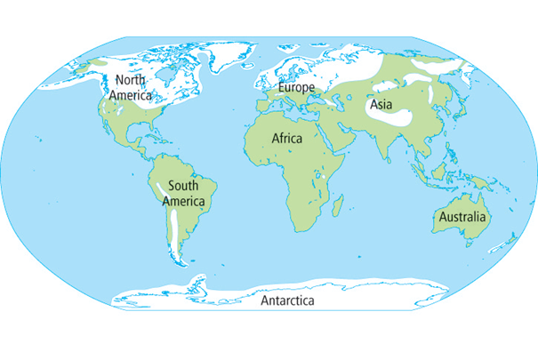
Cenozoic Paleogeography
Ice ages
At the peak of Pleistocene glaciation, glaciers up to 3 km thick covered nearly one-third of Earth’s land surfaces.
The Cenozoic Era
Copyright © McGraw-Hill Education

Slide 12
Cenozoic Mountain Building
During the Cenozoic, erosion wore down the Rockies but uplift continued. Eroded sediment filled large basins adjacent to the mountains. Today, some of this sediment is mined for coal. Some sediment also contains well-preserved fossils of fish, insects, plants, and birds.
The Cenozoic Era
Copyright © McGraw-Hill Education

Slide 13
Cenozoic Mountain Building
Subduction in the West
Volcanism returned to the western coast of North America at the end of the Eocene Epoch when the oceanic Farallon Plate began a steep subduction beneath the Pacific Northwest. As a result, the Cascade Mountains began to rise.
The Cenozoic Era
Copyright © McGraw-Hill Education

Slide 14
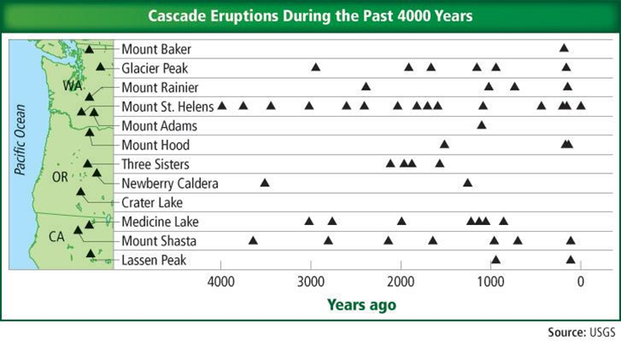
Cenozoic Mountain Building
Subduction in the West
The Cascade Mountain Range includes active volcanoes that have erupted many times during the past 4000 years.
The Cenozoic Era
Copyright © McGraw-Hill Education

Slide 15
Cenozoic Mountain Building
Subduction in the West
After the Farallon Plate disappeared under what is now California, the North American Plate came into contact with another oceanic plate—the Pacific Plate—that was moving in a different direction.
As a result, the San Andreas Fault formed.
The Cenozoic Era
Copyright © McGraw-Hill Education

Slide 16
Cenozoic Mountain Building
Basin and Range Province
The beginning of the interaction between the North American Plate and the Pacific Plate coincided with the formation of the Basin and Range Province in the southwestern United States and northern Mexico.
The mountains in the Basin and Range Province were formed when stresses in Earth’s crust—called tension—pulled it apart.
The Cenozoic Era
Copyright © McGraw-Hill Education

Slide 17
Visualizing the Basin and Range Province
The Basin and Range Province is a series of mountains and basins that is bordered on the west by California’s Sierra Nevada and on the east by Utah’s Wasatch Mountains. During the past 25 million years, crustal stretching has increased the distance between these two points by over 250 km.
The Cenozoic Era
Copyright © McGraw-Hill Education

Slide 18
Visualizing the Basin and Range Province
Go to your ConnectED resources to play Animation: Visualizing the Basin and Range Province.
Copyright © McGraw-Hill Education
The Cenozoic Era

Slide 19
Cenozoic Mountain Building
Continental collisions
During the Paleocene, Africa began to collide with Eurasia, creating the Alps and narrowing the ancient Tethys Ocean.
The remnants of this ocean now exist as three landlocked bodies of water in central Asia—the Black, Caspian, and Aral Seas.
The Cenozoic Era
Copyright © McGraw-Hill Education

Slide 20
Cenozoic Mountain Building
Continental collisions
During the Paleocene, India began crashing into the southern margin of Asia to form the Himalayas, a mountain range that is still rising today.
The Cenozoic Era
Copyright © McGraw-Hill Education

Slide 21
Cenozoic Mountain Building
Tectonic forces continue
The tectonic forces that have shaped Earth over the past 4.6 billion years continue today.
The Cenozoic Era
Copyright © McGraw-Hill Education

Slide 22
Cenozoic Mountain Building
Tectonic forces continue
Some scientists think that in 250 million years, tectonic forces will have largely eliminated the Atlantic Ocean and formed the continents into another supercontinent.
The Cenozoic Era
Copyright © McGraw-Hill Education

Slide 23
Cenozoic Life
Many marine organisms, including clams, sea urchins, and sharks, survived the mass extinction at the end of the Cretaceous and populated the oceans during the Cenozoic.
Forests dominated the early Cenozoic landscapes. As the climate cooled during the late Eocene, forests gave way to open land, and grasses appeared.
The Cenozoic Era
Copyright © McGraw-Hill Education

Slide 24
Cenozoic Life
By the late Oligocene, grassy savannas were common worldwide. The rise of grasslands led to the diversification of many new mammal groups. Because mammals are the dominant terrestrial animals, many scientists call the Cenozoic the Age of Mammals.
The Cenozoic Era
Copyright © McGraw-Hill Education

Slide 25
Cenozoic Life
Ice age mammals
Two of the most famous mammals of the late Pleistocene are the woolly mammoth and the saber-toothed cat.
By the time these animals roamed Earth, modern humans—called Homo sapiens—were well established.
The Cenozoic Era
Copyright © McGraw-Hill Education

Slide 26
Cenozoic Life
Humans
The defining characteristic of humans is their upright, or bipedal, locomotion.
The fossil record, while incomplete, shows that the first bipedal humanlike primates appeared about 6 mya during the late Miocene.
The Cenozoic Era
Copyright © McGraw-Hill Education

Slide 27
Cenozoic Life
Humans
The fossil remains of the earliest modern humans—found in Africa—are about 195,000 years old.
The migrations of early humans were undoubtedly influenced by the ice ages of the late Pleistocene.
The Cenozoic Era
Copyright © McGraw-Hill Education

Slide 28
Review
Essential Questions
What was the extent of glaciation during the Cenozoic?
How can the tectonic activity in North America during the Cenozoic be described?
How did climate change affect life-forms during the Cenozoic?
Vocabulary
Homo sapiens
bipedal
Copyright © McGraw-Hill Education
The Cenozoic Era

