Slide 1

Section 1: The Paleozoic Era
Life increased in complexity during the Paleozoic while the continents collided to form Pangaea.
K What I Know | W What I Want to Find Out | L What I Learned

Slide 2
Essential Questions
What is a passive margin?
How do transgressions and regressions indicate sea-level changes?
What tectonic events shaped Laurentia during the Paleozoic?
How are changes in Paleozoic life-forms summarized?
Copyright © McGraw-Hill Education
The Paleozoic Era

Slide 3
Vocabulary
Review
evaporite
New
paleogeography
passive margin
transgression
regression
Cambrian explosion
Copyright © McGraw-Hill Education
The Paleozoic Era

Slide 4
Paleozoic Paleogeography
The ancient geographic setting of an area is called its paleogeography.
The paleogeography of the Paleozoic Era—the first era of the Phanerozoic—is defined by the breakup of the supercontinent Rodinia.
The Paleozoic Era
Copyright © McGraw-Hill Education

Slide 5
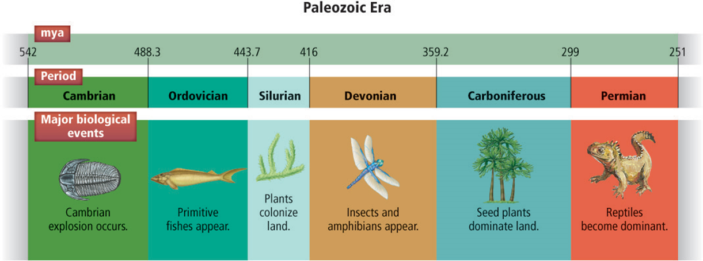
Paleozoic Paleogeography
Life-forms became more complex during the six periods of the Paleozoic.
The Paleozoic Era
Copyright © McGraw-Hill Education

Slide 6
Paleozoic Paleogeography
Passive margins
The edge of a continent is called a margin. When there is no tectonic activity along a margin, it is called a passive margin.
During the Cambrian, the ancient North American continent of Laurentia was completely surrounded by passive margins.
The Paleozoic Era
Copyright © McGraw-Hill Education

Slide 7
Sea-Level Changes in the Rock Record
Shoreline deposition
Transgression occurs when sea level rises and causes the shoreline to move inland, resulting in deeper-water deposits overlying shallower-water deposits.
The Paleozoic Era
Copyright © McGraw-Hill Education

Slide 8
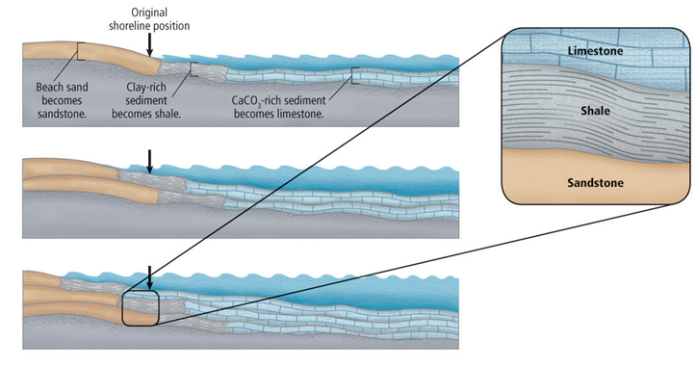
Sea-Level Changes in the Rock Record
Shoreline deposition
A vertical sequence of sandstone-shale-limestone in the rock record indicates that transgression occurred.
The Paleozoic Era
Copyright © McGraw-Hill Education

Slide 9
Sea-Level Changes in the Rock Record
Shoreline deposition
Regression occurs when sea level falls, causing the shoreline to move seaward, and results in shallower-water deposits overlying deeper-water deposits.
The Paleozoic Era
Copyright © McGraw-Hill Education

Slide 10
Sea-Level Changes in the Rock Record
Evaporites
Fossilized reefs are made of the carbonate skeletons of tiny organisms called corals. Reefs form in long, linear mounds parallel to a continent or island, where they absorb the energy of waves that crash against them on their seaward side.
The Paleozoic Era
Copyright © McGraw-Hill Education

Slide 11
Sea-Level Changes in the Rock Record
Evaporites
A reef protects the area behind it, called a lagoon, from wave energy. Water in the lagoon evaporates, and minerals such as halite and gypsum precipitate out. Over time, cycles of evaporite deposition mark changes in water level.
The Paleozoic Era
Copyright © McGraw-Hill Education

Slide 12
Sea-Level Changes in the Rock Record
Evaporites
Huge amounts of gypsum and halite evaporites were deposited in Paleozoic lagoons. Some deposits, such as those in the Great Lakes area of North America, are mined commercially.
The Paleozoic Era
Copyright © McGraw-Hill Education

Slide 13
Sea-Level Changes in the Rock Record
Factors of sea-level change
Geologists have found a number of reasons for relative sea level change—climate and glaciation cycles, crustal subsidence and uplift, sedimentation rates, and plate motions.
These were all factors in the transgressive and regressive cycles of the Paleozoic.
The Paleozoic Era
Copyright © McGraw-Hill Education

Slide 14
Mountain Building
During the Ordovician Period, Laurentia collided with the Taconic Island Arc, and mountains began to rise in what is now northeastern North America. This event is called the Taconic Orogeny. Remnants of this event are present in New York’s Taconic Mountains.
The Paleozoic Era
Copyright © McGraw-Hill Education

Slide 15
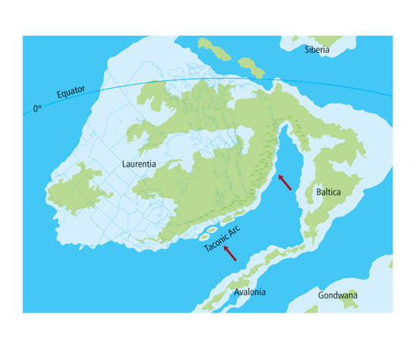
Mountain Building
Laurentia deformed
Baltica and Avalonia collided with the Taconic Island Arc during the Ordovician.This was the first of many Paleozoic tectonic events that transformed eastern Laurentia.
The Paleozoic Era
Copyright © McGraw-Hill Education

Slide 16
Mountain Building
Laurentia deformed
The Ouachita Orogeny occurred during the Carboniferous Period when southeastern Laurentia began to collide with Gondwana. Vertical faults raised rocks more than 2 km, forming a mountain range that geologists called the Ancestral Rockies.
The Paleozoic Era
Copyright © McGraw-Hill Education

Slide 17
Mountain Building
Laurentia deformed
As Gondwana continued to push against Laurentia, the Appalachian Mountains began to form. This event, called the Alleghenian Orogeny, was the last of the Paleozoic mountain-building events to affect eastern North America. At the end of the Paleozoic, Pangaea had formed on Earth’s surface.
The Paleozoic Era
Copyright © McGraw-Hill Education

Slide 18
Paleozoic Life
Multicellular animals went through extensive diversification at the beginning of the Paleozoic Era.
The Paleozoic Era
Copyright © McGraw-Hill Education

Slide 19
Paleozoic Life
Cambrian explosion
Nearly every major marine group living today appeared during the first period of the Paleozoic. The geologically rapid diversification of such a large collection of organisms in the Cambrian fossil record is known as the Cambrian explosion.
The Paleozoic Era
Copyright © McGraw-Hill Education

Slide 20
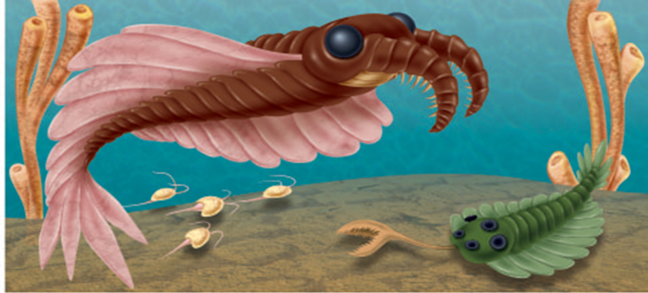
Paleozoic Life
Cambrian explosion
The organisms shown in this artist’s reconstruction are among the Cambrian organisms that had hard parts.
The Paleozoic Era
Copyright © McGraw-Hill Education

Slide 21
Paleozoic Life
Ordovician extinction
At the end of the Ordovician, more than half of the marine groups that appeared in the Cambrian became extinct. This most likely occurred as a result of regression caused by glacial formation.
The Paleozoic Era
Copyright © McGraw-Hill Education

Slide 22
Paleozoic Life
Devonian extinction
Following the late Ordovician extinction, marine life recovered and new species evolved. There was a tremendous diversification of vertebrates, including fish and the first appearance of tetrapods on land.
The Paleozoic Era
Copyright © McGraw-Hill Education

Slide 23
Paleozoic Life
Devonian extinction
In the late Devonian, another extinction event eliminated approximately 50 percent of the marine groups.
Some scientists think that global cooling was again the cause and there is evidence that some continents had glaciers at this time.
The Paleozoic Era
Copyright © McGraw-Hill Education

Slide 24
Paleozoic Life
Terrestrial plants
The Ordovician and Devonian extinction events had little effect on life-forms living on land. Simple land plants began to appear on Earth in the Ordovician.
In the Carboniferous, the first plants with seeds, called seed ferns, diversified.
The Paleozoic Era
Copyright © McGraw-Hill Education

Slide 25
Paleozoic Life
Terrestrial plants
Many Carboniferous plants lived in low-lying swamps. As these plants died and sediment accumulated, they were compacted to coal.
Fossils of the largest known insects have been found in Carboniferous sediment deposits, including dragonflies with 74-cm wingspans.
The Paleozoic Era
Copyright © McGraw-Hill Education

Slide 26
Paleozoic Life
Permian changes
At the end of the Permian, the largest mass extinction in the history of Earth occurred.
The Permo-Triassic Extinction Event caused the extinction of nearly 95 percent of marine life-forms.
This extinction event affected both marine and terrestrial organisms.
The Paleozoic Era
Copyright © McGraw-Hill Education

Slide 27
Review
Essential Questions
What is a passive margin?
How do transgressions and regressions indicate sea-level changes?
What tectonic events shaped Laurentia during the Paleozoic?
How are changes in Paleozoic life-forms summarized?
Vocabulary
paleogeography
passive margin
transgression
regression
Cambrian explosion
Copyright © McGraw-Hill Education
The Paleozoic Era

