Slide 1
Biology
Sylvia S. Mader Michael Windelspecht
Chapter 2
Basic Chemistry
Lecture Outline
See separate FlexArt PowerPoint slides for all figures and tables pre-inserted into PowerPoint without notes.
Copyright ©2019 McGraw-Hill Education. All rights reserved. No reproduction or distribution without the prior written consent of McGraw-Hill Education.
Notes:
1

Slide 2
Search for Life on Other Planets
Precursors to life, methane, ammonia, and hydrocarbons have been found on Titan, a moon of Saturn.
NASA announced a new mission to Europa, a moon of Jupiter, to continue to search for elements that support life.
The finding of water and organic materials on other planets will help us better understand how life originated on Earth.

Slide 3
Outline
2.1 Chemical Elements
2.2 Molecules and Compounds
2.3 Chemistry of Water
2.4 Acids and Bases

Slide 4
2.1 Chemical Elements
Matter refers to anything that has mass and occupies space.
Matter exists in four states: solid, liquid, gas, or plasma.
All matter (both living and nonliving) is composed of basic substances called elements.

Slide 5
Elements
An element is a substance that cannot be broken down into substances with different properties; composed of one type of atom.
Ninety-two elements are naturally occurring.
Six elements make up 95% of the body weight of organisms (acronym CHNOPS):
Carbon
Hydrogen
Nitrogen
Oxygen
Phosphorus
Sulfur

Slide 6
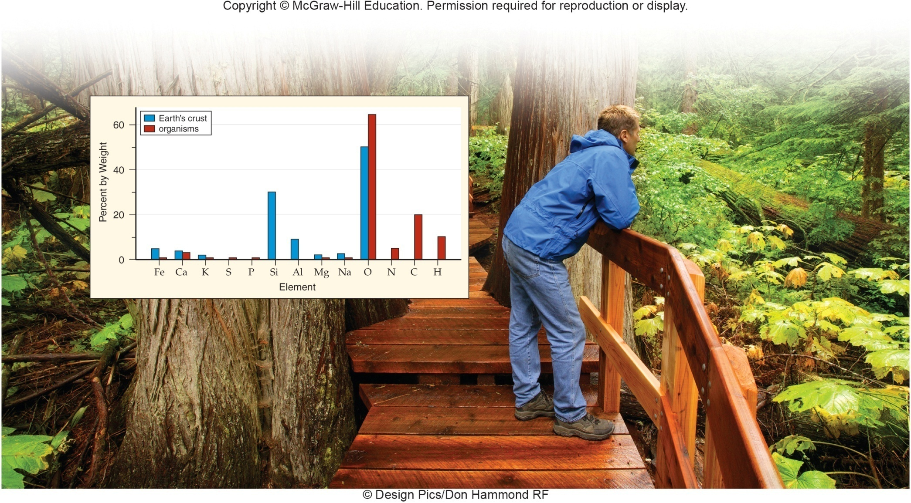
Composition of Earth’s Crust and Its Organisms
© Design Pics/Don Hammond RF
Jump to Composition of Earth’s Crust and Its Organisms Long Description

Slide 7
Atoms (1)
An atom is the smallest part of an element that displays the property of the element.
An element and its atoms share the same name.
Composed of subatomic particles: protons, neutrons, electrons
Central nucleus
Protons – positively charged, 1 amu
Neutrons – no charge, 1 amu
Orbiting clouds around nucleus (electron shells)
Electrons – negatively charged, very low mass—negligible in calculations

Slide 8
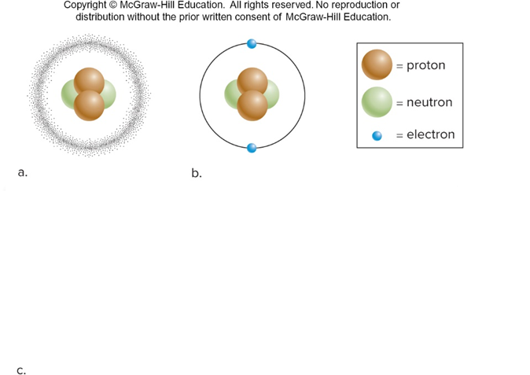
Atoms (2)
Particle | Subatomic Particles Electric Charge | Subatomic Particles Atomic Mass Unit (AMU) | Location
Proton | $$+1$$ | 1 | Nucleus
Neutron | 0 | 1 | Nucleus
Electron | $$−1$$ | 0 | Electron shell

Slide 9
Atoms (3)
Particle | Subatomic Particles Electric Charge | Subatomic Particles Atomic Mass Unit (AMU) | Location
Proton | $$+1$$ | 1 | Nucleus
Neutron | 0 | 1 | Nucleus
Electron | $$−1$$ | 0 | Electron shell

Slide 10
Atoms (4)
Particle | Subatomic Particles Electric Charge | Subatomic Particles Atomic Mass Unit (AMU) | Location
Proton | $$+1$$ | 1 | Nucleus
Neutron | 0 | 1 | Nucleus
Electron | $$−1$$ | 0 | Electron shell
Jump to Atoms (4) Long Description

Slide 11
Atomic Number and Mass Number (1)
Each element is represented by one or two letters to give it a unique atomic symbol.
H = hydrogen, Na = sodium, C = carbon
The atomic number is equal to the number of protons in each atom of an element.
The mass number of an atom is equal to the sum of the number of protons and neutrons in the nucleus.
The atomic mass is approximately equal to the mass number.

Slide 12
Atomic Number and Mass Number (2)

Slide 13
Periodic Table
Atoms of an element are arranged horizontally by increasing atomic number in rows called periods.
Atoms of an element arranged in vertical columns are called groups.
Atoms within the same group share the same chemical binding characteristics.
Group VIII are the noble gases and are inert.
Atoms shown in the periodic table are electrically neutral.
Therefore, the atomic number tells you the number of electrons as well as the number of protons.

Slide 14
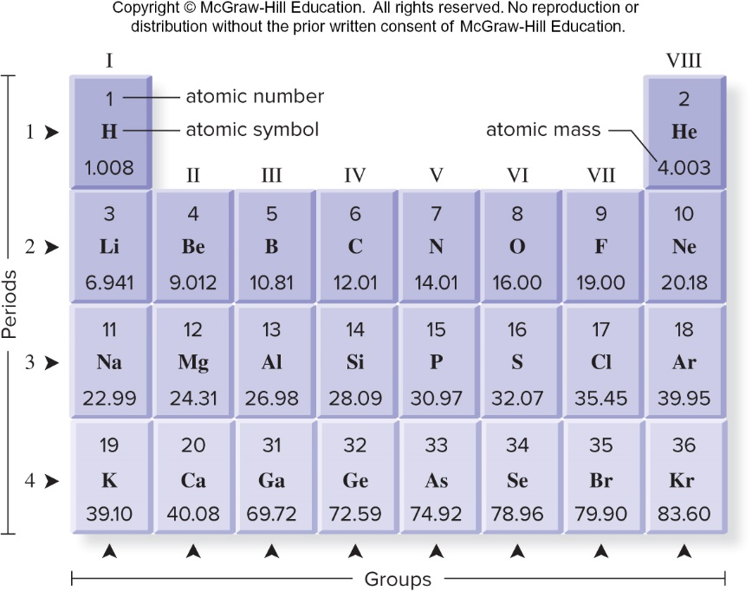
A Portion of the Periodic Table
Jump to A Portion of the Periodic Table Long Description

Slide 15
Isotopes
Isotopes are atoms of the same element that differ in the number of neutrons (and therefore different atomic masses).
Some isotopes spontaneously decay.
Radioactive isotopes give off energy in the form of rays and subatomic particles.
They can be helpful or harmful.
Carbon 14 is an example of a radioactive isotope.
Has been used to examine reactions in photosynthesis
$${}_{6}^{12}C$$
$${}_{6}^{13}C$$
$${}_{6}^{14}C$$
Carbon 12
Carbon 13
Carbon 14

Slide 16
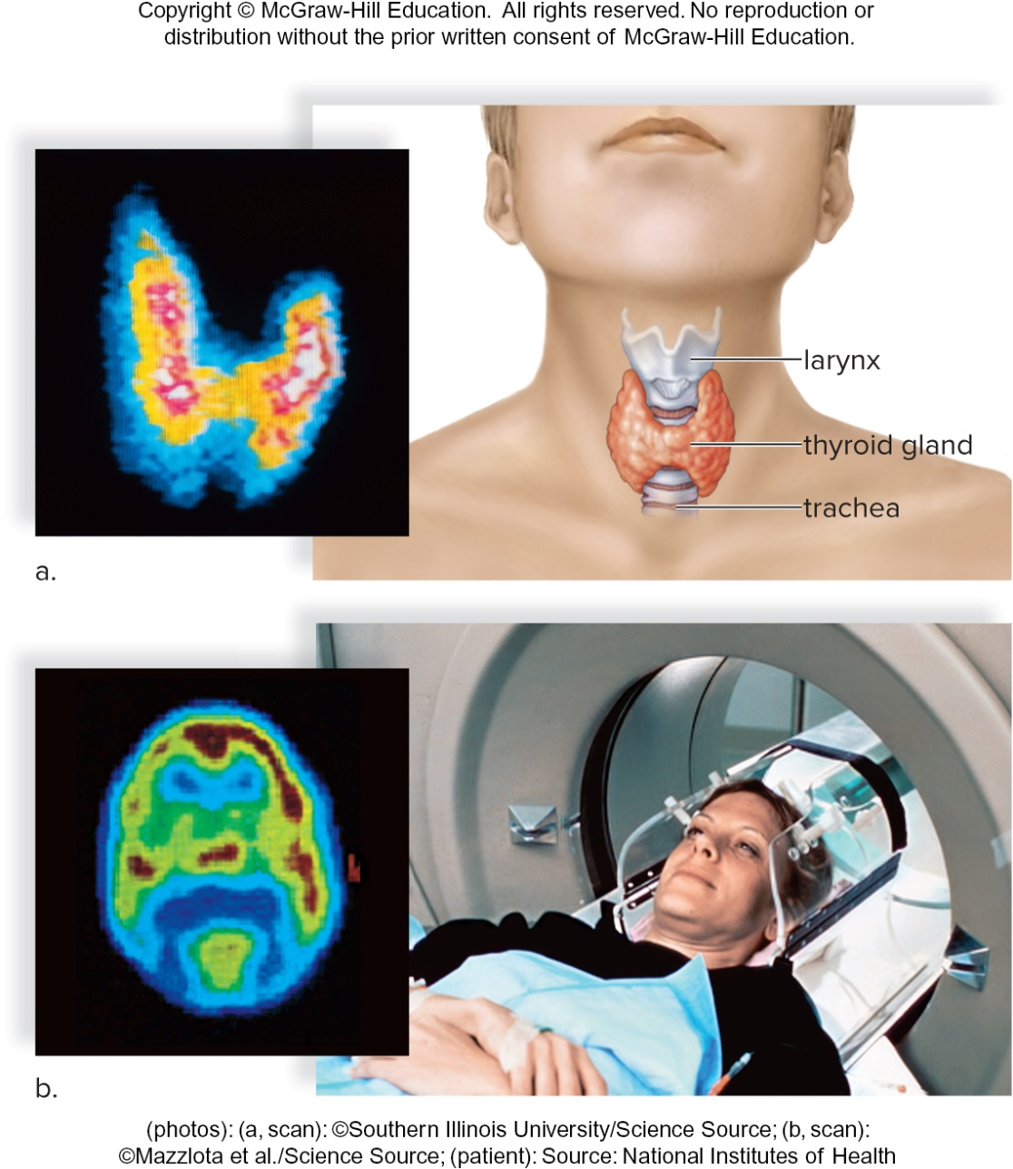
Uses of Low Levels of Radiation
2.4a: © Southern Illinois University/Science Source; 2.4b(left): © Mazzlota et al./Science Source; 2.4b(right): © National Institutes of Health
(photos): (a, scan): ©Southern Illinois University/Science Source; (b, scan): ©Mazzlota et al./Science Source; (patient): Source: National Institutes of Health
Jump to Uses of Low Levels of Radiation Long Description

Slide 17
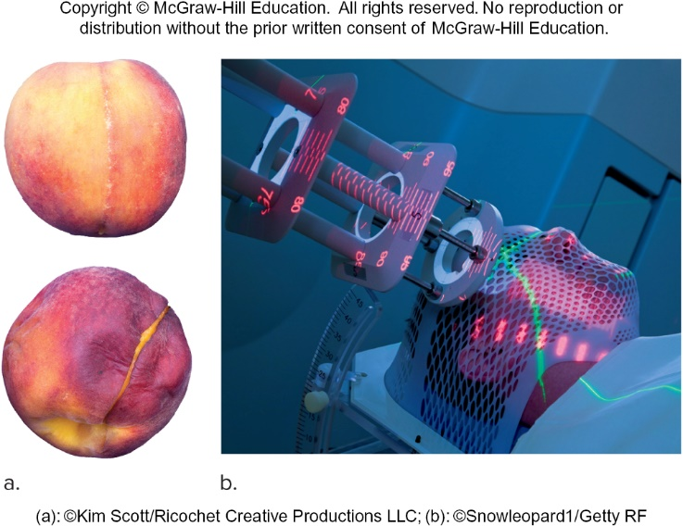
Uses of High Levels of Radiation
(a): ©Kim Scott/Ricochet Creative Productions LLC; (b): ©Snowleopard1/Getty RF
Jump to Uses of High Levels of Radiation Long Description

Slide 18
Electrons and Energy
Electrons are attracted to the positively charged nucleus; thus, it takes energy to hold electrons in place.
It takes energy to push them away and keep them in their own shell.
The more distant the shell, the more energy it takes to hold in place.
Electrons have energy due to their relative position (potential energy).
Electrons determine chemical behavior of atoms.

Slide 19
The Distribution of Electrons
The Bohr model is a useful way to visualize electron location.
Electrons revolve around the nucleus in energy shells (energy levels).
For atoms with atomic numbers of 20 or less, the following rules apply:
The first energy shell can hold up to 2 electrons.
Each additional shell can hold up to 8 electrons.
Each lower shell is filled first before electrons are placed in the next shell.
These rules cover most of the biologically significant elements.

Slide 20
Valence Electrons (1)
The outermost energy shell of any atom is called the valence shell.
The valence shell is important because it determines many of an atom’s chemical properties.
The octet rule states that the outermost shell is most stable when it has eight electrons.
Exception: If an atom has only one shell, the outermost valence shell is complete when it has two electrons.

Slide 21
Valence Electrons (2)
The number of electrons in an atom’s valence shell determines whether the atom gives up, accepts, or shares electrons to acquire eight electrons in the outer shell.
Atoms that have their valence shells filled with electrons tend to be chemically stable.
Atoms that do not have their valence shells filled with electrons are chemically reactive.

Slide 22
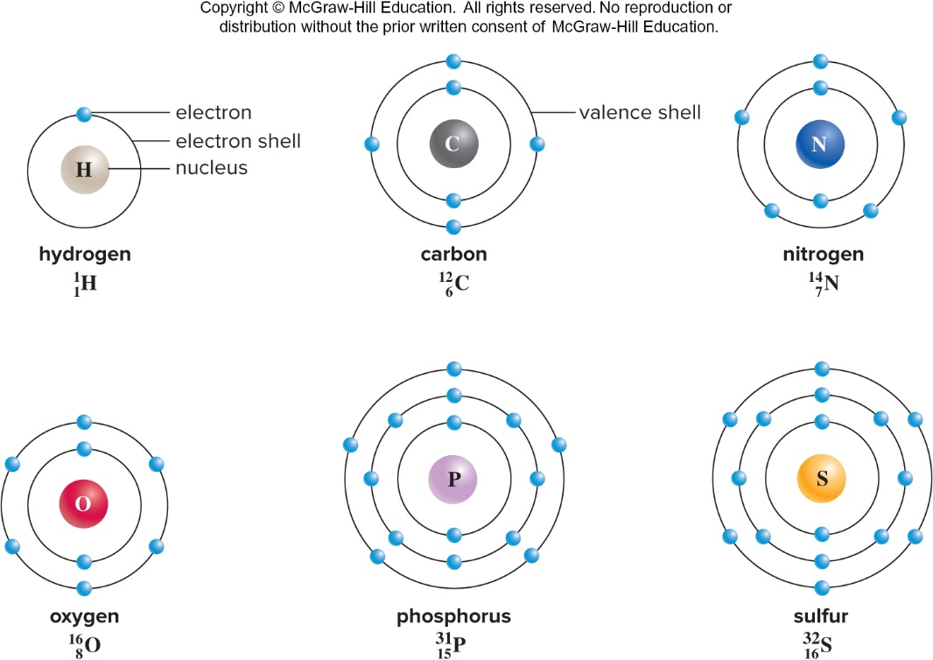
Bohr Models of Atoms
Jump to Bohr Models of Atoms Long Description

Slide 23
2.2 Molecules and Compounds
A molecule is two or more elements bonded together.
It is the smallest part of a compound that retains its chemical properties.
$NaCl$, $H_{2}$, etc.
A compound is a molecule containing at least two different elements bonded together.
${CO}_{2}$, $H_{2}O$, $C_{6}H_{12}O_{6}$, etc.
A formula tells the number of each kind of atom in a molecule.
$C_{6}H_{12}O_{6}$ means there is one molecule of glucose containing 6C,12H, 6O.

Slide 24
Compounds and Molecules

Slide 25
Chemical Bonding
Bonds that exist between atoms in molecules contain energy.
Bonds between atoms are caused by the interactions between electrons in outermost energy shells.
The process of bond formation is called a chemical reaction.

Slide 26
Types of Bonds: Ionic Bonding
An ion is an atom that has lost or gained an electron.
An ionic bond forms when electrons are transferred from one atom to another atom and the oppositely charged ions are attracted to each other.
Example: formation of sodium chloride
Salts are solid substances that usually separate and exist as individual ions in water.

Slide 27
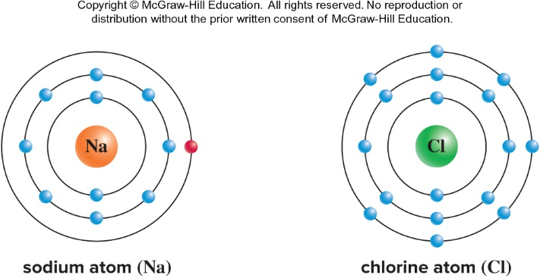
Formation of Sodium Chloride (1)

Slide 28
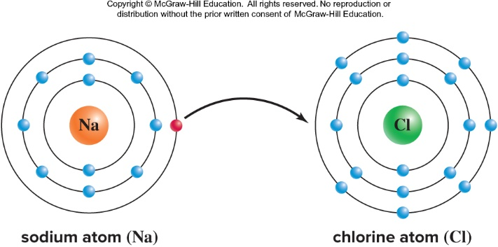
Formation of Sodium Chloride (2)

Slide 29
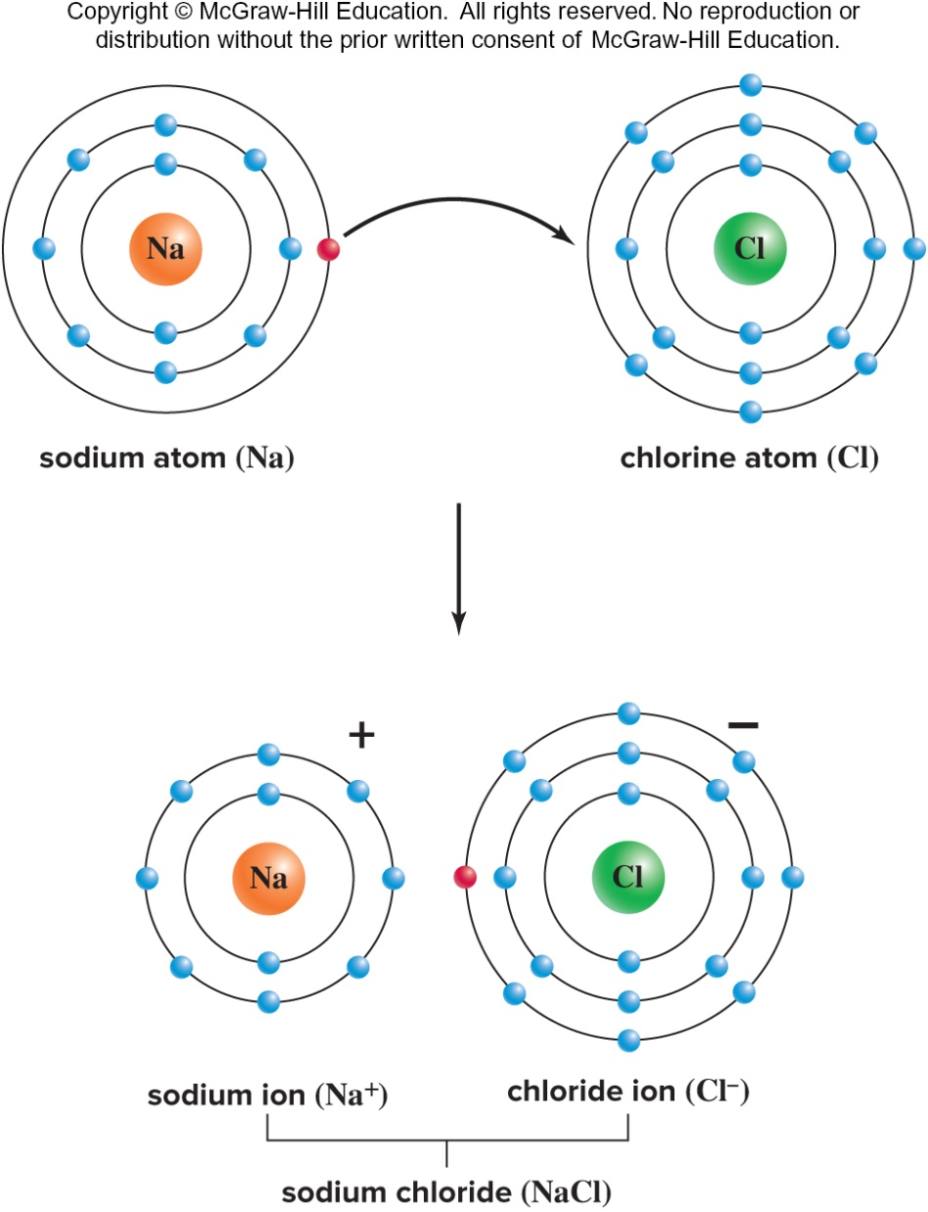
Formation of Sodium Chloride (3)

Slide 30
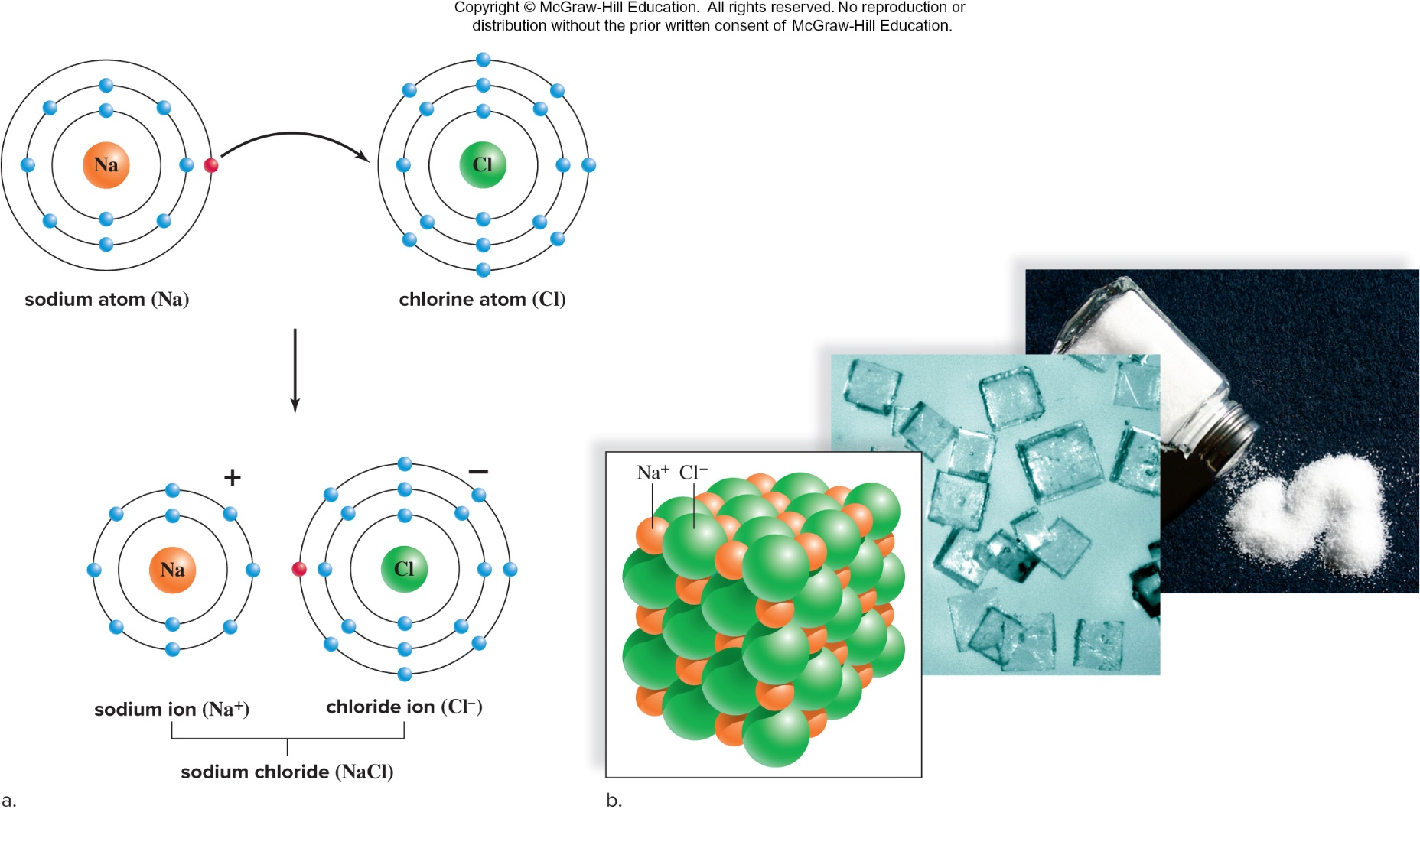
Formation of Sodium Chloride (4)
b (middle): © Evelyn Jo Johnson; b (right): © Evelyn Jo Johnson
Jump to Formation of Sodium Chloride (4) Long Description

Slide 31
Types of Bonds: Covalent Bonds (1)
Covalent bonds result when two atoms share electrons so each atom has an octet of electrons in the outer shell.
Note: In the case of hydrogen, the outer energy shell is complete when it contains two electrons.
In a nonpolar covalent bond electrons are shared equally between atoms.
Examples: hydrogen gas, oxygen gas, methane

Slide 32
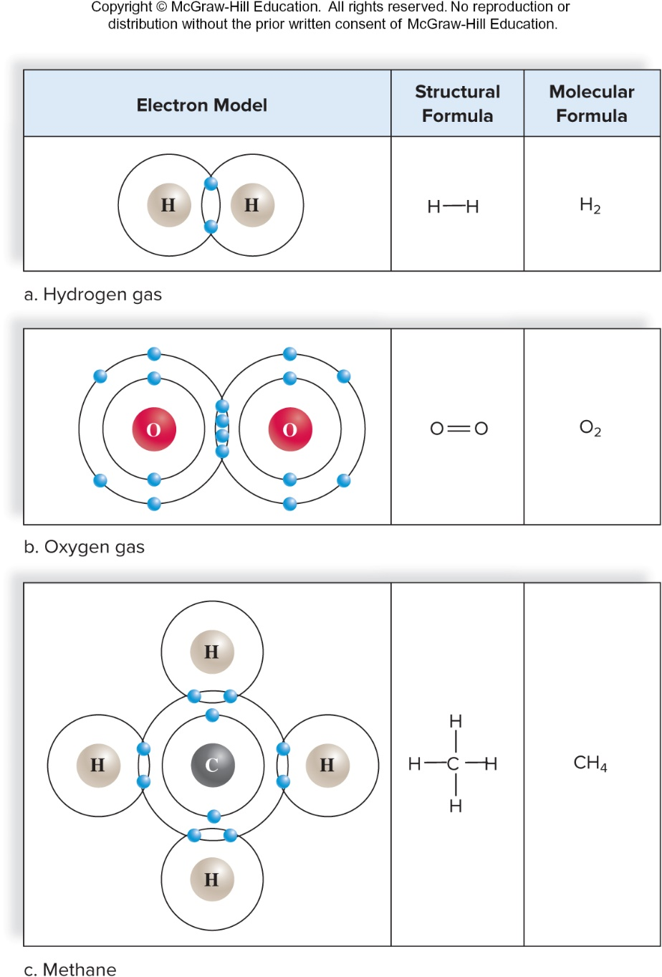
Covalently Bonded Molecules
Jump to Covalently Bonded Molecules Long Description

Slide 33
Types of Bonds: Covalent Bonds (2)
In a polar covalent bond electrons are shared unequally.
Example: water
Electronegativity is the ability of an atom to attract electrons towards itself in a chemical bond.
In water, the oxygen atom is more electronegative than the hydrogen atoms and the bonds are therefore polar.

Slide 34
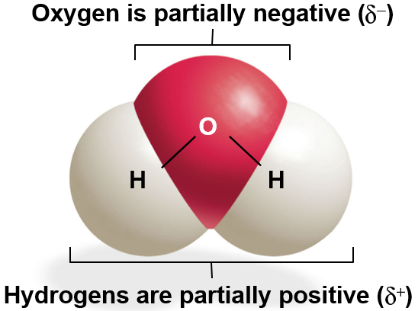
Types of Bonds: Covalent Bonds (3)

Slide 35
2.3 Chemistry of Water (1)
Water is a polar molecule.
The shape of a water molecule and its polarity make hydrogen bonding possible.
This is an example of a structure-function relationship.
A hydrogen bond is a weak attraction between a slightly positive hydrogen atom and a slightly negative atom.
It can occur between atoms of different molecules or within the same molecule.
A single hydrogen bond is easily broken, while multiple hydrogen bonds are collectively quite strong.
It helps to maintain the proper structure and function of complex molecules such as proteins and DNA.

Slide 36
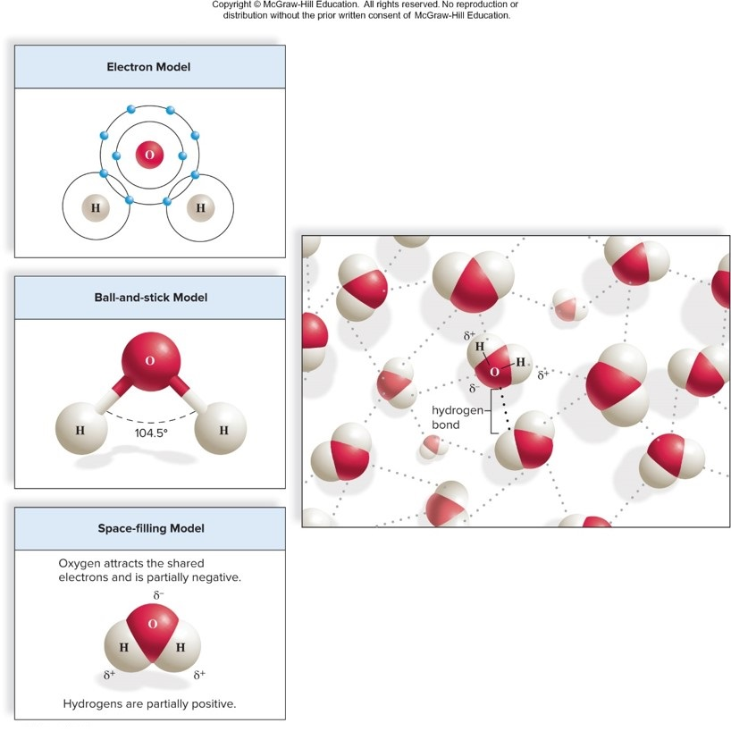
2.3 Chemistry of Water (2)
Hydrogen bonding between water molecules
Water $\left(H_{2}O\right)$
Jump to 2.3 Chemistry of Water (2) Long Description

Slide 37
Properties of Water (1)
Water molecules cling together because of hydrogen bonding.
This association gives water many of its unique chemical properties.
Water has a high heat capacity.
The many hydrogen bonds allow water to absorb a large amount of thermal energy without a great change in temperature.
The temperature of water rises and falls slowly.
Allows organisms to maintain their normal internal temperatures and protect them from rapid temperature changes.

Slide 38
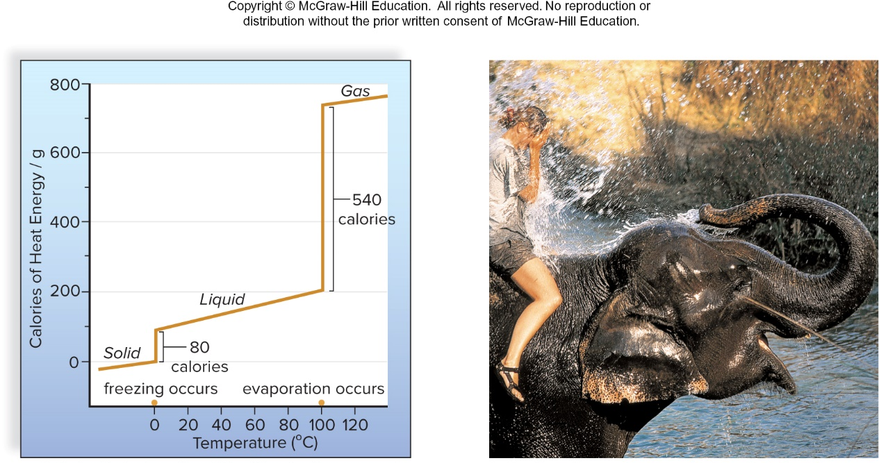
Temperature and Water
Calories lost when 1 g of liquid water freezes and calories required when 1 g of liquid water evaporates.
Bodies of organisms cool when their heat is used to evaporate water.
(b): ©Grant Taylor/Stone/Getty Images
Jump to Temperature and Water Long Description

Slide 39
Properties of Water (2)
Water has a high heat of evaporation.
Hydrogen bonds must be broken to evaporate water.
Bodies of organisms cool when their heat is used to evaporate water.
Example: sweating
Water is a good solvent.
Water is a good solvent because of its polarity.
Polar substances dissolve readily in water.
Hydrophilic molecules dissolve in water.
Hydrophobic molecules do not dissolve in water.
A solution contains dissolved substances, or solutes.

Slide 40
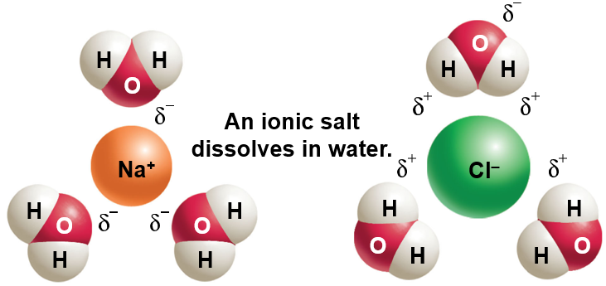
Water as a Solvent

Slide 41
Properties of Water (3)
Water molecules are cohesive and adhesive.
Cohesion is the ability of water molecules to cling to each other due to hydrogen bonding.
Water flows freely
Surface tension
Adhesion is the ability of water molecules to cling to other polar surfaces.
Due to water’s polarity
Capillary action
Cohesion and adhesion account for water transport in plants as well as transport in blood vessels.

Slide 42
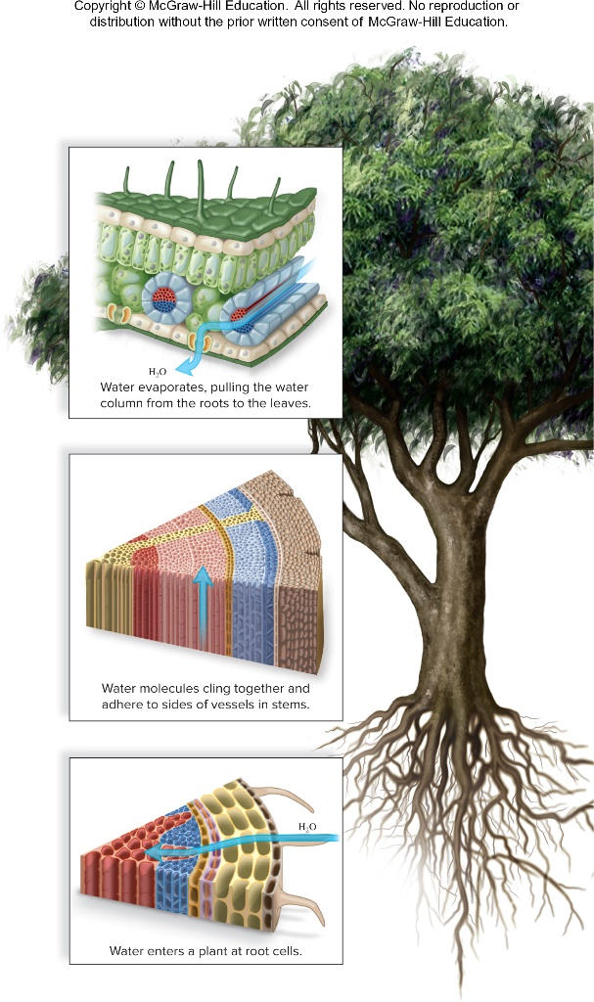
Water as a Transport Medium
Water evaporates, pulling the water
column from the roots to the leaves.
Water molecules cling together and
adhere to sides of vessels in stems.
Water enters a plant at root cells.
Jump to Water as a Transport Medium Long Description

Slide 43
Properties of Water (4)
Frozen water (ice) is less dense than liquid water.
At temperatures below 4 degree Celsius, hydrogen bonds between water molecules become more rigid but also more open.
Water expands as it reaches 0 degree Celsius and freezes.
Ice floats on liquid water.
Without this property, ice would sink and oceans would freeze solid, instead of from the top down.
Ice acts as an insulator on top of a frozen body of water.

Slide 44
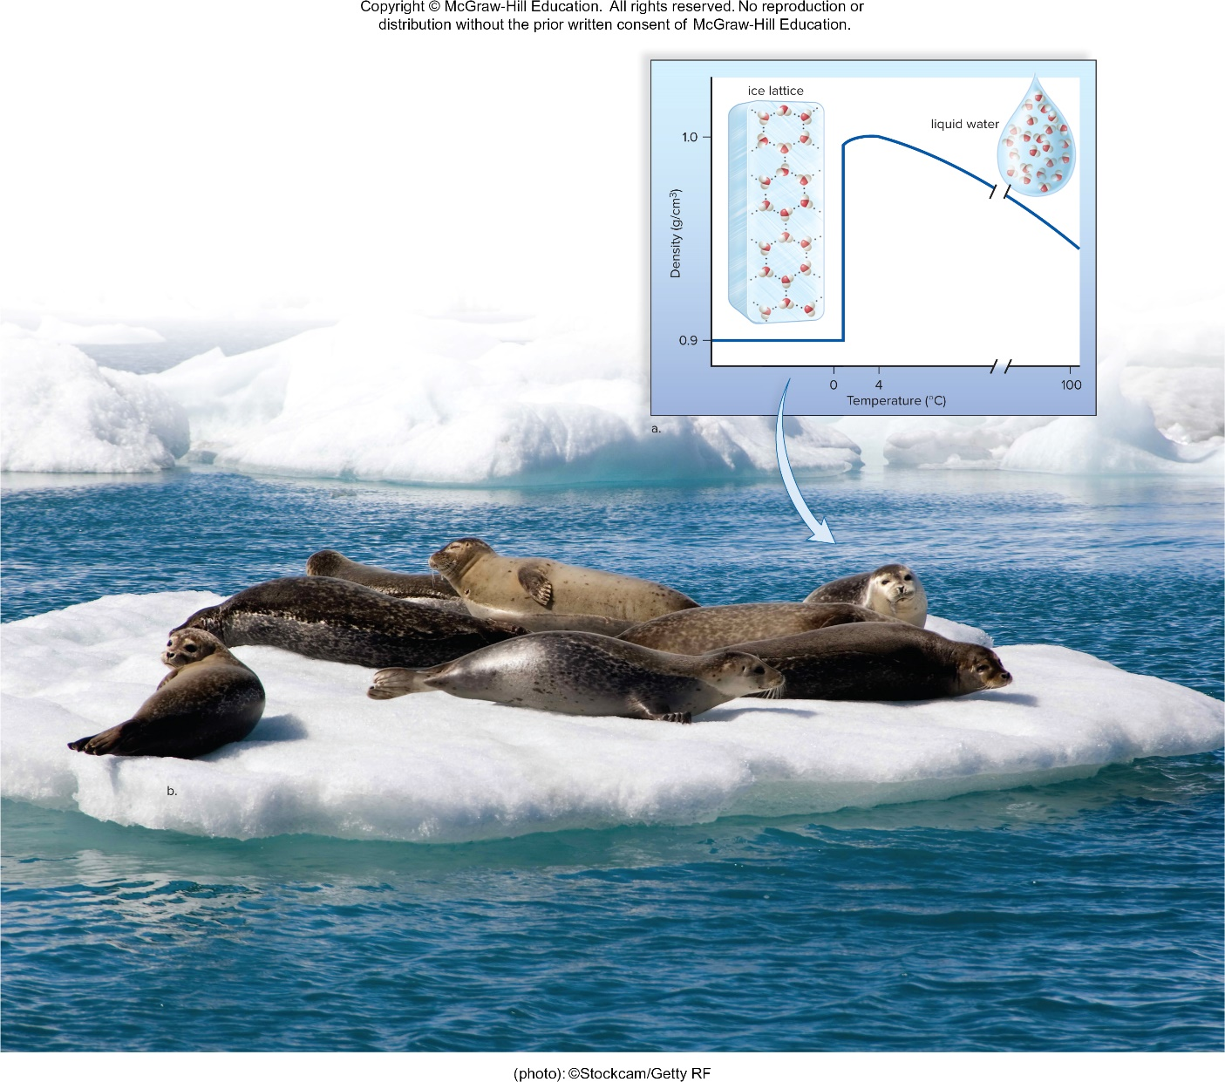
Ice Is Less Dense than Water
Jump to Ice Is Less Dense than Water Long Description
(photo): ©Stockcam/Getty RF

Slide 45
2.4 Acids and Bases
pH is a measure of hydrogen ion concentration in a solution.
When water ionizes or dissociates, it releases an equal number of hydrogen ($H^{+}$) ions and hydroxide (${OH}^{−}$) ions.
Acids are substances that dissociate in water, releasing hydrogen ions.
Bases are substances that either take up hydrogen ions ($H^{+}$) or release hydroxide ions (${OH}^{−}$).

Slide 46
The pH Scale (1)
The pH scale is used to indicate the acidity or basicity (alkalinity) of a solution.
Values range from 0 to 14
0 to <7 = Acidic
7 = Neutral
>7 to 14 = Basic (or alkaline)
Logarithmic scale
Each unit change in pH represents a 10-fold change in $H^{+}$ concentration.
pH of 4 is 10× as acidic as pH of 5
pH of 10 is 100× more basic than pH of 8

Slide 47
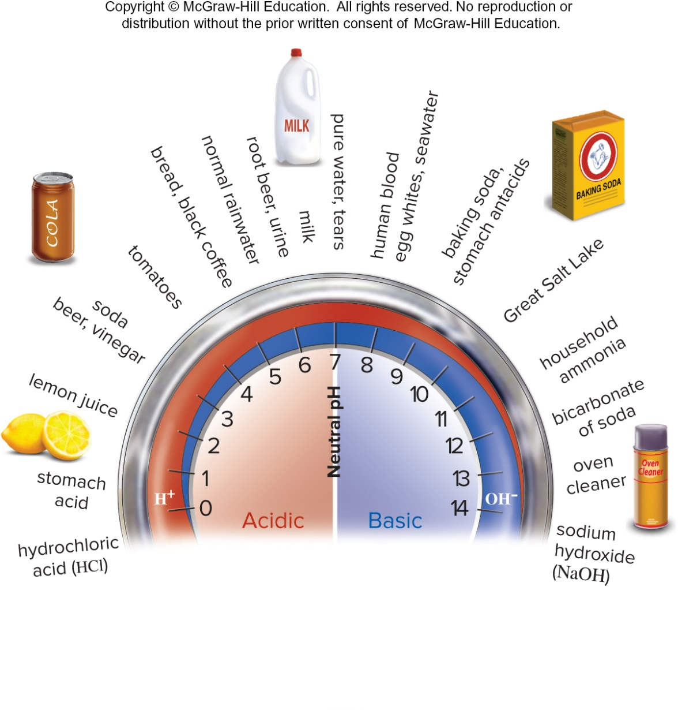
The pH Scale (2)
Jump to The pH Scale (2) Long Description

Slide 48
Buffers and pH
A buffer is a chemical or a combination of chemicals that keeps pH within normal limits.
Health of organisms requires maintaining the pH of body fluids within narrow limits.
Human blood is normally pH 7.4 (slightly basic).
If blood pH drops below 7.0, acidosis results.
If blood pH rises above 7.8, alkalosis results.
Both are life-threatening situations.
The body has built-in mechanisms to prevent pH changes.
Example: carbonic acid buffer dissociates and re-forms to reduce changes in pH

Slide 49
Appendix of Image Long Description

Slide 50
Composition of Earth’s Crust and Its Organisms Long Description
A comparison of the elements that make up the Earth’s crust and living organisms. The graph inset shows that the Earth’s crust primarily contains the elements silicon (Si), aluminum (Al), and oxygen (O). Living organisms, such as the tree and human, primarily contain the elements oxygen (O), nitrogen (N), carbon (C), and hydrogen (H). Biological molecules also often contain the elements sulfur (S) and phosphorus (P).
Jump back to Composition of Earth’s Crust and Its Organisms

Slide 51
Atoms (4) Long Description
A model of helium (He). Atoms contain subatomic particles, which are located as shown. Protons and neutrons are found within the nucleus, and electrons are outside the nucleus.
The shading shows the probable location of the electrons in the helium atom.
The average location of an electron is sometimes represented by an electron shell.
The electric charge and the atomic mass units (AMU) of the subatomic particles vary as shown.
Jump back to Atoms (4)

Slide 52
A Portion of the Periodic Table Long Description
In the periodic table, elements are listed in the order of their atomic numbers but are arranged so that each element is placed in a group (vertical column) and period (horizontal row). All the atoms in a particular group have the same number of valence electrons and therefore share common chemical characteristics. Each period shows the number of electron shells for an element. This abbreviated periodic table contains the elements most important in biology; the complete periodic table is in Appendix C.
Jump back to A Portion of the Periodic Table

Slide 53
Uses of Low Levels of Radiation Long Description
Low levels of radiation.
A medical scan of the thyroid gland (colored image) indicates the presence of a tumor that does not take up radioactive iodine.
A positron-emission tomography (PET) scan reveals which portions of the brain are most active (green and red colors).
Jump back to Uses of Low Levels of Radiation

Slide 54
Uses of High Levels of Radiation Long Description
High levels of radiation.
Radiation used to kill bacteria and fungi on peaches reduces spoilage and allows them to stay fresh for a longer period of time.
Physicians use targeted radiation therapy to kill cancer cells.
Jump back to Uses of High Levels of Radiation

Slide 55
Bohr Models of Atoms Long Description
Electrons orbit the nucleus at particular energy levels (electron shells). The first shell contains up to two electrons, and thereafter each shell is most stable when it contains 8 electrons. Atoms with an atomic number above 20 may have more electrons in their outer shells. The outermost, or valence, shell helps determine the atom’s chemical properties and how many other elements it can interact with.
Jump back to Bohr Models of Atoms

Slide 56
Formation of Sodium Chloride (4) Long Description
Formation of sodium chloride (table salt).
During the formation of sodium chloride, an electron is transferred from the sodium atom to the chlorine atom. At the completion of the reaction, each atom has eight electrons in the outer shell, but each also carries a charge as shown.
In a sodium chloride crystal, ionic bonding between ${Na}^{+}$ and ${Cl}^{−}$ causes the atoms to assume a three-dimensional lattice in which each sodium ion is surrounded by six chloride ions, and each chloride ion is surrounded by six sodium ions. The result is crystals of salt as in table salt.
Jump back to Formation of Sodium Chloride (4)

Slide 57
Covalently Bonded Molecules Long Description
In a covalent bond, atoms share electrons, allowing each atom to have a completed outer shell.
A molecule of hydrogen $\left(H_{2}\right)$ contains two hydrogen atoms sharing a pair of electrons. This single covalent bond can be represented in any of the three ways shown.
A molecule of oxygen $\left(O_{2}\right)$ contains two oxygen atoms sharing two pairs of electrons. This results in a double covalent bond.
A molecule of methane $\left({CH}_{4}\right)$ contains one carbon atom bonded to four hydrogen atoms.
Jump back to Covalently Bonded Molecules

Slide 58
2.3 Chemistry of Water (2) Long Description
Three models for the structure of water. The electron model does not indicate the shape of the molecule. The ball-and-stick model shows that the two bonds in a water molecule are angled at 104.5 degree. The space-filling model also shows the V shape of a water molecule.
Hydrogen bonding between water molecules. Each water molecule can hydrogen bond with up to four other molecules, in three dimensions. When in a liquid state, water is constantly forming and breaking hydrogen bonds.
Jump back to 2.3 Chemistry of Water (2)

Slide 59
Temperature and Water Long Description
Water can be a solid, a liquid, or a gas at naturally occurring environmental temperatures. At room temperature and pressure, water is a liquid. When water freezes and becomes a solid (ice), it gives off heat, and this heat can help keep the environmental temperature higher than expected. On the other hand, when water evaporates, it takes up a large amount of heat as it changes from a liquid to a gas.
This means that splashing water on the body will help keep body temperature within a normal range.
Jump back to Temperature and Water

Slide 60
Water as a Transport Medium Long Description
Water molecules are cohesive and adhesive. Cohesion and adhesion play an important role in the movement of water in a plant. When water evaporates from the leaves, the water column is pulled upward due to the cohesion of water molecules to one another and the adhesion of water molecules to the sides of the vessels. This capillary action is critical for plants to function.
Jump back to Water as a Transport Medium

Slide 61
Ice Is Less Dense than Water Long Description
Water is more dense at 4 degree Celsius than at 0 degree Celsius. Most substances contract when they solidify, but water expands when it freezes. In ice, water molecules form a lattice in which the hydrogen bonds are farther apart than in liquid water.
This property of water allows ice to flow, providing habitats for some aquatic species and protecting other species that live beneath the ice.
Jump back to Ice Is Less Dense than Water

Slide 62
The pH Scale (2) Long Description
The pH scale ranges from 0 to 14, with 0 being the most acidic and 14 being the most basic. pH 7 (neutral pH) has equal amounts of hydrogen ions $\left(H^{+}\right)$ and hydroxide ions $\left({OH}^{−}\right)$. An acidic pH has more $H^{+}$ than ${OH}^{−}$ and a basic pH has more ${OH}^{−}$ than $H^{+}$.
Jump back to The pH Scale (2)

