Slide 2
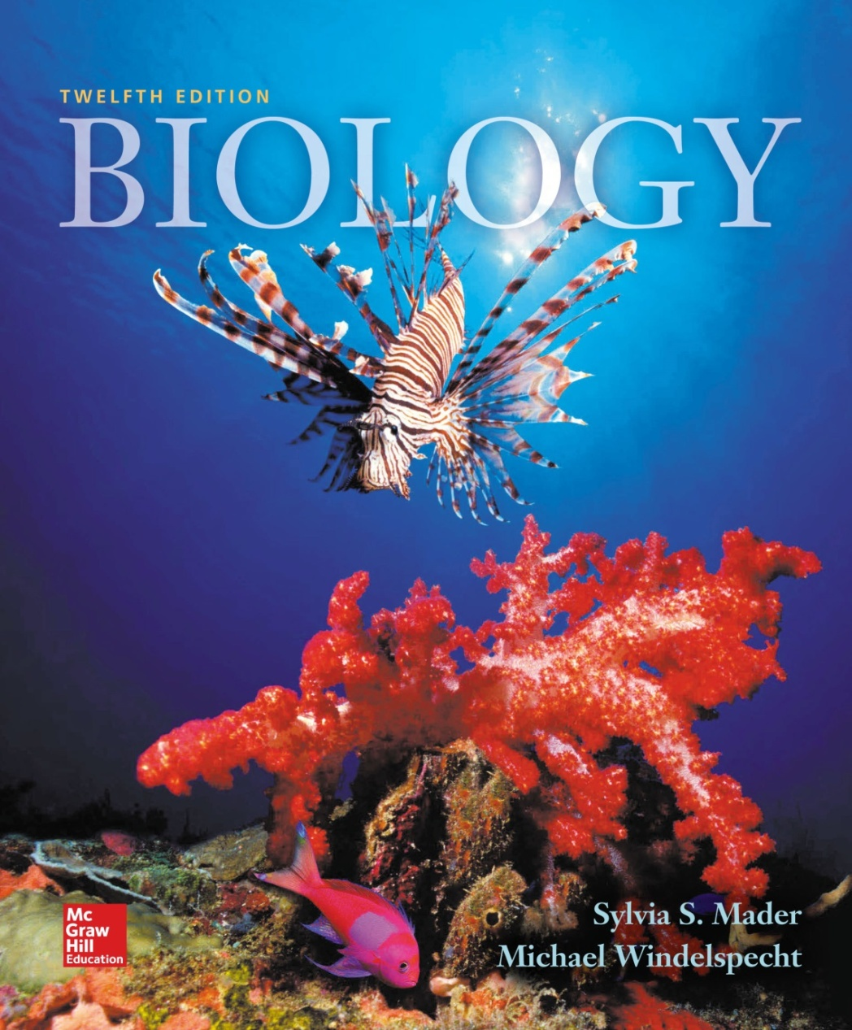
Biology
Sylvia S. Mader
Michael Windelspecht
Chapter 1
A View of Life
Lecture Outline
See separate FlexArt PowerPoint slides for all figures and tables pre-inserted into PowerPoint without notes.
Copyright © McGraw-Hill Education. Permission required for reproduction or display.
Notes:
2

Slide 3
Outline
1.1 The Characteristics of Life
1.2 Evolution and the Characteristics of Life
1.3 The Process of Science
1.4 Challenges Facing Science

Slide 4
1.1 The Characteristics of Life
Biology is the scientific study of life.
There is great diversity among living things.
Living things
  are composed of the same chemical elements as nonliving things.
  obey the same physical and chemical laws that govern everything in the universe.

Slide 5
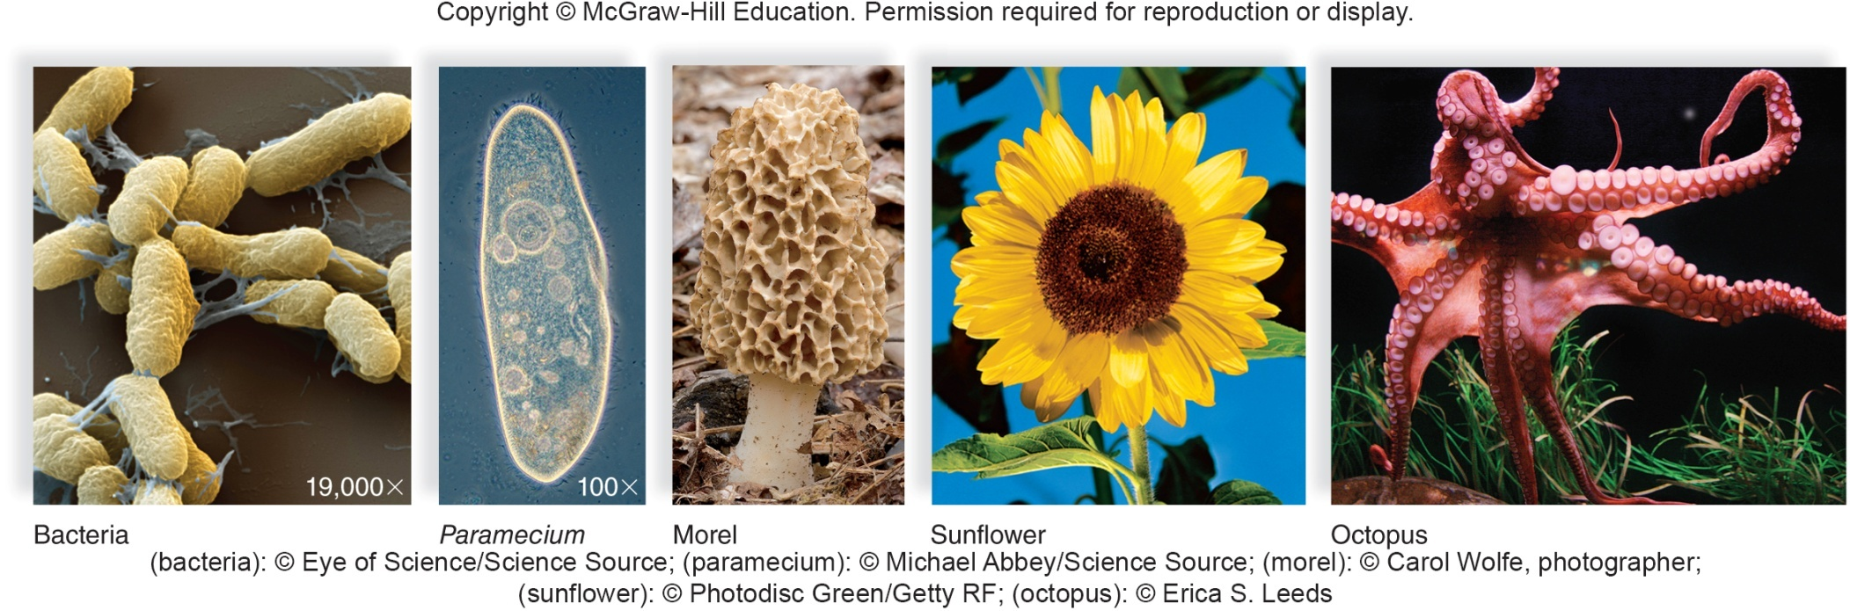
Diversity of Life
Despite diversity, all living things share the same basic characteristics.
Notes:
I made this figure as a draft. I could replace it by a better one or if you do have a similar figure add it here.

Slide 6
Characteristics of Life
1. Living things are organized.
  The levels of biological organization range from atoms to the biosphere.
  The cell is the basic unit of structure and function of all living things.
    Unicellular or multicellular
  Each level of organization is more complex than the level preceding it.
    As biological complexity increases, each level acquires new emergent properties.

Slide 7
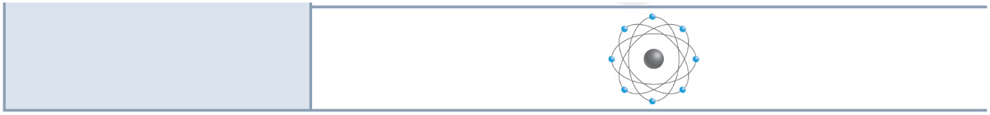
Levels of Biological Organization
Copyright © The McGraw-Hill Companies, Inc. Permission required for reproduction or display.
oxygen
Atom
Smallest unit of an element composed
of electrons, protons, and neutrons

Slide 8
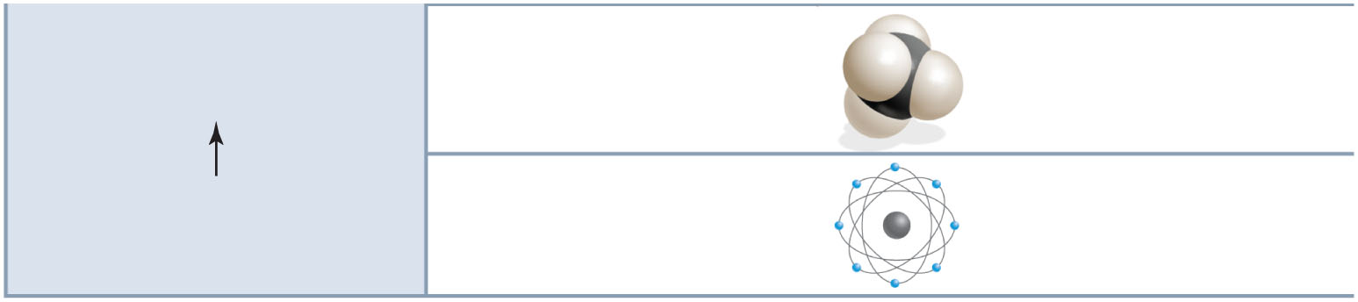
Copyright © The McGraw-Hill Companies, Inc. Permission required for reproduction or display.
Molecule
Union of two or more atoms of
the same or different elements
methane
oxygen
Atom
Smallest unit of an element composed
of electrons, protons, and neutrons

Slide 9
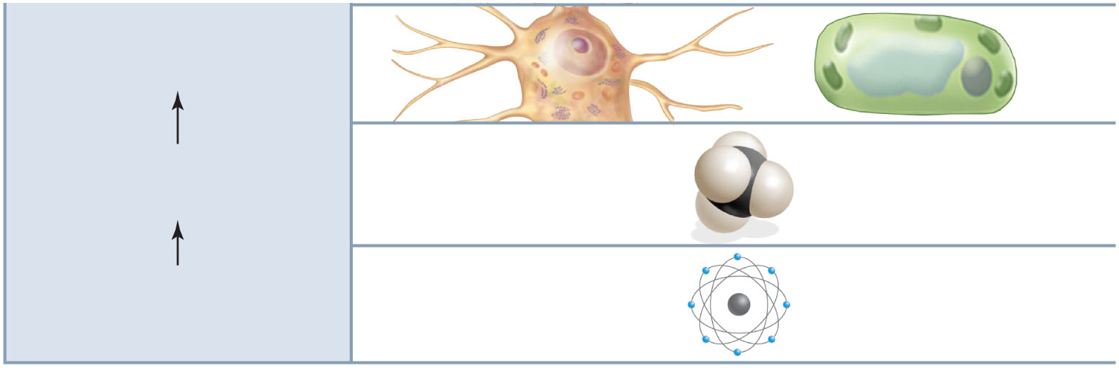
Copyright © The McGraw-Hill Companies, Inc. Permission required for reproduction or display.
Cell
The structural and functional
unit of all living things
nerve cell
plant cell
Molecule
Union of two or more atoms of
the same or different elements
methane
oxygen
Atom
Smallest unit of an element composed
of electrons, protons, and neutrons

Slide 10
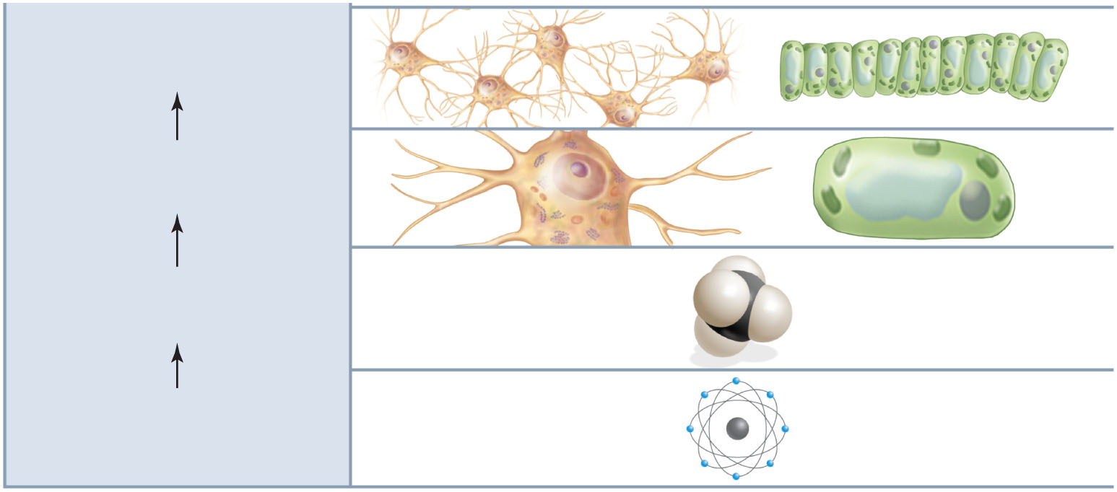
Copyright © The McGraw-Hill Companies, Inc. Permission required for reproduction or display.
Tissue
A group of cells with a common
structure and function
nervous tissue
Cell
The structural and functional
unit of all living things
nerve cell
plant cell
Molecule
Union of two or more atoms of
the same or different elements
methane
oxygen
Atom
Smallest unit of an element composed
of electrons, protons, and neutrons

Slide 11
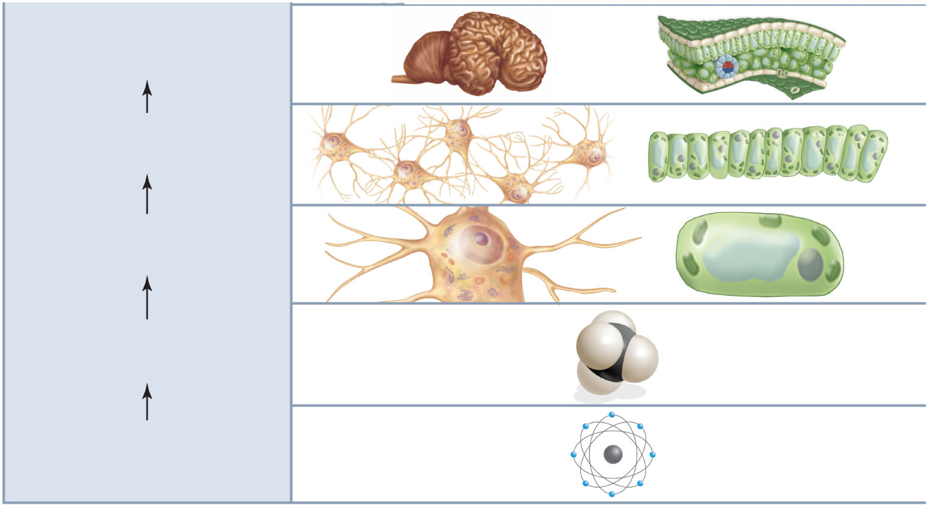
Copyright © The McGraw-Hill Companies, Inc. Permission required for reproduction or display.
Organ
Composed of tissues functioning
together for a specific task
the brain
leaves
Tissue
A group of cells with a common
structure and function
nervous tissue
leaf tissue
Cell
The structural and functional
unit of all living things
nerve cell
plant cell
Molecule
Union of two or more atoms of
the same or different elements
methane
oxygen
Atom
Smallest unit of an element composed
of electrons, protons, and neutrons

Slide 12
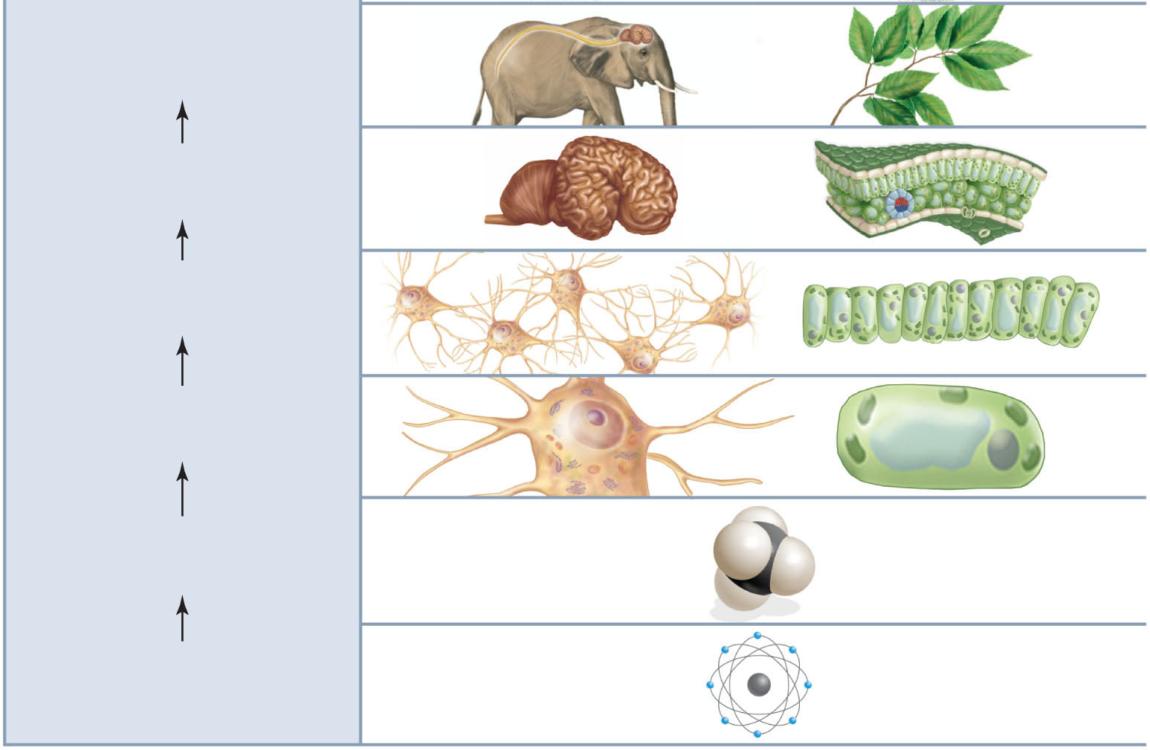
Copyright © The McGraw-Hill Companies, Inc. Permission required for reproduction or display.
Organ System
Composed of several organs
working together
nervous
system
shoot
system
Organ
Composed of tissues functioning
together for a specific task
the brain
leaves
Tissue
A group of cells with a common
structure and function
nervous tissue
leaf tissue
Cell
The structural and functional
unit of all living things
nerve cell
plant cell
Molecule
Union of two or more atoms of
the same or different elements
methane
Atom
Smallest unit of an element composed
of electrons, protons, and neutrons
oxygen

Slide 13
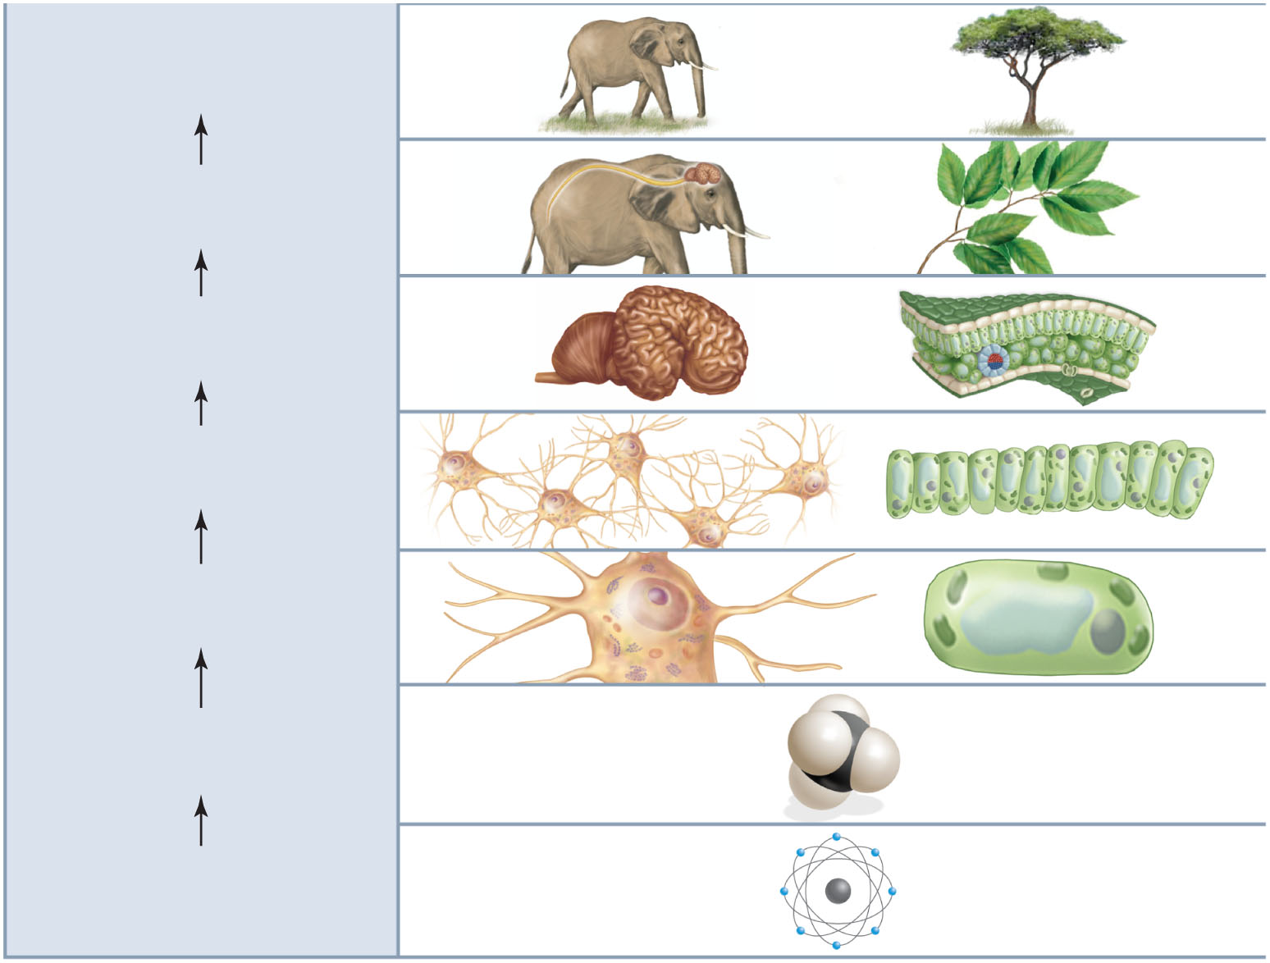
Copyright © The McGraw-Hill Companies, Inc. Permission required for reproduction or display.
Organism
An individual; complex
individuals contain organ systems
elephant
tree
Organ System
Composed of several organs
working together
nervous
system
shoot
system
Organ
Composed of tissues functioning
together for a specific task
the brain
leaves
Tissue
A group of cells with a common
structure and function
nervous tissue
leaf tissue
Cell
The structural and functional
unit of all living things
nerve cell
plant cell
Molecule
Union of two or more atoms of
the same or different elements
methane
Atom
Smallest unit of an element composed
of electrons, protons, and neutrons
oxygen

Slide 14
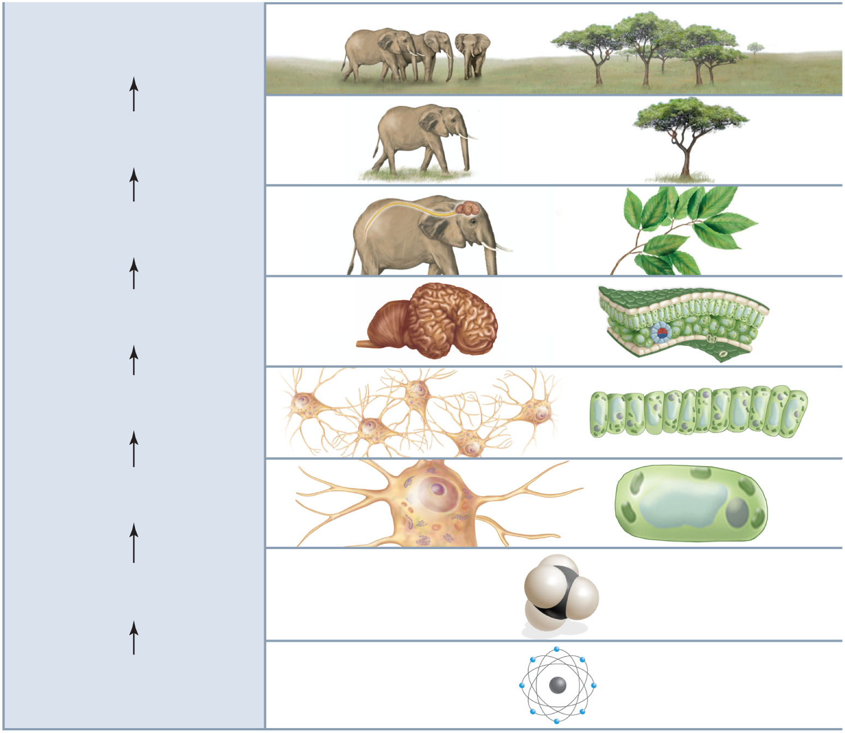
Copyright © The McGraw-Hill Companies, Inc. Permission required for reproduction or display.
Population
Organisms of the same
species in a particular area
Organism
An individual; complex
individuals contain organ systems
elephant
tree
Organ System
Composed of several organs
working together
nervous
system
shoot
system
Organ
Composed of tissues functioning
together for a specific task
the brain
leaves
Tissue
A group of cells with a common
structure and function
nervous tissue
leaf tissue
Cell
The structural and functional
unit of all living things
nerve cell
plant cell
Molecule
Union of two or more atoms of
the same or different elements
methane
Atom
Smallest unit of an element composed
of electrons, protons, and neutrons
oxygen

Slide 15
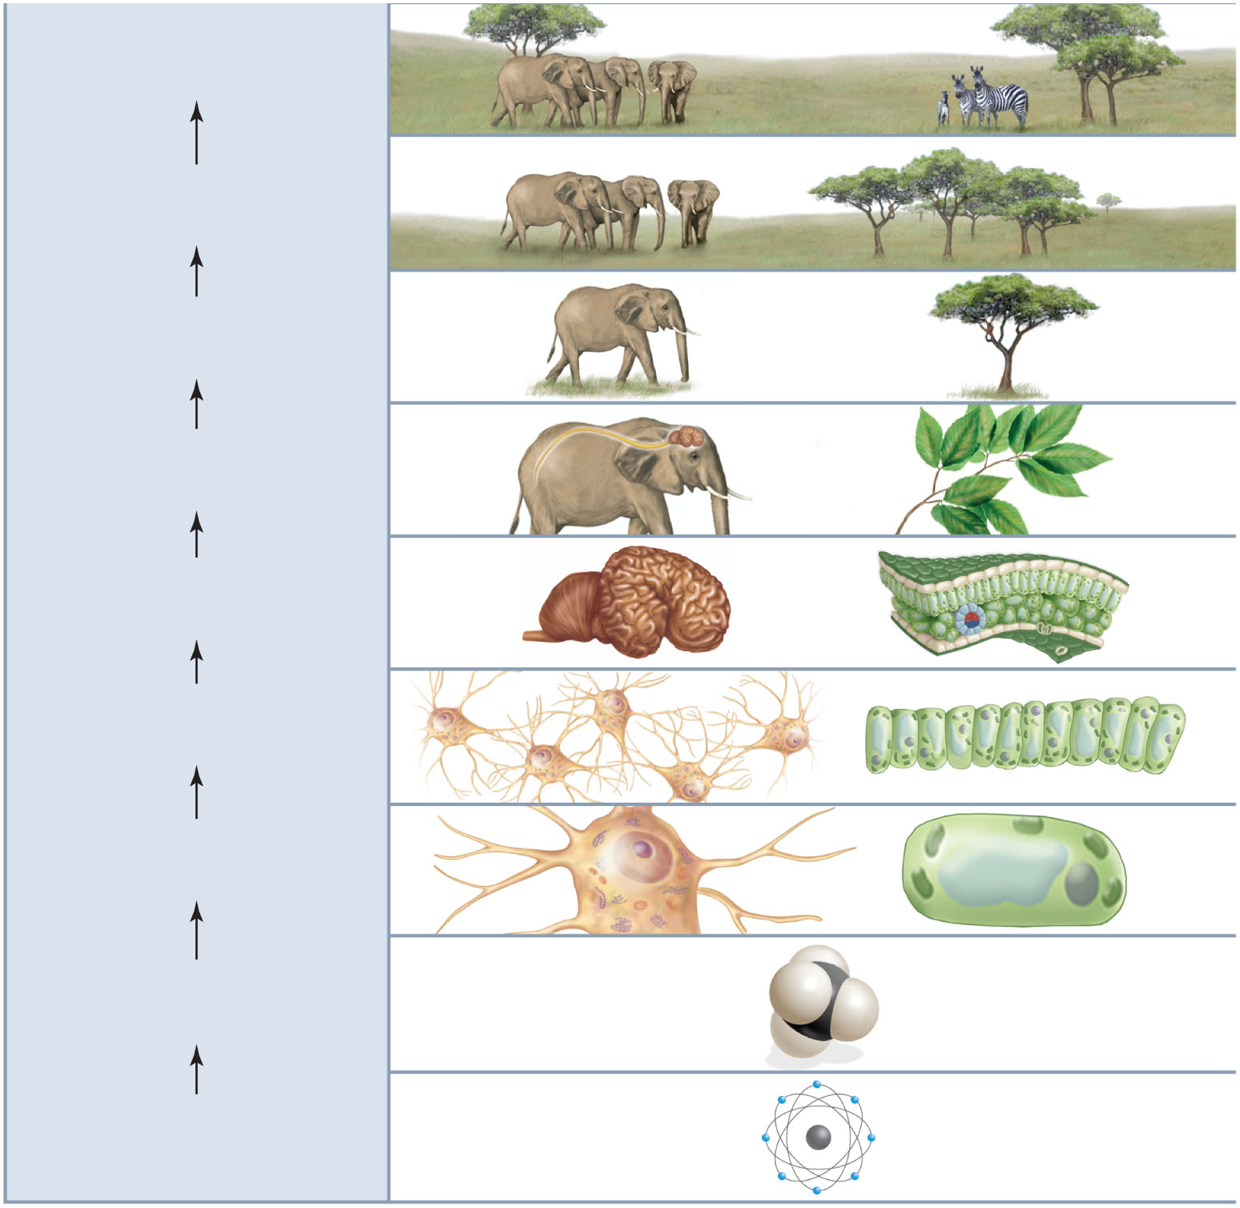
Copyright © The McGraw-Hill Companies, Inc. Permission required for reproduction or display.
Community
Interacting populations in a
particular area
Population
Organisms of the same
species in a particular area
Organism
An individual; complex
individuals contain organ systems
elephant
tree
Organ System
Composed of several organs
working together
nervous
system
shoot
system
Organ
Composed of tissues functioning
together for a specific task
leaves
the brain
Tissue
A group of cells with a common
structure and function
nervous tissue
leaf tissue
Cell
The structural and functional
unit of all living things
nerve cell
plant cell
Molecule
Union of two or more atoms of
the same or different elements
methane
Atom
Smallest unit of an element composed
of electrons, protons, and neutrons
oxygen

Slide 16
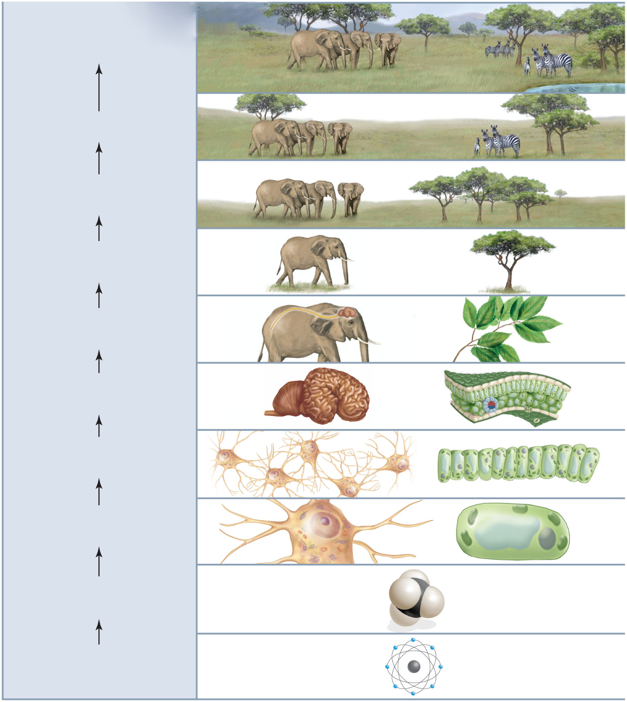
Copyright © The McGraw-Hill Companies, Inc. Permission required for reproduction or display.
Ecosystem
A community plus
the physical environment
Community
Interacting populations in a
particular area
Population
Organisms of the same
species in a particular area
Organism
An individual; complex
individuals contain organ systems
elephant
tree
Organ System
Composed of several organs
working together
nervous
system
shoot
system
Organ
Composed of tissues functioning
together for a specific task
the brain
leaves
Tissue
A group of cells with a common
structure and function
nervous tissue
leaf tissue
Cell
The structural and functional
unit of all living things
nerve cell
plant cell
Molecule
Union of two or more atoms of
the same or different elements
methane
Atom
Smallest unit of an element composed
of electrons, protons, and neutrons
oxygen

Slide 17
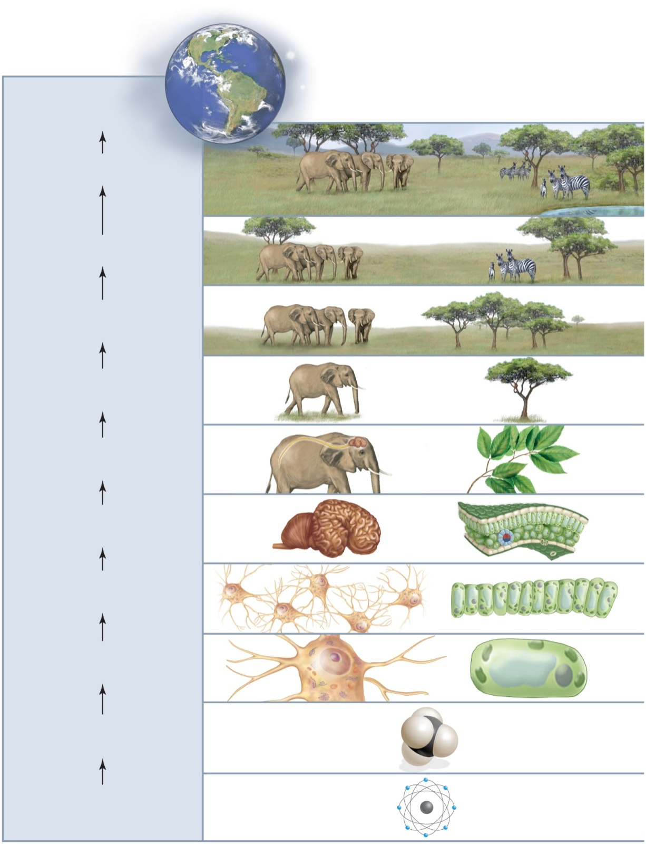
Copyright © The McGraw-Hill Companies, Inc. Permission required for reproduction or display.
Biosphere
Regions of the Earth’s crust,
waters, and atmosphere
inhabited by living things
Ecosystem
A community plus
the physical environment
Community
Interacting populations in a
particular area
Population
Organisms of the same
species in a particular area
Organism
An individual; complex
individuals contain organ systems
elephant
tree
Organ System
Composed of several organs
working together
nervous
system
shoot
system
Organ
Composed of tissues functioning
together for a specific task
the brain
leaves
Tissue
A group of cells with a common
structure and function
nervous tissue
leaf tissue
Cell
The structural and functional
unit of all living things
nerve cell
plant cell
Molecule
Union of two or more atoms of the same or different elements
methane
Atom
Smallest unit of an element composed of electrons, protons,
and neutrons
oxygen

Slide 18
How the Biosphere Is Organized
The biosphere is the zone of air, land, and water where organisms exist.
An ecosystem is community plus its physical environment.
A community is a collection of interacting populations within the same environment.
A population is all the members of a species within an area.
A group of similar, interbreeding organisms is a species. (Not a level of organization.)

Slide 19
How the Biosphere Is Organized
An organism is formed when organ systems are joined together.
Organs work together to form organ systems.
Tissues make up organs.
Similar cells combine together to form tissues.
Molecules join to form larger molecules within a cell.
Atoms combine to form molecules.
The organization of life begins with atoms.

Slide 20
Characteristics of Life
2. Life requires materials and energy.
  Energy is the capacity to do work.
    Energy is required to maintain organization and conduct life-sustaining processes such as chemical reactions.
      Metabolism is all the chemical reactions that occur in a cell.
    The sun is the ultimate source of energy for nearly all life on Earth.
      Plants, algae, and some other organisms capture solar energy and perform photosynthesis.
      Photosynthesis is a process that converts solar energy into the chemical energy of carbohydrates.

Slide 21
Ecosystems
Ecosystems are characterized by chemical cycling and energy flow.
  Chemicals are not used up when organisms die.
    Chemicals move from one population to another in a food chain.
    Example: Chemicals move from producers to consumers to decomposers.
    As a result of death and decomposition, chemicals are returned to living plants.
  Energy from the sun flows through plants and other members of the food chain as one population feeds on another.
    Therefore, there must be a constant input of solar energy.

Slide 22
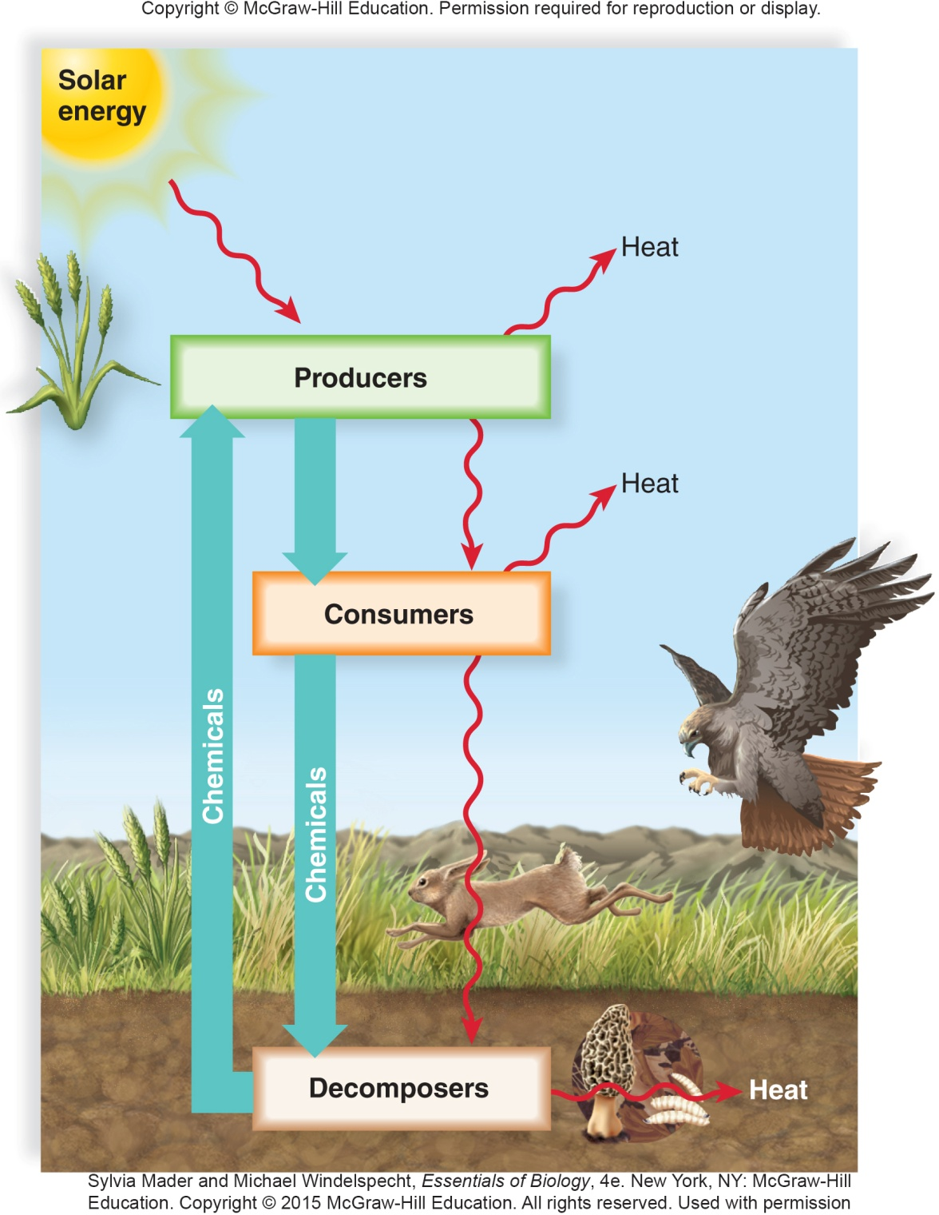

Slide 23
Characteristics of Life
3. Living things maintain homeostasis.
  Homeostasis is the maintenance of internal conditions within certain boundaries.
    It is imperative than an organism maintain a state of biological balance.
    Feedback systems monitor internal conditions and make adjustments.
4. Living things respond to stimuli.
  Living things interact with the environment and respond to changes in the environment.
    The ability to respond often produces movement.

Slide 24
Characteristics of Life
5. Living things reproduce and develop.
  All living organisms must reproduce to maintain a population.
  The manner of reproduction varies among different organisms.
  When organisms reproduce, they pass on copies of their genetic information (genes) to the next generation.
    Genes determine the characteristics of an organism.
    Genes are composed of DNA (deoxyribonucleic acid).

Slide 25
Characteristics of Life
6. Living things have adaptations.
  An adaptation is any modification that makes an organism better able to function in a particular environment.
  The diversity of life exists because over long periods of time, organisms respond to changing environments by developing new adaptations.
  Evolution is the change in a population of organisms over time to become more suited to the environment.

Slide 26
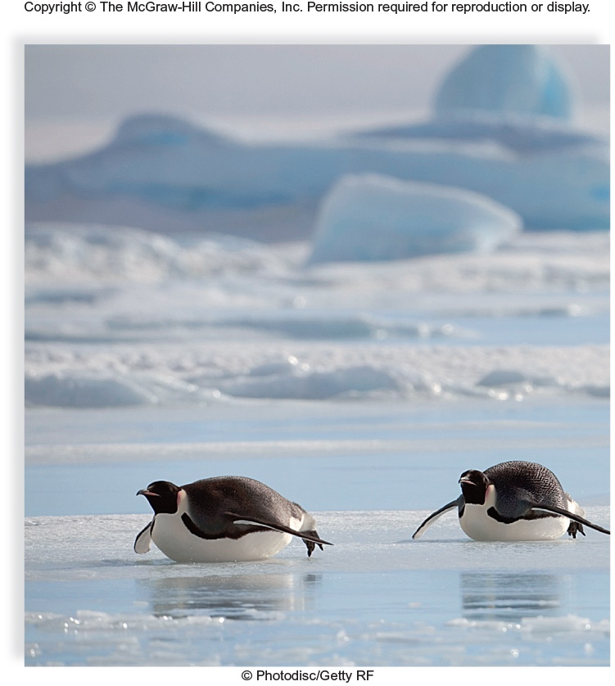
Notes:
I made this figure as a draft. I could replace it by a better one or if you do have a similar figure add it here.

