Slide 2
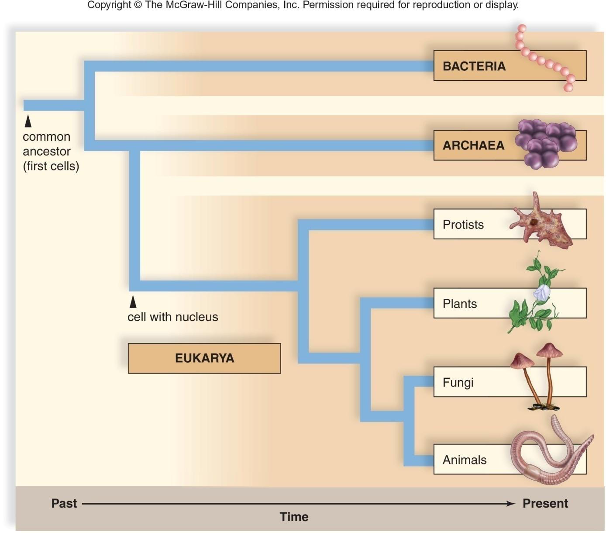
Evolutionary Tree of Life
An evolutionary tree is like a family tree. An evolutionary tree traces the ancestry of life on Earth to a common ancestor.

Slide 3
Copyright © The McGraw-Hill Companies, Inc. Permission required for reproduction or display.
common
ancestor
(first cells)

Slide 4
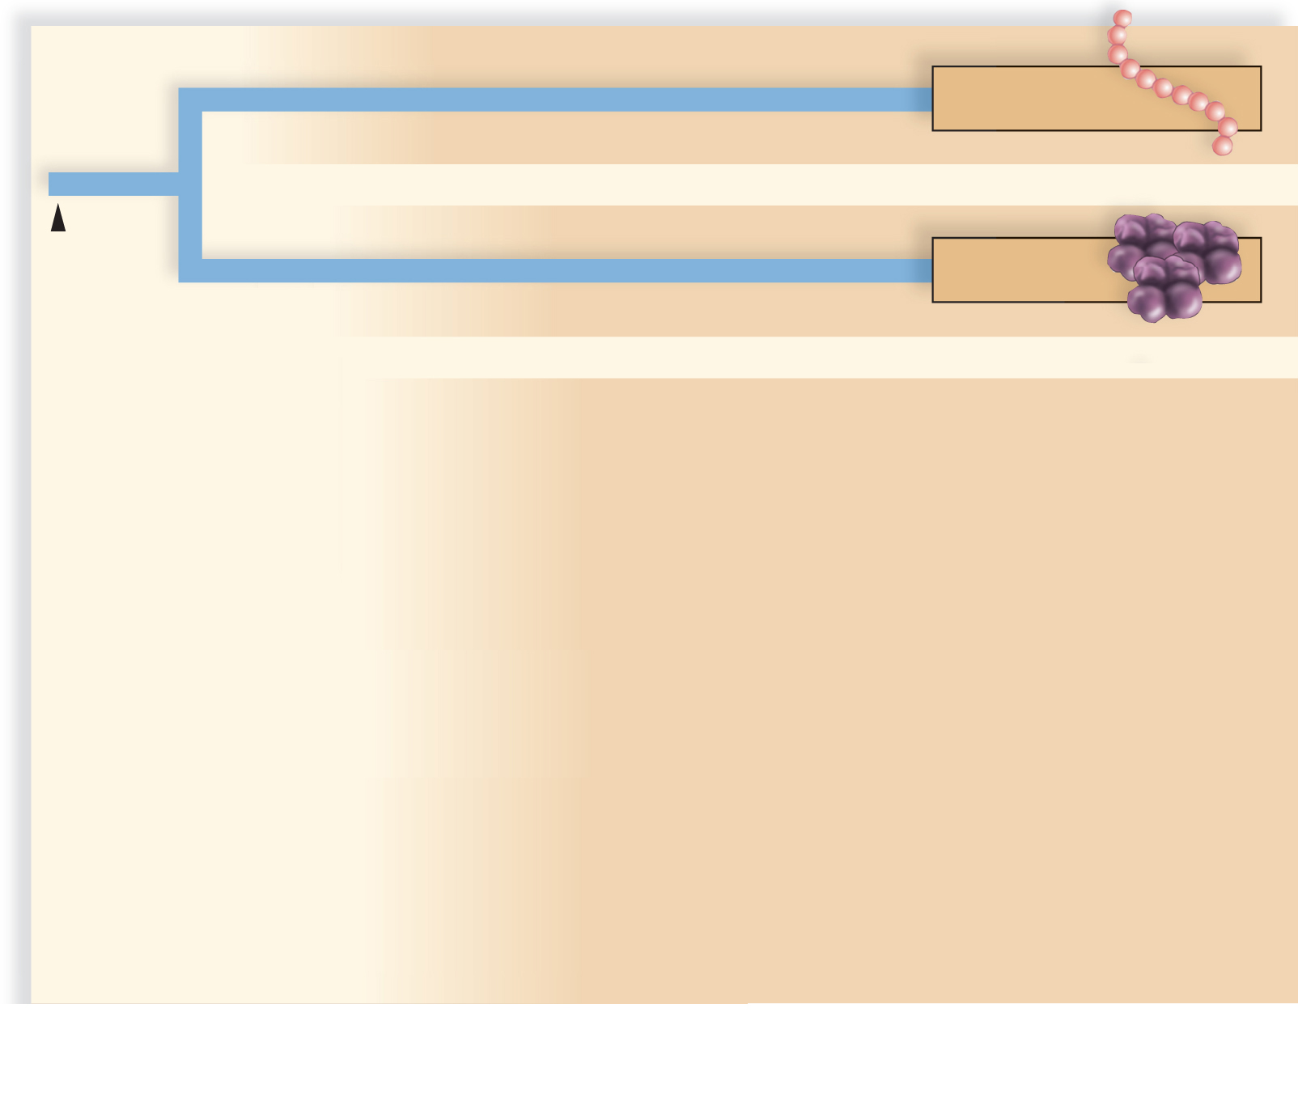
Copyright © The McGraw-Hill Companies, Inc. Permission required for reproduction or display.
BACTERIA
common
ancestor
(first cells)
ARCHAEA

Slide 5
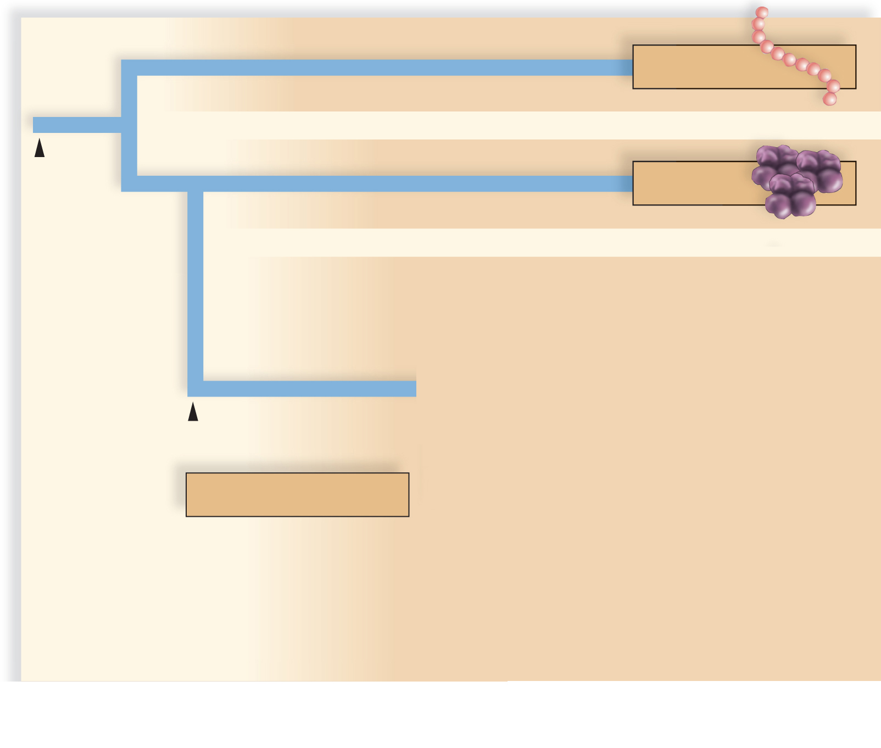
Copyright © The McGraw-Hill Companies, Inc. Permission required for reproduction or display.
BACTERIA
common
ancestor
(first cells)
ARCHAEA
cell with nucleus
EUKARYA

Slide 6
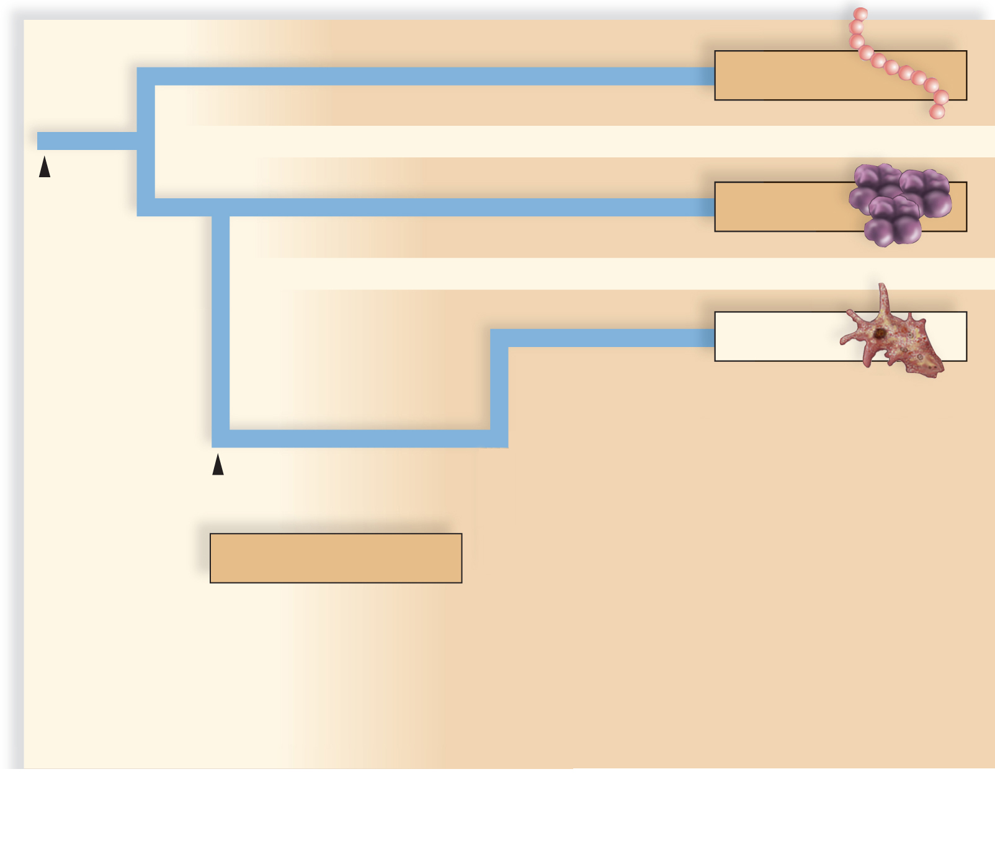
Copyright © The McGraw-Hill Companies, Inc. Permission required for reproduction or display.
BACTERIA
common
ancestor
(first cells)
ARCHAEA
Protists
cell with nucleus
EUKARYA

Slide 7
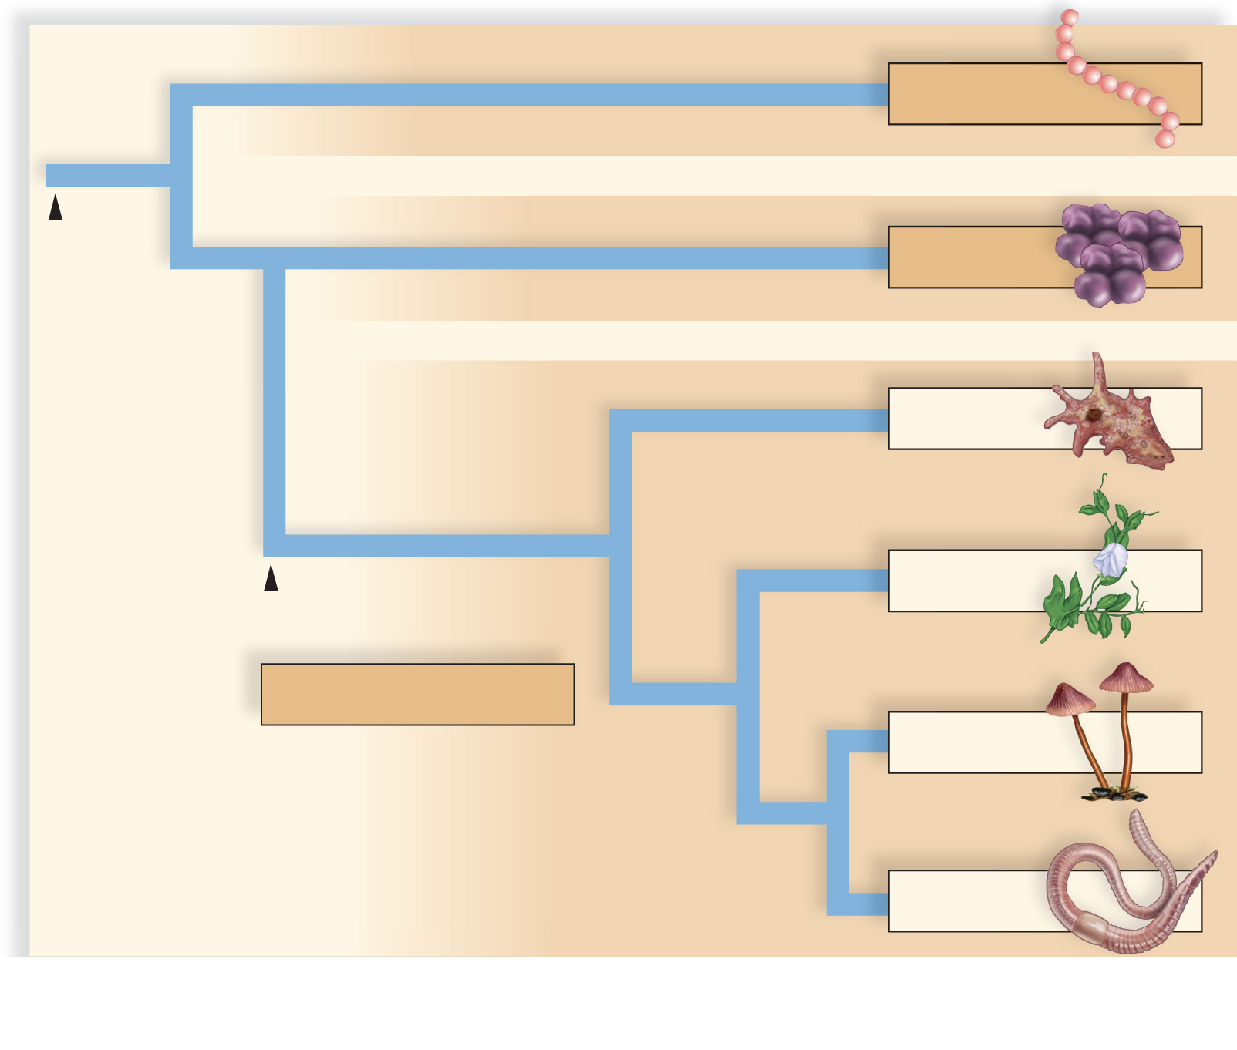
Copyright © The McGraw-Hill Companies, Inc. Permission required for reproduction or display.
BACTERIA
common
ancestor
(first cells)
ARCHAEA
Protists
Plants
cell with nucleus
EUKARYA
Fungi
Animals

Slide 8
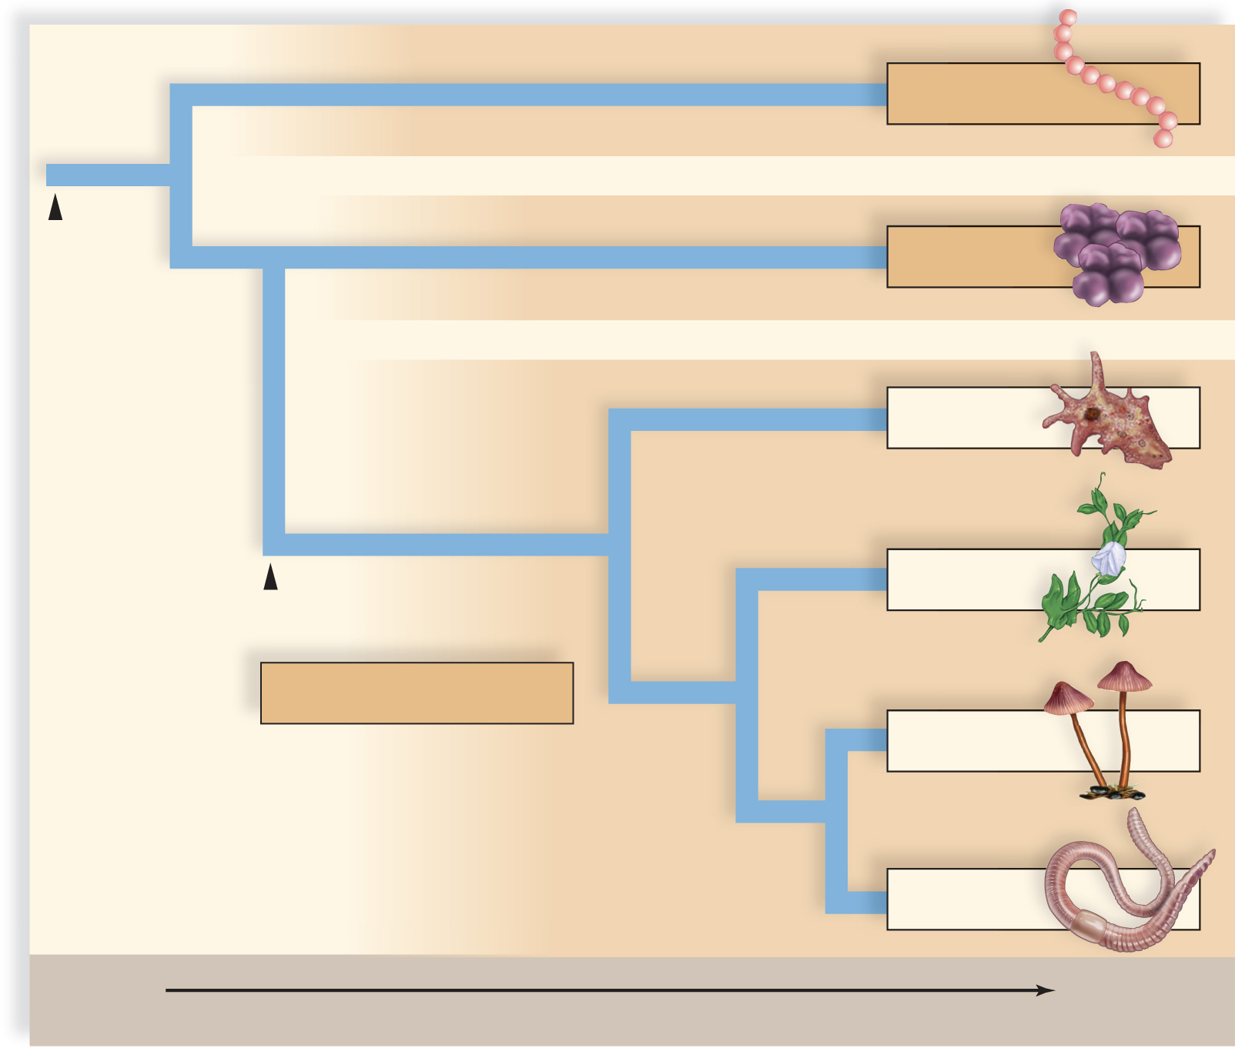
Copyright © The McGraw-Hill Companies, Inc. Permission required for reproduction or display.
BACTERIA
common
ancestor
(first cells)
ARCHAEA
Protists
Plants
cell with nucleus
EUKARYA
Fungi
Animals
Past
Present
Time

Slide 9
Organizing Diversity
Taxonomy is the discipline of biology that identifies, names, and classifies organisms according to certain rules.
Systematics is the study of evolutionary relationships between organisms.
Classification categories
From least inclusive category (species) to most inclusive category (domain):
Species, genus, family, order, class, phylum, kingdom, and domain
Each successive category above species includes more types of organisms than the preceding one.

Slide 10
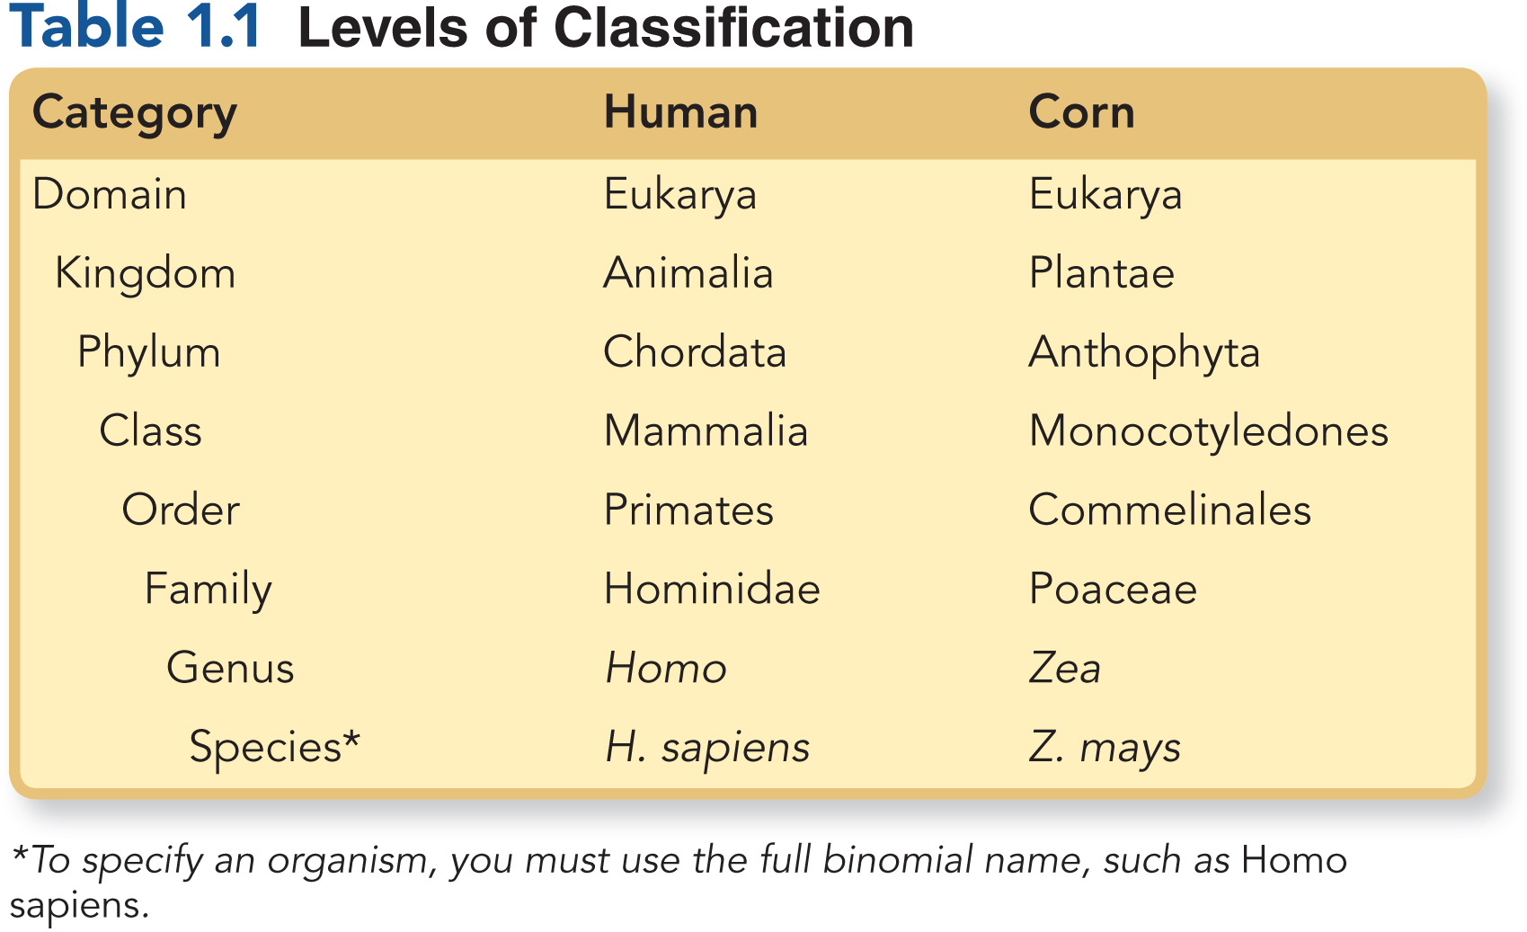
Levels of Classification

Slide 11
Domains
Domain Archaea
Contains unicellular prokaryotes that live in extreme environments probably similar to the primitive earth
Prokaryotes lack a membrane-bound nucleus.
Domain Bacteria
Contains unicellular prokaryotes that live in all environments including on our skin and in our mouths and intestines
Domain Eukarya
Contains unicellular and multicellular eukaryotes
Eukaryotes contain a membrane-bound nucleus.

Slide 12
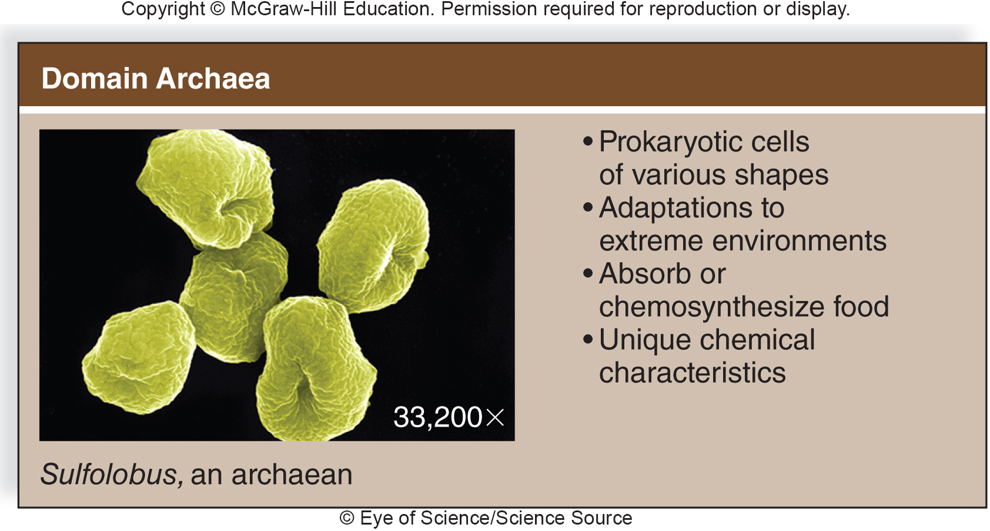

Slide 13
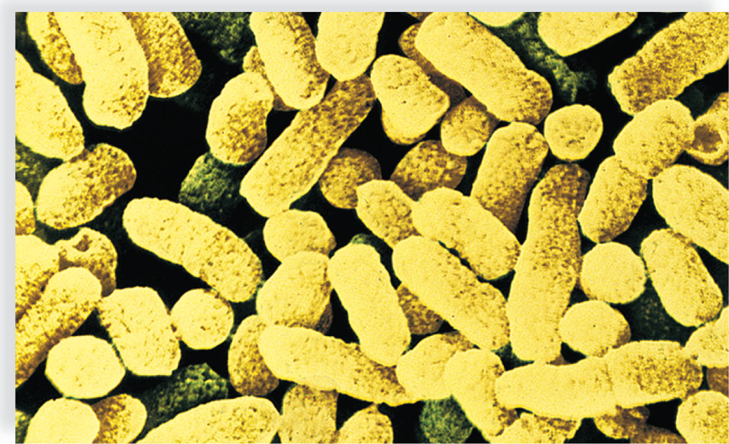
Domain Bacteria
Copyright © The McGraw-Hill Companies, Inc. Permission required for reproduction or display.
Prokaryotic cells of various shapes
Adaptations to all environments
Absorb, photosynthesize, or chemosynthesize food
Unique chemical characteristics
Escherichia coli, a bacterium
6,600x
© A.B. Dowsett/SPL/Science Source

Slide 14
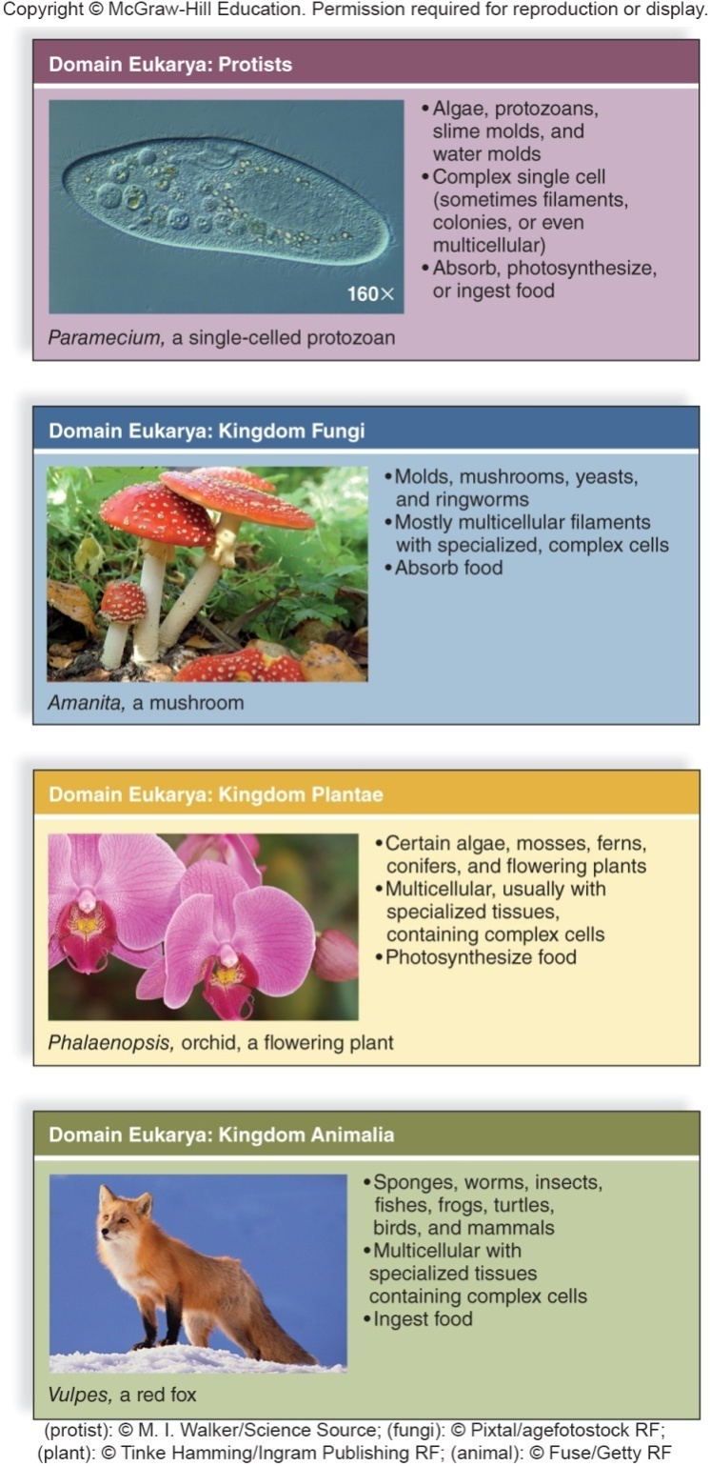
Domain Eukarya

Slide 15
Kingdoms
Domain Archaea – kingdom designations are being determined
Domain Bacteria – kingdom designations are being determined
Domain Eukarya
Protists (composed of several kingdoms)
Kingdom Fungi
Kingdom Plantae
Kingdom Animalia

Slide 16
Scientific Names
Universal
Latin-based
Binomial nomenclature
Two-part name
First word is the genus.
Always capitalized
Second word is the species designation (or specific epithet).
Written in lowercase
Both words are italicized.
Examples: Homo sapiens (humans), Zea mays (corn)

Slide 17
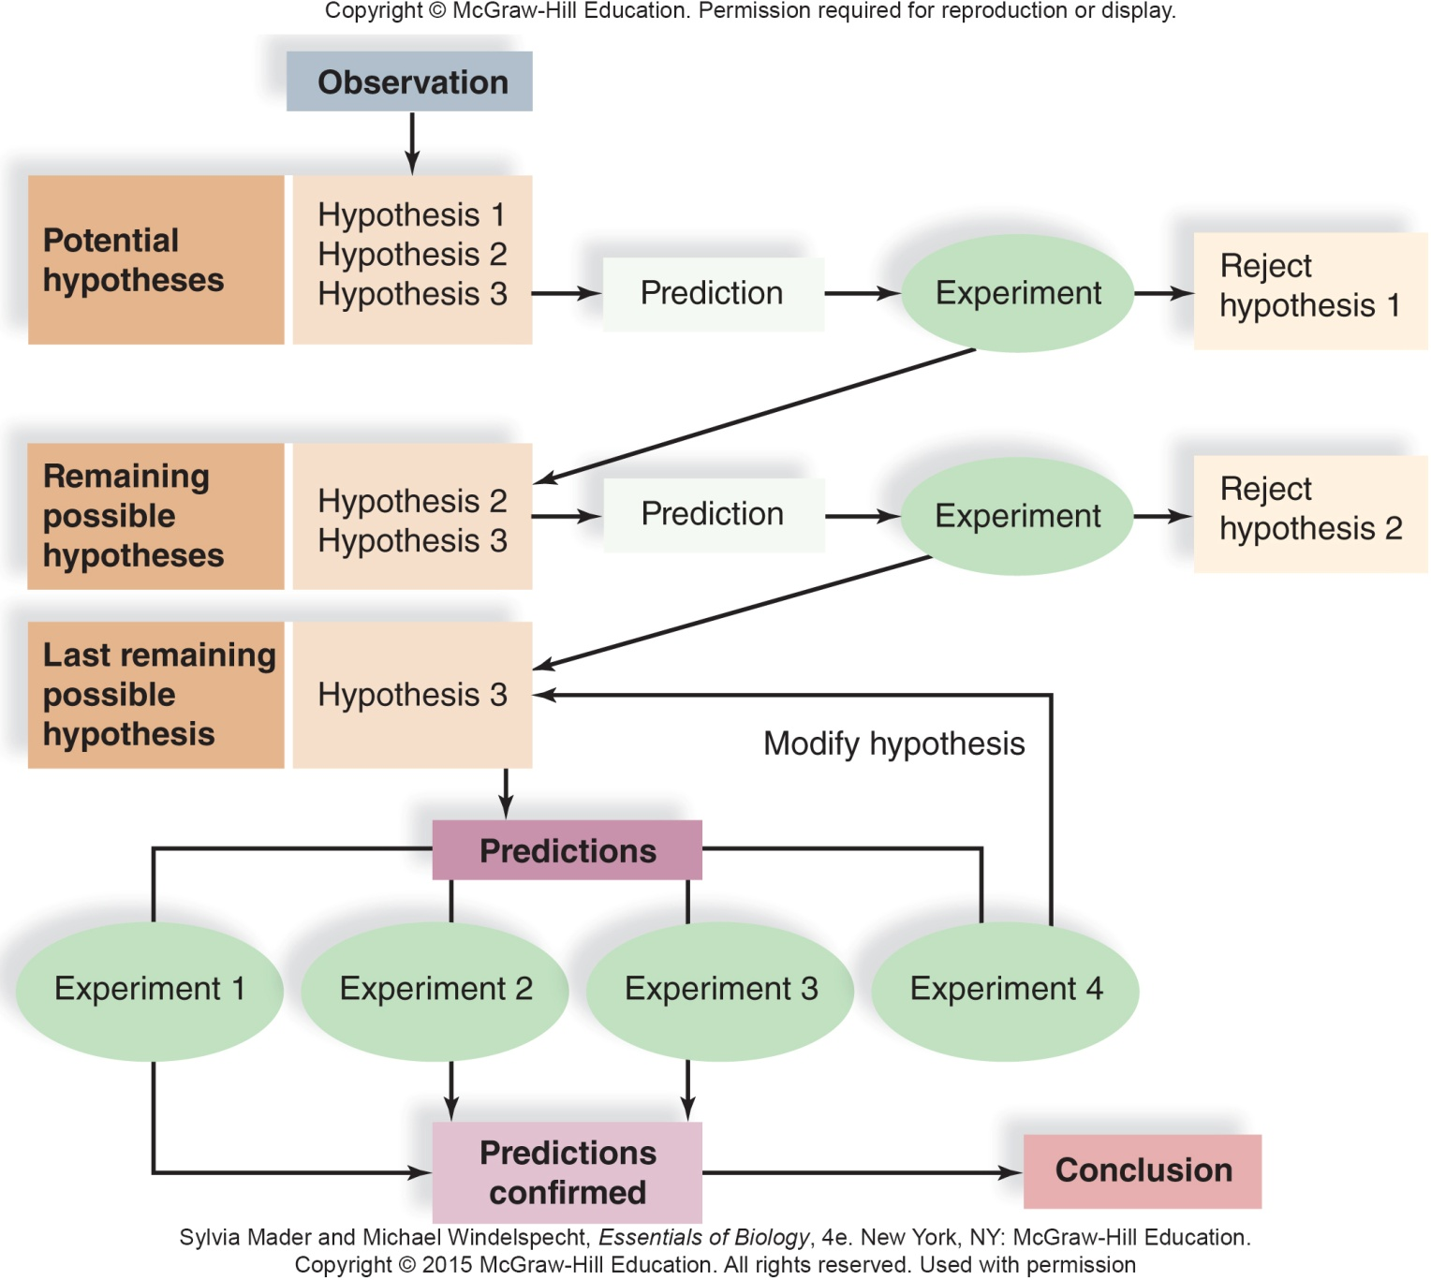

Slide 18
1.3 The Process of Science
The scientific method is a standard series of steps used in gaining new knowledge through research.
The scientific method can be divided into five steps:
Observation
Hypothesis
Predictions and Experiments
Data Collection with Statistical Analysis
Conclusion

Slide 19
The Scientific Method
1. Observation
Scientists use their senses to gather information about a phenomenon or natural event.
2. Hypothesis
A hypothesis is a tentative explanation for what was observed.
An example is the discovery of the antibiotic penicillin.
It is developed through inductive reasoning.
It is testable.

Slide 20
The Scientific Method
3. Predictions and Experiments
An experiment is a series of procedures designed to test a hypothesis.
It utilizes deductive reasoning to make a prediction or expected outcome.
The manner in which a scientist conducts an experiment is called the experimental design.
A good experimental design ensures that the scientist is examining the contribution of a specific factor called the experimental (independent) variable to the observation.
The experimental variable is the factor being tested.

Slide 21
The Scientific Method
3. Experiments (cont’d)
A test group is exposed to the experimental variable.
A control group goes through all aspects of the experiment but is not exposed to the experimental variable.
If the control and test groups show the same results, the hypothesis is not supported
4. Data
The data are the results of an experiment.
Should be observable and objective

Slide 22
The Scientific Method
4. Data (cont’d)
Tables and graphs are two possible formats for the data.
Data are analyzed using statistics.
Measures of variation
Standard error: How far off the average of the data is
Statistical significance
Probability value (p)
Less than 5% is acceptable (p<0.05)
The lower the p value, the greater the confidence in the results
Not due to chance alone

Slide 23
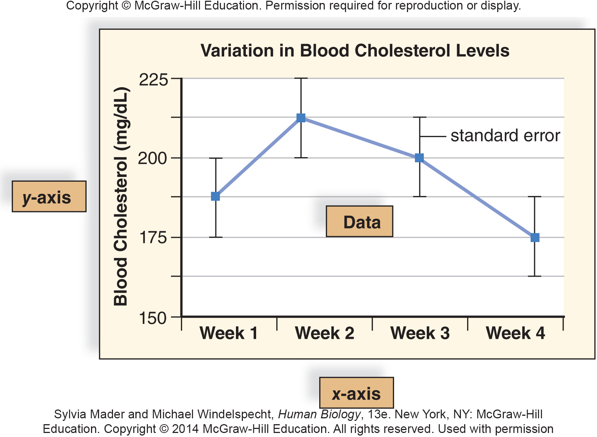

Slide 24
The Scientific Method
5. Conclusion
The data are interpreted to determine whether the hypothesis is supported or not.
If prediction happens, hypothesis is supported.
If not, hypothesis is rejected.
Findings are reported in scientific journals.
Peers review the findings.
Other scientists then attempt to duplicate or dismiss the published findings.

Slide 25
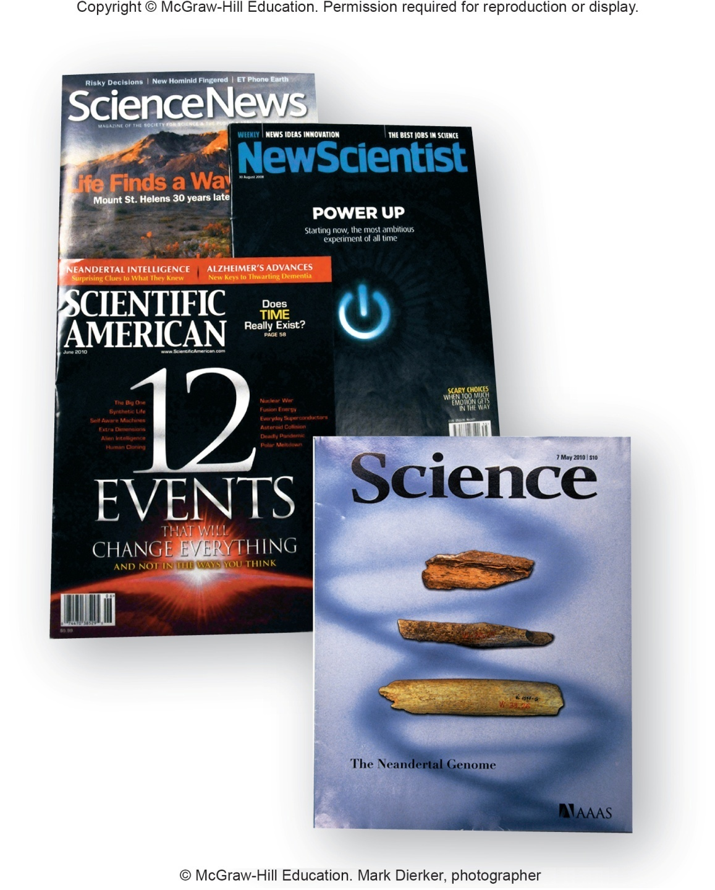

Slide 26
Scientific Theory
Scientific Theory:
Concepts that join together two or more well-supported and related hypotheses
Supported by broad range of observations, experiments, and data
Scientific Principle / Law:
Widely accepted set of theories
No serious challenges to validity

Slide 27
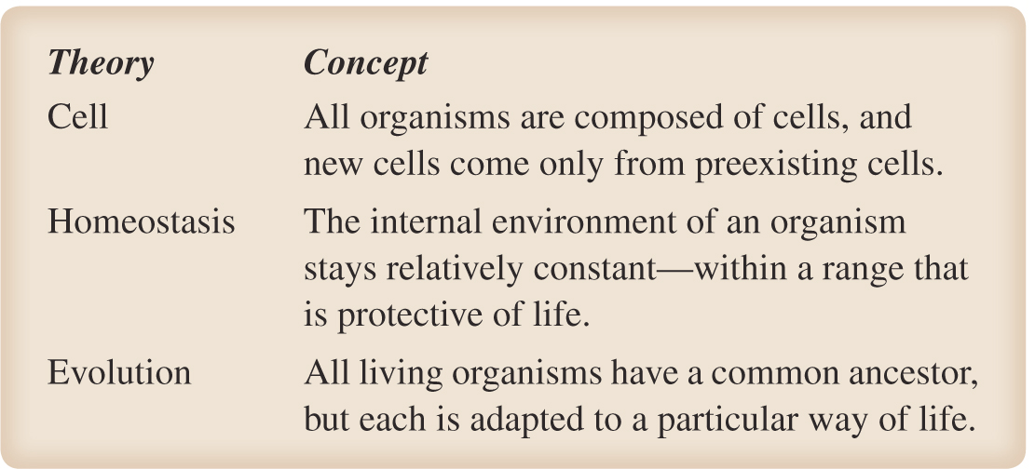
Basic Theories of Biology
Notes:
I made this figure as a draft. I could replace it by a better one or if you do have a similar figure add it here.

Slide 29
Experimental Design
Hypothesis:
Newly discovered antibiotic B is a better treatment
for ulcers than antibiotic A, in current use.
Experimental Design:
One control group includes subjects with ulcers who are untreated by antibiotics.
Two test groups are subjects with ulcers who are treated with either antibiotic A or B.

Slide 30
Experimental Design
Results and Conclusion:
An endoscopy (procedure that allows doctors to examine the linings of the throat, stomach and upper small intestine to check for ulcers) is performed on all subjects.
The investigators then use statistics to determine the effectiveness of the various treatments.
On the basis of the data, the investigators conclude that their hypothesis has been supported.

Slide 31
1.4 Challenges Facing Science
Science is a systematic way of acquiring knowledge about the natural world.
Technology is the application of scientific knowledge to the interests of humans.
Examples: cell phone, new drug, others?

Slide 32
Biodiversity and Habitat Loss
Biodiversity is the total number and relative abundance of species, the variability of their genes, and the ecosystems in which they live.
Estimated to be as high as 15 million species
Less than 2 million have been named and identified
Extinction is the death of the last member of a species or larger classification category.
Estimates of 400 species/day lost due to human activities

Slide 33
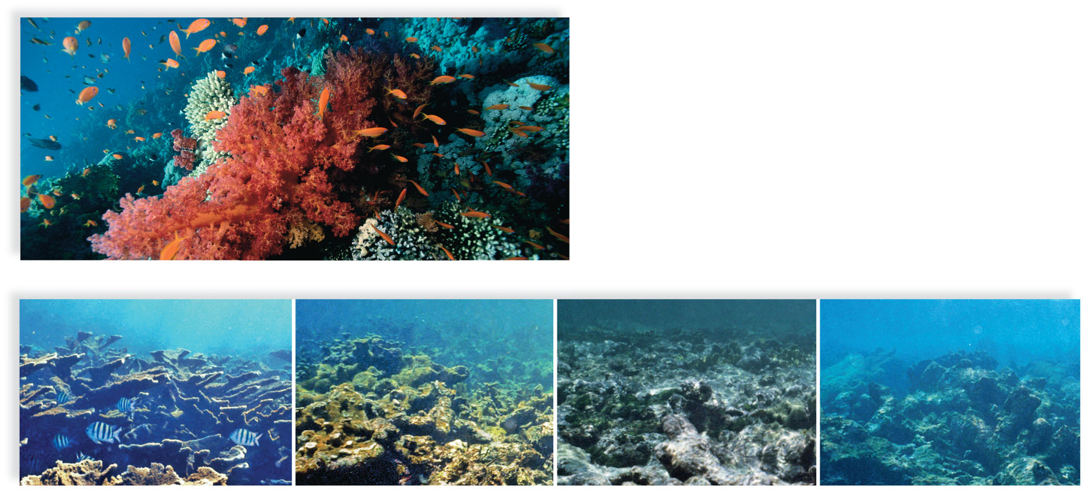
The Effect of Human Activities on Coral Reefs
Copyright © The McGraw-Hill Companies, Inc. Permission required for reproduction or display.
a. Healthy coral reef
1975 Minimal coral death
1985 Some coral death
With no fish present
1995 Coral bleaching with
limited chance of recovery
2004 Coral is black from
sedimentation; bleaching
still evident
b.
1.15a: © Frank & Joyce Burek/Getty RF; 1.15b: © Dr. Phillip Dustan

Slide 34
Biologically Diverse Ecosystems Are in Danger
Tropical rain forests and coral reef ecosystems are home to many organisms.
Both ecosystems are threatened by human activities.
The canopy of the tropical rain forest supports orchids, insects, and monkeys, among other organisms.
Coral reefs provide habitats for jellyfish, sponges, crabs, lobsters, sea turtles, moray eels, and fishes.

Slide 35
Destruction of Healthy Ecosystems Has Unintended Consequences
Humans depend upon healthy ecosystems for:
Food
Medicines
Raw materials
Draining of wetlands of Mississippi and Ohio Rivers:
Worsened flooding
Ruined farmland
Destruction of South American rain forests:
Killed species
Decreased availability of lumber

Slide 36
Emerging Diseases
Over the past decade several new disease have been in the news:
H5N1
H7N9
SARS
Ebola
Where do emerging diseases come from?
New or increased exposure to insects or animals
Changes on behaviors
Use of technology (Legionnaires’ disease)
Globalization
Pathogens mutating and changing hosts (avian flu)

Slide 37
Climate Change
Changes in normal cycles of Earth’s climate attributable to human activities
Due to imbalance in chemical cycling of carbon
More carbon is being released than removed.
Burning of fossil fuels
Destruction of forests and replacement by farmland
Increase in CO₂ causes temperature increases, called global warming.
Produced by greenhouse effect
Global warming is changing Earth’s ecosystems

