Slide 1
South Winneshiek Track and Field 200-400-800 Runners
Kevin Kearney
kkearney@swinn.k12.ia.us

Slide 2
For a PDF Copy of the Packet I handed out, you can find it on my classroom website- Google: Kearney Unweaving Rainbow - I believe it is the first site to come up. Weebly. Go to Track & Field Tab Document is posted- 2019 NHSACA

Slide 3
Key Thoughts
General Background Information
General Philosophies.
Training 200-400-800 athletes – Less is More
Using common “themes” in setting up training.

Slide 4
General Background
Started Coaching at South Winneshiek in 1994 as a volunteer
Started Cross Country Program from scratch in 1994
Head Girls Track Coach since 1995
180 kids in our school, grades 9-12
60 boys/girls participated in track this past spring = 30%
We run a “Co – Ed” Track team. I coach Sprints/Long Sprints 100-800
Co – Head CC Coach – Scott Conway. He is Head boys Track Coach.
We were college teammates at Wartburg

Slide 5
Some General Philosophical Positions
Coach the kids you have – not the kids you wish you had.
Individualized training, expectations and motivation based on Individual experience, ability and goals.
Not everyone wants to be a super star. Not everyone can be a superstar.
However, everyone can get better……. And, you never know when their best friend or little sister/brother might be a superstar ☺
The enemy of good and great is the quest for perfect
We want 100% of our kids at 95-97% of their potential. We don’t want 75% of our kids at 100% of their potential and 25% hurt, sick, breaking down.
We want great races, not great workouts. A great workout has the potential to destroy a season.

Slide 6
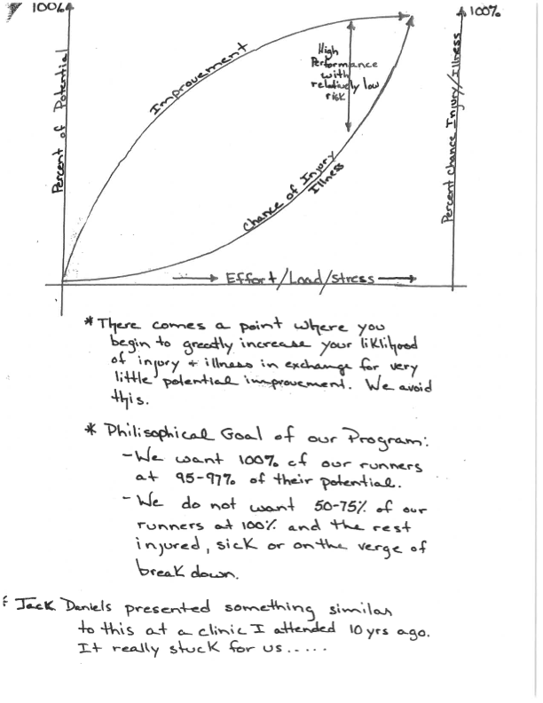

Slide 7
Less is more for the 200-400-800 Type
I was a distance runner in HS and in College.
I started my career as a “distance coach.”
In my experience, the “distance coach” mentality is not particularly effective when coaching sprinters, long sprinters and even for some 800 runners.
I highly recommend the products/programs from Complete Track and Field. In particular, Latif Thomas, Ron Grigg and Mark Mangiacotti. (Youtube or go to the CTF site).
Much of what we do is similar to or based on their programs and insight.
There are others that recommend similar philosophy... But they present the information very well.
That is the best place to get “details” in regard to program design.

Slide 8
Less is more for the 200-400-800 Type
It can be very difficult as a distance runner/distance coach to come to grips with the fact that 8-12 x 30 meters @100% with 3-5 minutes rest, or 4-6 x 150 @90-95% w/3-5 min. rest are “Hard” workouts.
High Quality, Lower Volume, More Recovery.
Learn and use Energy Systems when setting up workouts – Purpose.
Most meets don’t matter – USE them as Special Endurance Workouts
Combinations of 200/400’s, sometimes close together.
Emphasis on speed from the beginning.
You can’t run a longer distance fast if you can’t run a shorter distance fast.

Slide 9
Less is more for the 200-400-800 Type
I am not saying that 800 runners should never run “distance” type workouts. In my opinion, the very best 800 runners generally tend to come from a distance background.
What I am saying is there are “long sprinters” who can make very good 800 runners (V-ball, F-ball, B-ball kids). These kids can contribute to your depth and relays. In a small school, you have to get these types of kids to field good relays.
These kids can often get there in less traditional ways.
Long runs and volume tends to trash them….. Build on their speed and strength.

Slide 10
Two Roads to the Same Destination
More traditional “distance” 800 types. Normal “distance base.”
“Long Sprinter” 800 types who never went on a 20—30 minute “run.”
Heather = 2:20
Amber = 2:20
Marissa = 2:18
Ashley = 2:22
Angie = 2:22
Felicity =2:20
Josie = 2:18
Jill = 2:19
Brittany = 2:20
Bridget = 2:18
Shannon = 2:22
Elise = 2:21
Ivy = 2:22
Kelly = 2:23

Slide 11
Two Roads to the Same Destination
More traditional “distance” 800 types. Normal “distance base.”
“Long Sprinter” 800 types who never went on a 20—30 minute “run.”
Brian = 1:57
Dan = 1:52
Rob = 1:58
Devin = 1:58
Adam = 1:59
Brett = 1:59
Josh = 1:58
Eric = 1:58
Bryan = 1:59
Nic = 1:58
Lee = 1:59
Phil = 1:57
Ben =2:00
Jayden =1:59

Slide 12
The Lesson?
Simple – Neither of those groups would have been as successful at the 800 trying to train in the way the other group did.
I think we all know and agree that there are different ways programs can be successful. We all know “that one coach” who “does it wrong” but, there they are being successful at the end of the year…..
If different programs can succeed with different strategies, why not employ multiple strategies on your own team toward the same end?
We basically doubled the number of good 800 runners we have had by using multiple strategies with different types of runners.
But…….. It can be difficult coordinating all of this…..

Slide 13
Training Your Team On Consistent Themes
What?
Everyone, 100 – 3000, has a similar themed workout on the same day.
Not the SAME WORKOUT….. The SAME THEME.
Why?
Small school, limited staff, making the most of athletes we have.
This allows us to move kids between groups (800 runners might be with distance kids for a threshold workout one day and sprinters for speed endurance the next day).
This prevents kids from getting too much of one theme and not enough of another. Prevents them from missing their recovery days.

Slide 14
Our General Training Themes – Typical Week
Monday - Power/Speed/Acceleration
Tuesday - Tempo (Ext./Int. Tempo for Sprinters, VO2 Max for Distance)
Wednesday – Recovery
Thursday – Threshold (distance)/ Critical Velocity 10K pace (800 runners)/ Tempo for sprinters
Friday – Speed Endurance/Special Endurance/ (MEET)
Saturday – Stregth/Endurance
*** See Descriptions in Packet/PDF Handout for a bit more detail
The closer to 100 or 3000, the less we might blend these workouts

Slide 15
RED = SPECIAL ENDURANCE/RACES/MEETS
PINK = SPEED/SPEED ENDURANCE (100-200-400 PACE)
ORANGE = INTENSIVE TEMPO (80-90% 400 PACE, OR 800-1500 RACE PACE)
YELLOW = EXTENSIVE TEMPO (70-80% 400 PACE, OR 3K-5K RACE PACE …VO2)
WHITE = CRITICAL VELOCITY (10K PACE, ENDURANCE WORK FOR 800 RUNNERS)
BLUE = THRESHOLD PACE FOR DISTANCE RUNNERS, 60-70% FOR 400 RUNNERS
GREEN = AEROBIC, EASY, RECOVERY

Slide 16
Sunday | Monday | Tuesday | Wednesday | Thursday | Friday | Saturday
Easy/Off | Off | Ext. Temp 3-5K | Aerobic/Easy | TH Short | Long Hills | Easy/Off
Easy/Off | Speed | Int. Temp 8-15 | Aerobic/Easy | 10K/CV | Short Hills | Easy/Off
Easy/Off | Speed | Ext. Temp 3-5K | Aerobic/Easy | TH Short | Long Hills | Aerobic/Easy
Easy/Off | Premeet | Wartburg Indoor | Aerobic/Easy | 10K CV | Premeet | Luther Indoor
Easy/Off | Speed | Int. Temp 8-15 | TH SHort | Premeet | UIC Indoor | Aerobic/Easy
Easy/Off | Premeet | Sumner Fred | Aerobic/Easy | 10K CV | Short Hills | Ext. Temp 3-5K
Easy/Off | Premeet | Jesup | Aerobic/Easy | Premeet | Decorah | Aerobic/Easy
Easy/Off | Speed | 10K CV | Premeet | Decorah | Easy | Speed Endur
Easy/Off | Hudson | Aerobic/Easy | Premeet | North Fayette | Easy | Int. Temp 8-15
Easy/Off | Speed | Thold Short | Premeet | Crestwood | Easy | Speed Endur
Easy/Off | S. Winn | Aerobic/Easy | Premeet | UIC Outdoor | Easy | Int. Temp 8-15
Easy/Off | Speed | Thold Short | Premeet | State Qual. | Easy | Speed Endur
Easy/Off | Speed | Easy/Tempo | Premeet | State | State | State

Slide 17
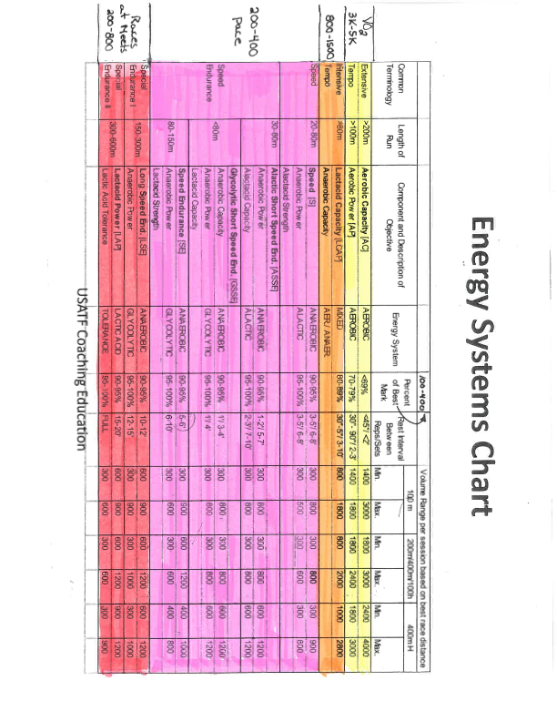

Slide 18
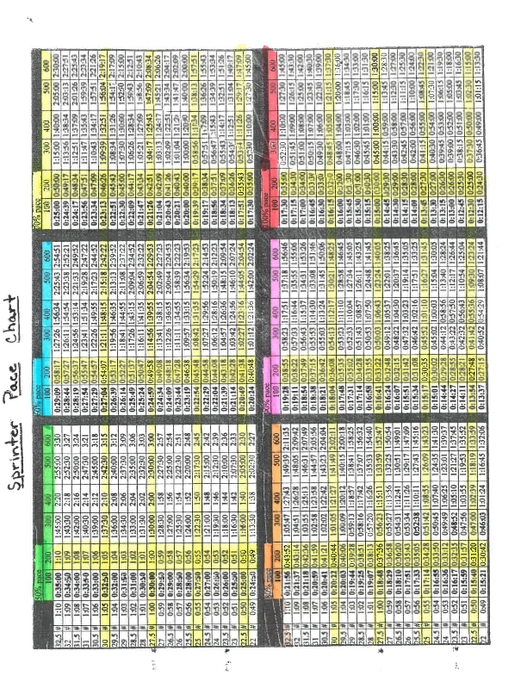

Slide 19
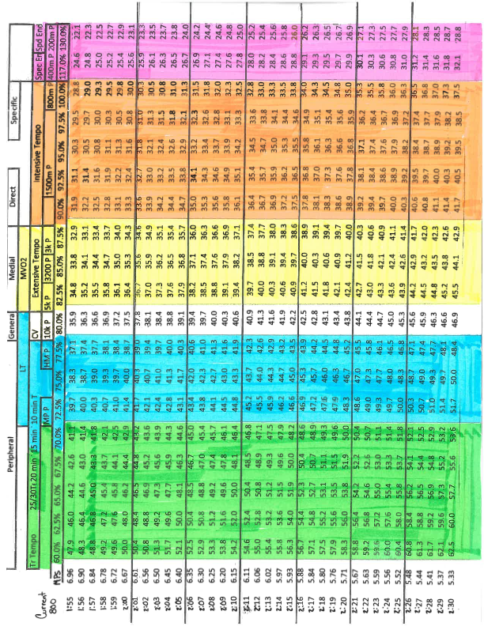

Slide 20
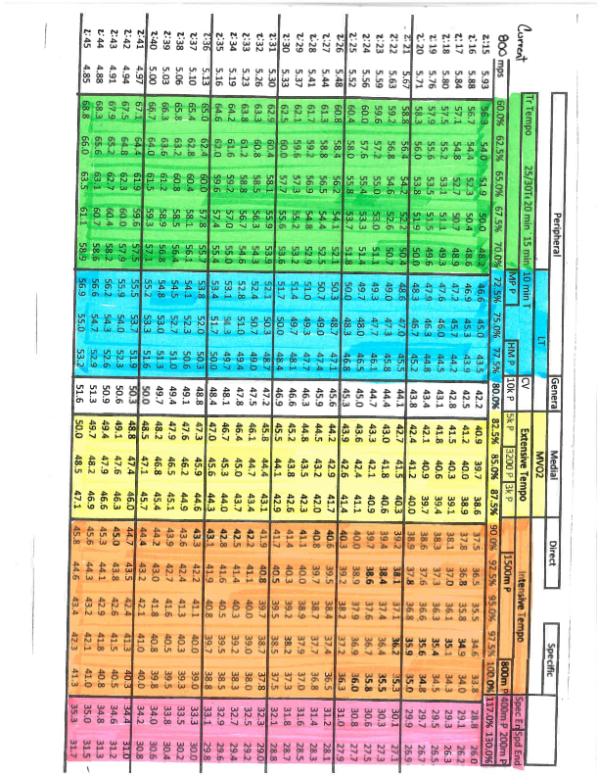

Slide 21
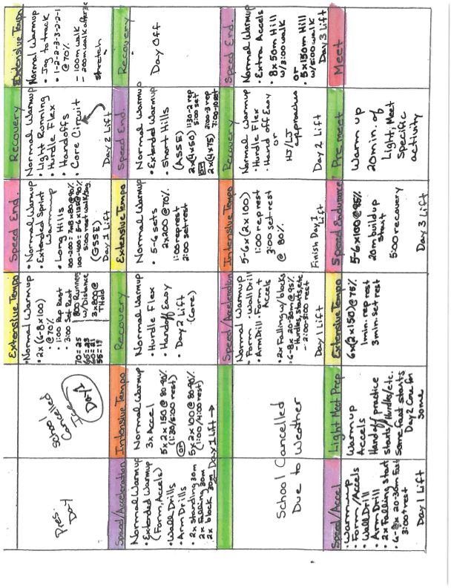

Slide 22
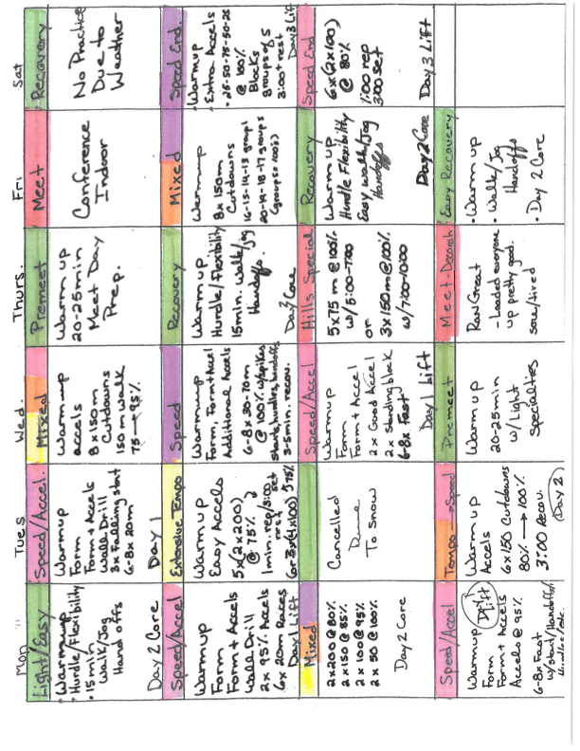

Slide 23
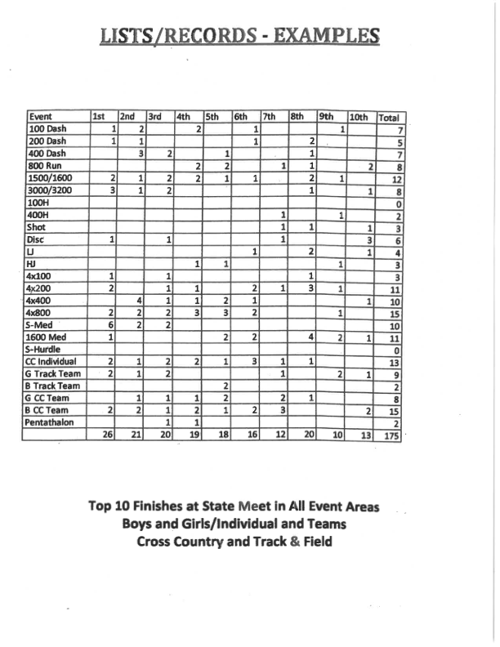

Slide 24
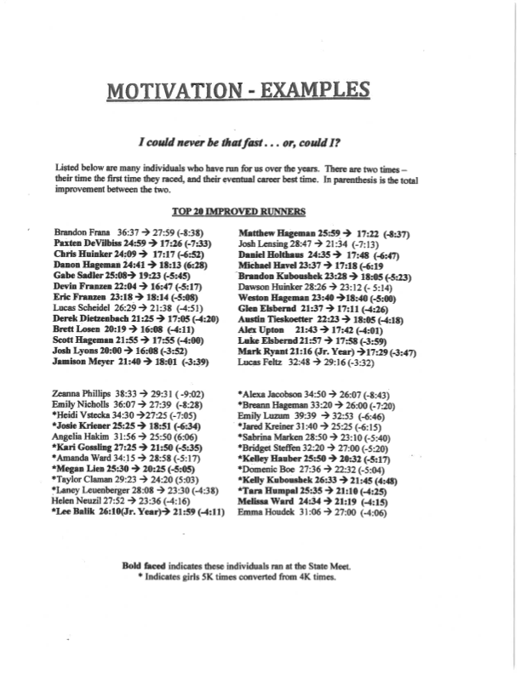

Slide 25
