Slide 1
Section 3: Communication in Science
Precise communication is crucial for scientists to share their results effectively with each other and with society.
K What I Know | W What I Want to Find Out | L What I Learned

Slide 2
Essential Questions
Why is precise communication crucial in science?
What are the differences between scientific theories and scientific laws?
When is it appropriate to use a graph or a model?
Copyright © McGraw-Hill Education
Communication in Science

Slide 3
Vocabulary
Review
hypothesis
New
scientific model
scientific theory
scientific law
Copyright © McGraw-Hill Education
Communication in Science

Slide 4
Communicating Results
Lab report
A written account of a lab is a lab report.
Communication in Science
Copyright © McGraw-Hill Education

Slide 5
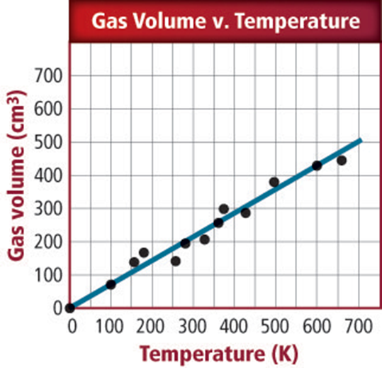
Communicating Results
Graphs
In line graphs, the independent variable is plotted on the horizontal (x) axis, and the dependent variable is plotted on the vertical (y) axis.
Copyright © McGraw-Hill Education
Communication in Science

Slide 6
Communicating Results
Graphs
Circle graphs show a fixed quantity using slices representing parts of the whole.
Bar graphs represent quantitative data using bars.
Copyright © McGraw-Hill Education
Communication in Science

Slide 7
How are graphs used to represent data?
Go to your ConnectED resources to play Virtual Lab: How are graphs used to represent data?
Copyright © McGraw-Hill Education
Communication in Science

Slide 8
Communicating Results
Models
A scientific model is an idea picture, a system, or a mathematical expression that represents the concept being explained.
Copyright © McGraw-Hill Education
Communication in Science

Slide 9
Theories and Laws
A scientific theory is an explanation based on many observations during repeated investigations.
A scientific law is a principle that describes the behavior of a natural phenomenon.
Copyright © McGraw-Hill Education
Communication in Science

Slide 10
Review
Essential Questions
Why is precise communication crucial in science?
What are the differences between scientific theories and scientific laws?
When is it appropriate to use a graph or a model?
Vocabulary
scientific model
scientific theory
scientific law
Copyright © McGraw-Hill Education
Communication in Science

