Slide 1

Section 2: Types of Maps
Maps are flat projections that come in many different forms.
K What I Know | W What I Want to Find Out | L What I Learned

Slide 2
Essential Questions
What are the different types of maps?
Why are different maps used for different purposes?
How are gradients on a topographic map calculated?
Copyright © McGraw-Hill Education
Types of Maps

Slide 3
Vocabulary
Review
parallel
New
Mercator projection
conic projection
gnomonic projection
topographic map
contour line
contour interval
geologic map
map legend
map scale
Copyright © McGraw-Hill Education
Types of Maps

Slide 4
Projections
Cartographers use projections to make maps. A map projection is made by transferring points and lines on a globe’s surface onto a sheet of paper.
Types of Maps
Copyright © McGraw-Hill Education

Slide 5
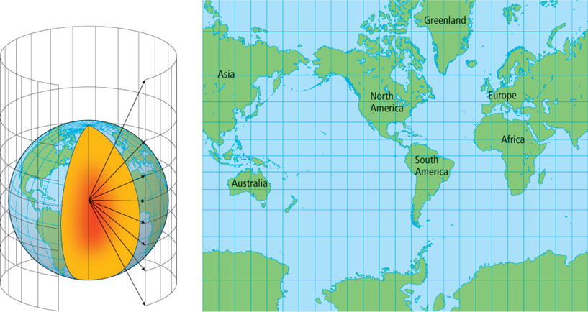
Projections
A Mercator projection is a map that has parallel lines of latitude and longitude.
It clearly indicates direction in straight lines.
It is used for the navigation of ships and planes.
Copyright © McGraw-Hill Education
Types of Maps

Slide 6
Map Projections
Go to your ConnectED resources to play Animation: Map Projections.
Copyright © McGraw-Hill Education
Types of Maps

Slide 7
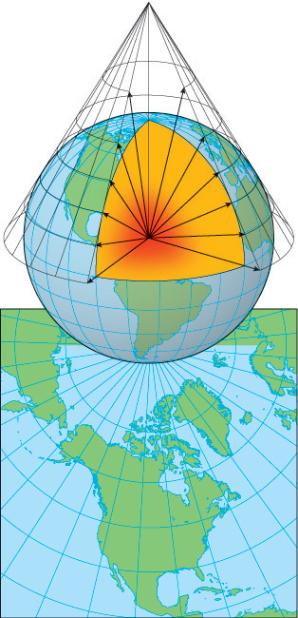
Projections
A conic projection is made by projecting points and lines from a globe onto a cone.
It has a high degree of accuracy for limited areas.
It is used to make road maps and weather maps.
Copyright © McGraw-Hill Education
Types of Maps

Slide 8
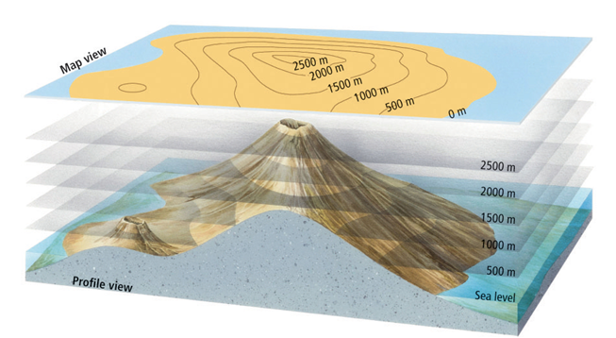
Topographic Maps
Topographic maps are detailed maps that use contour lines, symbols, and colors to represent changes in elevation and features on Earth’s surface.
Copyright © McGraw-Hill Education
Types of Maps

Slide 9
Topographic Maps
A contour line connects points of equal elevation on a topographic map.
The difference in elevation between two side-by-side contour lines is called the contour interval.
Copyright © McGraw-Hill Education
Types of Maps

Slide 10
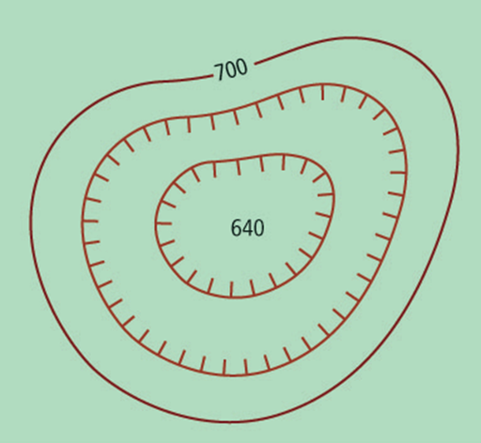
Topographic Maps
Index contours are contour lines labeled with a number that indicates the elevation.
Depression contour lines have hachures, or short lines at right angles to the contour line, to indicate the direction of elevation change.
Copyright © McGraw-Hill Education
Types of Maps

Slide 11
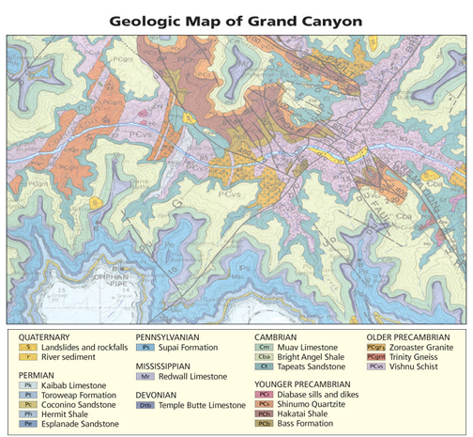
Geologic Maps
A geologic map is used to show the distribution, arrangement, and type of rocks located below the soil. It may also show geologic features such as fault lines.
Copyright © McGraw-Hill Education
Types of Maps

Slide 12
Types of Maps and Projections
Go to your ConnectED resources to play Interactive Table: Types of Maps and Projections.
Copyright © McGraw-Hill Education
Types of Maps

Slide 13
Geologic Maps
Three-dimensional maps
When scientists need to visualize Earth three-dimensionally, they often rely on computers to digitize features such as rivers, mountains, valleys, and hills.
Copyright © McGraw-Hill Education
Types of Maps

Slide 14
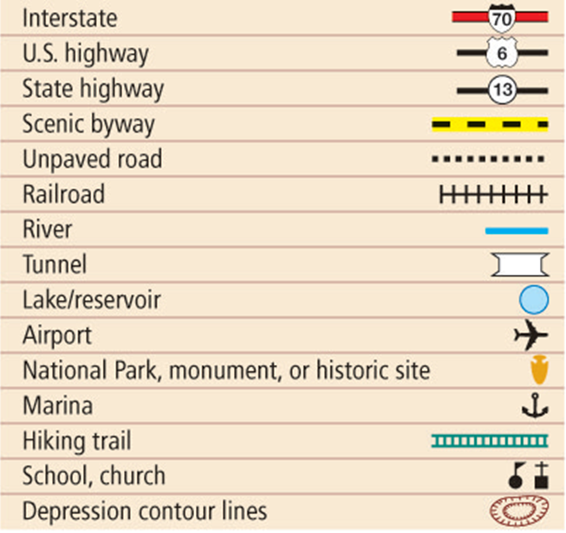
Map Legends
A map legend explains what the symbols on a map represent.
Copyright © McGraw-Hill Education
Types of Maps

Slide 15
Map Scales
A map scale is the ratio between distances on a map and actual distances on the surface of Earth.
Verbal Scales
When referring to maps, verbal scales are statements used to express distance.
Copyright © McGraw-Hill Education
Types of Maps

Slide 16
Map Scales
Graphic scales
Graphic scales consist of a line that represents a certain distance. These are the most common types of map scale.
Fractional scales
Fractional scales express distance as a ratio between two units of the same type.
Copyright © McGraw-Hill Education
Types of Maps

Slide 17
Review
Essential Questions
What are the different types of maps?
Why are different maps used for different purposes?
How are gradients on a topographic map calculated?
Vocabulary
Mercator projection
conic projection
gnomonic projection
topographic map
contour line
contour interval
geologic map
map legend
map scale
Copyright © McGraw-Hill Education
Types of Maps

