Slide 1

Section 1: Matter
Atoms are the basic building blocks of all matter.
K What I Know | W What I Want to Find Out | L What I Learned

Slide 2
Essential Questions
How are atoms and their components described?
How are the energy levels of atoms related to the chemical properties of elements?
What are isotopes?
Copyright © McGraw-Hill Education
Matter

Slide 3
Vocabulary
Review
atom
New
matter
element
nucleus
proton
neutron
electron
atomic number
mass number
isotope
ion
Copyright © McGraw-Hill Education
Matter

Slide 4
Atoms
Matter is anything that has volume and mass.
All matter is made of substances called elements.
An element is a substance that cannot be broken down into simpler substances by physical or chemical means.
Elements are made up of atoms.
Matter
Copyright © McGraw-Hill Education

Slide 5
What properties do elements have?
Go to your ConnectED resources to play Virtual Lab: Properties of Elements.
Copyright © McGraw-Hill Education
Matter

Slide 6
Atoms
All atoms consist of even smaller particles—protons, neutrons, and electrons.
The center of an atom is called the nucleus, which is made up of protons and neutrons.
A proton is a tiny particle that has mass and a positive electric charge.
A neutron is a tiny particle with approximately the same mass as a proton, but it has no electrical charge.
Copyright © McGraw-Hill Education
Matter

Slide 7
Atoms
Surrounding the nucleus of an atom are electrons, smaller particles that are in constant motion.
An electron has little mass, but it has a negative electric charge that is exactly the same magnitude as the positive charge of a proton.
Copyright © McGraw-Hill Education
Matter

Slide 8
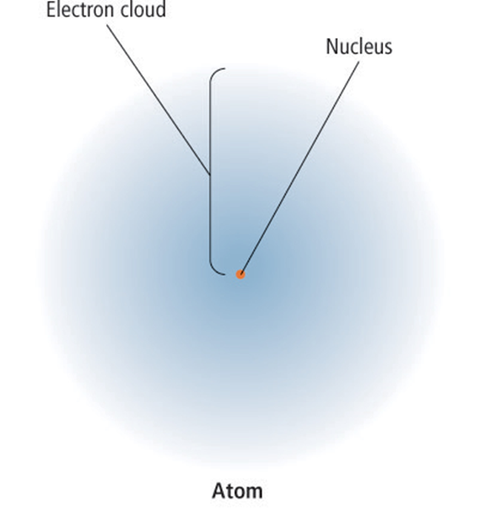
Atoms
In this representation of an atom, the fuzzy area surrounding the nucleus is referred to as an electron cloud.
Copyright © McGraw-Hill Education
Matter

Slide 9
Electron Cloud
Go to your ConnectED resources to play Animation: Electron Cloud.
Copyright © McGraw-Hill Education
Matter

Slide 10
Atoms
The periodic table of the elements is arranged so that a great deal of information about all of the known elements is provided in a small space.
Copyright © McGraw-Hill Education
Matter

Slide 11
Periodic Table of the Elements
Go to your ConnectED resources to play Animation: Periodic Table of the Elements.
Copyright © McGraw-Hill Education
Matter

Slide 12
How is an atom’s structure related to its position on the periodic table?
Go to your ConnectED resources to play Virtual Lab: The Periodic Table.
Copyright © McGraw-Hill Education
Matter

Slide 13
Atoms
Symbols for elements
Generally, each element is identified by a one-, two-, or three-letter abbreviation known as a chemical symbol.
All elements are classified and arranged according to their chemical properties in the periodic table of the elements.
Copyright © McGraw-Hill Education
Matter

Slide 14
Atoms
Mass number
The number of protons in an atom’s nucleus is its atomic number.
The sum of the protons and the neutrons in an atom’s nucleus is its mass number.
Copyright © McGraw-Hill Education
Matter

Slide 15
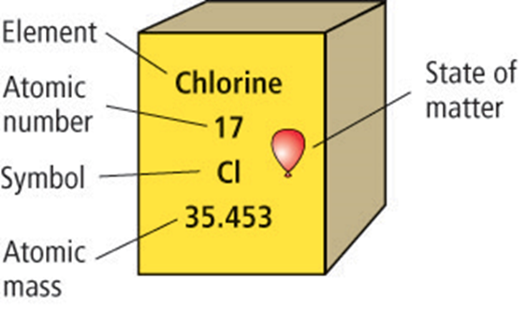
Atoms
Mass number
This diagram of the element chlorine explains how atomic numbers and atomic mass are listed in the periodic table of the elements.
Copyright © McGraw-Hill Education
Matter

Slide 16
Isotopes
All atoms of an element have the same number of protons. However, the number of neutrons of an element’s atoms can vary.
Atoms of the same element that have different mass numbers are called isotopes.
The atomic mass of an element is the average of the mass numbers of the isotopes of an element.
Copyright © McGraw-Hill Education
Matter

Slide 17
Isotopes: Atoms, Elements, and Compounds
Go to your ConnectED resources to play BrainPOP: Isotopes.
Copyright © McGraw-Hill Education
Matter

Slide 18
Isotopes
Radioactive isotopes
Radioactive decay is the spontaneous process through which unstable nuclei emit radiation.
In the process of radioactive decay, a nucleus can lose protons and neutrons, change a proton to a neutron, or change a neutron to a proton.
Because the number of protons in a nucleus identifies an element, decay can change the identity of an element.
Copyright © McGraw-Hill Education
Matter

Slide 19
Electrons in Energy Levels
Although the exact position of an electron cannot be determined, scientists have discovered that electrons occupy areas called energy levels.
Copyright © McGraw-Hill Education
Matter

Slide 20
Electrons in Energy Levels
Filling energy levels
Electrons are distributed over one or more energy levels in a predictable pattern.
Each energy level can hold only a limited number of electrons.
Copyright © McGraw-Hill Education
Matter

Slide 21
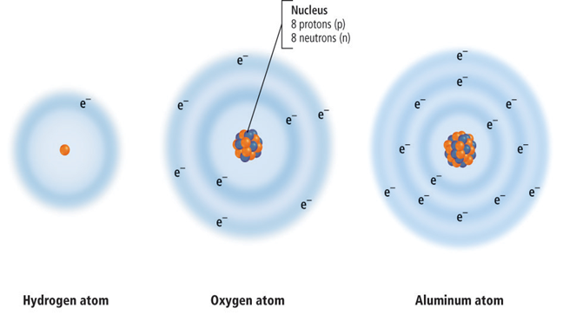
Electrons in Energy Levels
Filling energy levels
Electrons occupy one energy level in hydrogen, two energy levels in oxygen, and three energy levels in aluminum.
Copyright © McGraw-Hill Education
Matter

Slide 22
Electrons in Energy Levels
Valence electrons
The electrons in the outermost energy level, called valence electrons, determine the chemical behavior of the different elements.
Elements with the same number of valence electrons have similar chemical properties.
Elements that have full outermost energy levels are highly unreactive, which means that they do not combine easily with other elements.
Copyright © McGraw-Hill Education
Matter

Slide 23
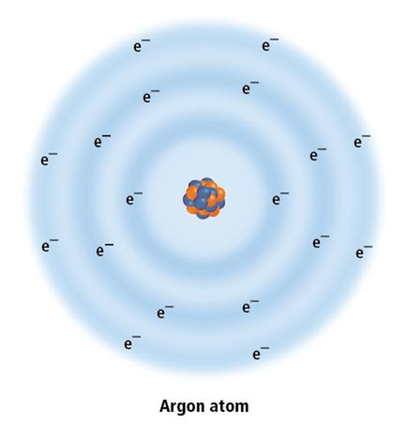
Electrons in Energy Levels
Valence electrons
The inert nature of argon makes it an ideal gas to use inside an incandescent light bulb because it does not react with the extremely hot filament.
Copyright © McGraw-Hill Education
Matter

Slide 24
Ions
An atom that gains or loses one or more electrons from its outermost energy level has a net electric charge and is called an ion.
In general, an atom in which the outermost energy level is less than half-full—that is, it has fewer than four valence electrons—tends to lose its valence electrons and forms a positively charged ion.
An atom in which the outermost energy level is more than half-full—that is, it has more than four valence electrons—tends to fill its outermost energy level and forms a negatively charged ion.
Copyright © McGraw-Hill Education
Matter

Slide 25
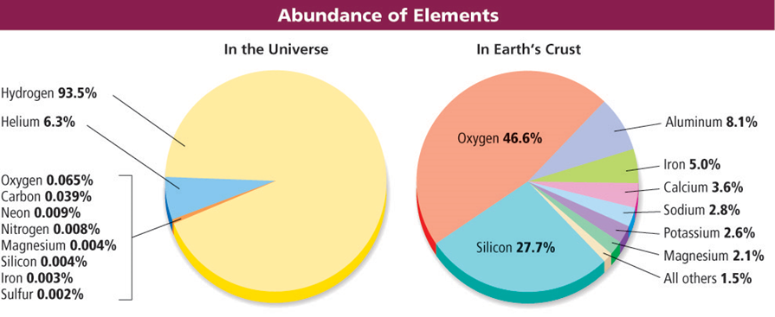
What elements are most abundant?
The two most abundant elements in the universe are hydrogen and helium. However, the two most abundant elements in Earth’s crust are oxygen and silicon.
Copyright © McGraw-Hill Education
Matter

Slide 26
Review
Essential Questions
How are atoms and their components described?
How are the energy levels of atoms related to the chemical properties of elements?
What are isotopes?
Vocabulary
matter
element
nucleus
proton
neutron
electron
atomic number
mass number
isotope
ion
Copyright © McGraw-Hill Education
Matter

