Slide 1

Section 2: Combining Matter
Atoms combine through electric forces, forming molecules and compounds.
K What I Know | W What I Want to Find Out | L What I Learned

Slide 2
Essential Questions
What are the different types of chemical bonds that unite atoms to form compounds?
How is the nature of chemical bonds that hold compounds together related to the physical structures of compounds?
What are the different types of mixtures and solutions?
Copyright © McGraw-Hill Education
Combining Matter

Slide 3
Vocabulary
Review
ion
New
compound
chemical bond
covalent bond
molecule
ionic bond
metallic bond
chemical reaction
solution
acid
base
Copyright © McGraw-Hill Education
Combining Matter

Slide 4
Compounds
A compound is a substance that is composed of atoms of two or more different elements that are chemically combined.
Compounds have different properties from the elements of which they are composed.
Combining Matter
Copyright © McGraw-Hill Education

Slide 5
Compounds
Chemical formulas
Compounds are represented by chemical formulas that include the symbol for each element followed by a subscript number showing the number of atoms of that element in the compound.
Copyright © McGraw-Hill Education
Combining Matter

Slide 6
Covalent Bonds
A state of stability is achieved by some elements by forming chemical bonds. A chemical bond is the force that holds together the elements in a compound.
The attraction of two atoms for a shared pair of electrons that holds the atoms together is called a covalent bond.
Copyright © McGraw-Hill Education
Combining Matter

Slide 7
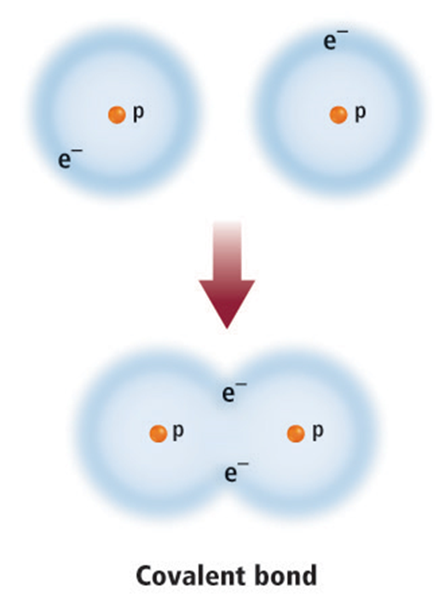
Covalent Bonds
In this example, the nucleus of each atom has one proton with a positive charge. The two positively charged protons attract the two negatively charged electrons.
Copyright © McGraw-Hill Education
Combining Matter

Slide 8
Covalent Bonds
Molecules
A molecule is composed of two or more atoms held together by covalent bonds.
A compound comprised of molecules is called a molecular compound.
Copyright © McGraw-Hill Education
Combining Matter

Slide 9
Covalent Bonds
Polar molecules
Molecules held together by covalent bonds may not share electrons equally, resulting in the electrons spending more time near one atom than another. This unequal sharing results in polar molecules.
Copyright © McGraw-Hill Education
Combining Matter

Slide 10
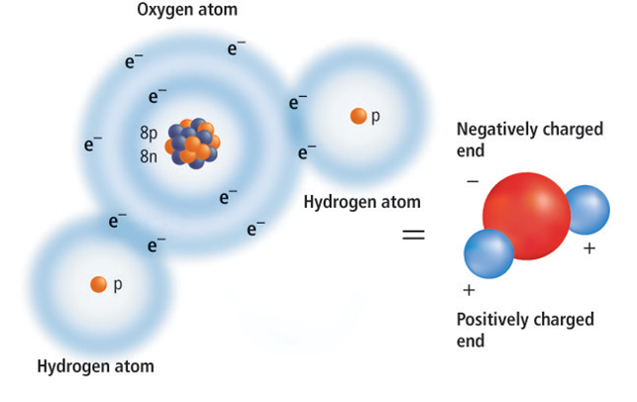
Covalent Bonds
Polar molecules
A polar molecule has a slightly positive end and a slightly negative end.
Copyright © McGraw-Hill Education
Combining Matter

Slide 11
Ionic Bonds
An ionic bond is the attractive force between two ions of opposite charge.
Compounds formed by ionic bonds are called ionic compounds.
Copyright © McGraw-Hill Education
Combining Matter

Slide 12
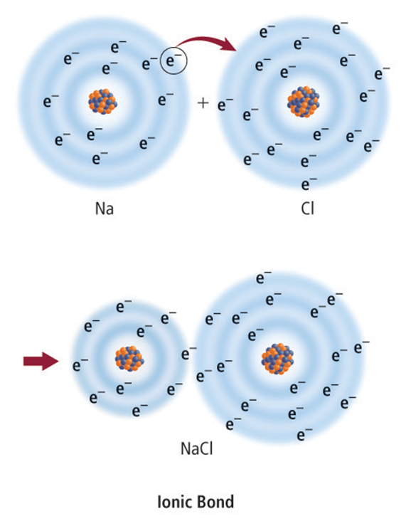
Ionic Bonds
A sodium atom tends to lose a single valence electron, and a chlorine atom tends to gain a single valence electron.
An ionic bond is formed by the attraction between oppositely charged ions.
Copyright © McGraw-Hill Education
Combining Matter

Slide 13
Ionic Bonds
Go to your ConnectED resources to play Animation: Ionic Bonding.
Copyright © McGraw-Hill Education
Combining Matter

Slide 14
Metallic Bonding
In a metallic bond, the positive ions of the metal are held together by the attraction to the negative electrons moving among them.
Copyright © McGraw-Hill Education
Combining Matter

Slide 15
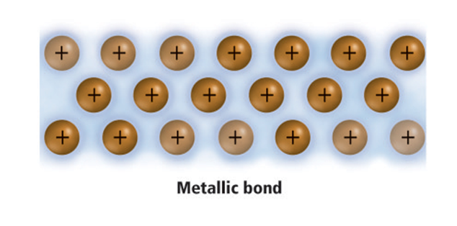
Metallic Bonding
Metallic bonds allow metals to conduct electricity because some of the electrons move freely throughout the entire metal.
Copyright © McGraw-Hill Education
Combining Matter

Slide 16
Electron Flow
Go to your ConnectED resources to play Animation: Electron Flow.
Copyright © McGraw-Hill Education
Combining Matter

Slide 17
Metallic Bonding
When a force is applied to a metal, some of the electrons are pushed aside. This allows the metal ions to move past each other, thus deforming or changing the shape of the metal.
Copyright © McGraw-Hill Education
Combining Matter

Slide 18
Visualizing Bonds
Atoms gain stability by sharing, gaining, or losing electrons to form ions and molecules. The properties of metals can be explained by metallic bonds.
Copyright © McGraw-Hill Education
Combining Matter

Slide 19
Visualizing Bonds
Go to your ConnectED resources to play Animation: Visualizing Bonds.
Copyright © McGraw-Hill Education
Combining Matter

Slide 20
Chemical Reactions
The change of one or more compounds into other compounds is called a chemical reaction.
Chemical reactions are described by chemical equations.
Copyright © McGraw-Hill Education
Combining Matter

Slide 21

Chemical Reactions
Example
Water is formed by the chemical reaction between hydrogen gas (H2) and oxygen gas (O₂).
Copyright © McGraw-Hill Education
Combining Matter

Slide 22
Chemical Reactions
When you write a chemical equation, you must balance the equation by showing an equal number of atoms for each element on each side of the equation. Therefore, the same amount of matter is present both before and after the reaction.
Copyright © McGraw-Hill Education
Combining Matter

Slide 23
Mixtures and Solutions
A mixture is a combination of two or more components that retain their identities.
When a mixture’s components are easily recognizable, it is called a heterogeneous mixture.
In a homogeneous mixture, also called a solution, the component particles cannot be distinguished, even though they still retain their original properties. A solution can be liquid, gaseous, or solid.
Copyright © McGraw-Hill Education
Combining Matter

Slide 24
Mixtures and Solutions
Acids
An acid is a solution containing a substance that produces hydrogen ions (H+) in water.
The pH scale is based on the amount of hydrogen ions in a solution.
Copyright © McGraw-Hill Education
Combining Matter

Slide 25
pH Scale
Go to your ConnectED resources to play Animation: pH Scale.
Copyright © McGraw-Hill Education
Combining Matter

Slide 26
Mixtures and Solutions
Bases
When a solution produces hydroxide ions (OH–) in water, the solution is called a base.
Copyright © McGraw-Hill Education
Combining Matter

Slide 27
Acids and Bases
Go to your ConnectED resources to play BrainPOP: Acids and Bases.
Copyright © McGraw-Hill Education
Combining Matter

Slide 28
Review
Essential Questions
What are the different types of chemical bonds that unite atoms to form compounds?
How is the nature of chemical bonds that hold compounds together related to the physical structures of compounds?
What are the different types of mixtures and solutions?
Vocabulary
compound
chemical bond
covalent bond
molecule
ionic bond
metallic bond
chemical reaction
solution
acid
base
Copyright © McGraw-Hill Education
Combining Matter

