Slide 1

Section 1: Earth Science
Earth science encompasses five areas of study: astronomy, meteorology, geology, oceanography, and environmental science.
K What I Know | W What I Want to Find Out | L What I Learned

Slide 2
Essential Questions
How do the areas of study within Earth science compare?
What are Earth’s systems?
What are the relationships among Earth’s systems?
Why is technology important?
Copyright © McGraw-Hill Education
Earth Science

Slide 3
Vocabulary
Review
technology
New
astronomy
meteorology
geology
oceanography
environmental science
geosphere
atmosphere
hydrosphere
cryosphere
biosphere
Copyright © McGraw-Hill Education
Earth Science

Slide 4
The Scope of Earth Science
Earth science can be broken into five major areas of specialization:
Astronomy
the study of objects beyond Earth’s atmosphere
Earth Science
Copyright © McGraw-Hill Education

Slide 5
The Scope of Earth Science
Meteorology
the study of the forces and processes that cause the atmosphere to change and produce weather
Copyright © McGraw-Hill Education
Earth Science

Slide 6
The Scope of Earth Science
Geology
the study of materials that make up Earth, the processes that form and change these materials, and the history of the planet and its life-forms
Copyright © McGraw-Hill Education
Earth Science

Slide 7
The Scope of Earth Science
Oceanography
the study of Earth’s oceans
Environmental science
the study of the interactions of organisms and their surroundings
Copyright © McGraw-Hill Education
Earth Science

Slide 8
Subspecialties of Earth Science
Go to your ConnectED resources to play Interactive Table: Subspecialties of Earth Science.
Copyright © McGraw-Hill Education
Earth Science

Slide 9
Earth’s Systems
Scientists who study Earth have identified four main Earth systems:
Copyright © McGraw-Hill Education
Earth Science

Slide 10
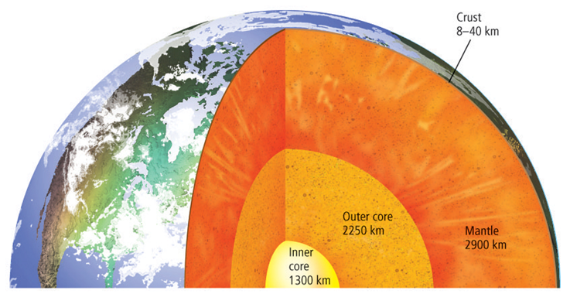
Earth’s Systems
Geosphere
the area from the surface of Earth down to its center
Copyright © McGraw-Hill Education
Earth Science

Slide 11
Earth’s Systems
Atmosphere
the blanket of gases that surrounds our planet
Hydrosphere
all the water on Earth, including the water in the atmosphere, and the permanently frozen water in the cryosphere
Copyright © McGraw-Hill Education
Earth Science

Slide 12
Earth’s Systems
Biosphere
all organisms on Earth as well as the environments in which they live
Copyright © McGraw-Hill Education
Earth Science

Slide 13
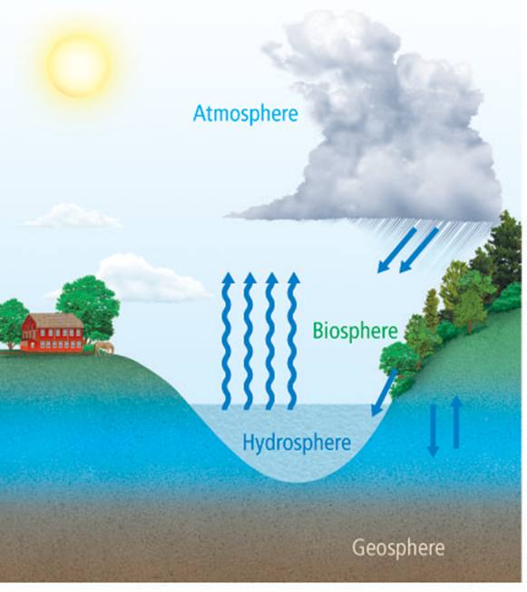
Earth’s Systems
All of Earth’s systems are interdependent. Notice how water from the hydrosphere enters the atmosphere, falls to the biosphere, and soaks into the geosphere.
Copyright © McGraw-Hill Education
Earth Science

Slide 14
Technology
Technology is not used only to make life easier. It can also make life safer.
Technology is important, not only in science, but in everyday life.
Copyright © McGraw-Hill Education
Earth Science

Slide 15
Review
Essential Questions
How do the areas of study within Earth science compare?
What are Earth’s systems?
What are the relationships among Earth’s systems?
Why is technology important?
Vocabulary
astronomy
meteorology
geology
oceanography
environmental science
geosphere
atmosphere
hydrosphere
cryosphere
biosphere
Copyright © McGraw-Hill Education
Earth Science

